Slide 1
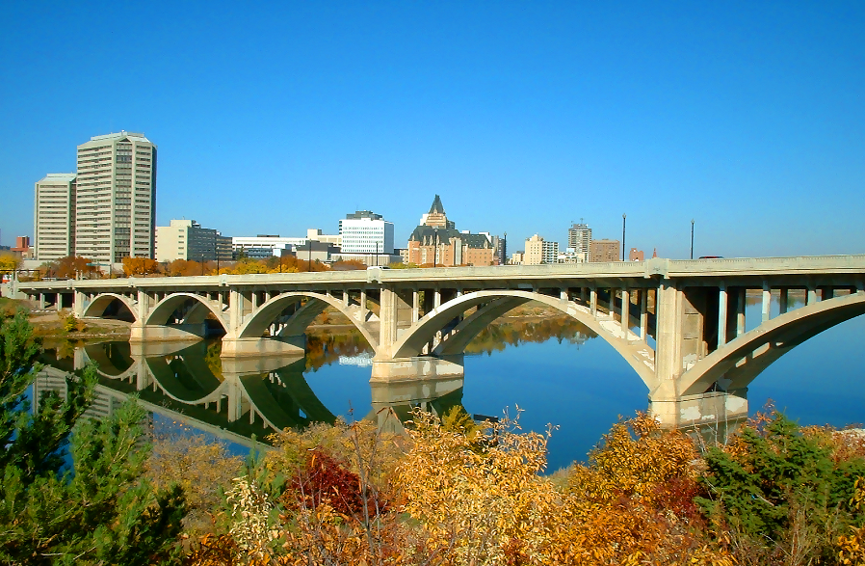
Case for Medical Marijuana in Epilepsy
CANADIAN LEAGUE AGAINST EPILEPSY
Jose F. Tellez-Zenteno MD PhD, FRCP, Professor Division of Neurology, University of Saskatchewan

Slide 3
Demographic information about study participants n=628
Barriers to access for Canadians who use cannabis for therapeutic purposes International journal of Drug Policy 2014;25:691-99

Slide 4
Demographic information about study participants n=628
Barriers to access for Canadians who use cannabis for therapeutic purposes International journal of Drug Policy 2014;25:691-99

Slide 5
Reported sources of cannabis for therapeutic purposes (%) n=628
Barriers to access for Canadians who use cannabis for therapeutic purposes International journal of Drug Policy 2014;25:691-99

Slide 6
Sources of purchased cannabis for therapeutic purposes by provincial region n=628
Barriers to access for Canadians who use cannabis for therapeutic purposes International journal of Drug Policy 2014;25:691-99

Slide 8
Medical Marijuana/CBD safety data
Fewer specialists support using medical marijuana and CBD in treating epilepsy patients compared with other medical professionals and patients: Result of Epilepsia’s survey. Epilepsia, 56(1):1–6, 2015

Slide 9
Medical Marijuana/advise using
Fewer specialists support using medical marijuana and CBD in treating epilepsy patients compared with other medical professionals and patients: Result of Epilepsia’s survey. Epilepsia, 56(1):1–6, 2015

Slide 10
Medical Marijuana/having cbd available
Fewer specialists support using medical marijuana and CBD in treating epilepsy patients compared with other medical professionals and patients: Result of Epilepsia’s survey. Epilepsia, 56(1):1–6, 2015

Slide 11
Use of Cannabis in patients with epilepsy
Neurology. 2004 Jun 8;62(11):2095-7
Eur J Neurol. 2014;21(1):167-70

Slide 12
Use of Cannabis in patients with epilepsy
Epilepsy and behaviour 2015:53:73-78

Slide 13
How effective is marijuana in helping your seizures?
Marijuana use in adults admitted to a Canadian epilepsy monitoring unit. Epilepsy and behaviour 2015:53:73-78

Slide 14
What effect does marijuana have on your stress level?
Marijuana use in adults admitted to a Canadian epilepsy monitoring unit. Epilepsy and behaviour 2015:53:73-78

Slide 16
Medicinal Marijuana for Epilepsy
Mean age of patients was 30±7 (19-50) years
The mean age at epilepsy diagnosis was 16±11 (1-43) years
44% had suffered at least one episode of status epilepticus
The mean number of seizures per month was 3.5±7.4 (0-30)
Developmental delay was present in five (28%) patients
Psychiatric comorbidity was common (61%)
The use of other illicit substances such as stimulants (cocaine or amphetamines), moderate to heavy smoking, or heavy alcohol drinking was also common (61%)
Medicinal Marijuana for Epilepsy: A Case Series Study. Can J Neurol Sci. 2014; 41: 1-6

Slide 17
Survey of benefits of using marijuana in patients with epilepsy. N= 18
Medicinal Marijuana for Epilepsy: A Case Series Study. Can J Neurol Sci. 2014; 41: 1-6

Slide 18
The study was advertised in
multiple online forums including
the Infantile Spasms Community
(www.IScommunity.org) and the
Lennox–Gastaut Foundation
(www.LGSfoundation.org).
Survey monkey

Slide 19
Patient demographics n=117
Variable | Measure
Age at epilepsy onset, months | 5.5 (3.0–24.0)
Age at CBD treatment, years | 6.0 (3.0–10.0)
Latency from epilepsy onset to CBD initiation, years | 5.0 (2.3–9.0)
Number of failed medications prior to CBD exposure | 8.0 (4.0–12.0)
Failed ketogenic diet therapy before CBD exposure, n (%) | 53 (45.3)
Failed resective surgery before CBD initiation, n (%) | 13 (11.1)
Failed vagal nerve stimulation before CBD exposure, n (%) | 21 (17.9)
Perceived efficacy of cannabidiol-enriched cannabis extracts for treatment of pediatric epilepsy: A potential role for infantile spasms and Lennox–Gastaut syndrome. Epilepsy & Behavior 47 (2015) 138–141

Slide 20
Epilepsy syndrome n=117

Slide 21
Patient demographics n=117
Variable | Measure
Duration of CBD treatment, months | 6.8 (3.8–9.8)
Continued CBD treatment at the time of survey completion, % (n = 101) | 93.1
CBD product with at least 15:1 ratio of CBD to THC, % (n = 91) | 83.5
CBD dosage, mg/kg/daya (n = 46) | 4.3 (2.9–7.5)
Number of medications continued during CBD exposurea (n= 117) | 2.0 (0.0–3.0)
Perceived efficacy of cannabidiol-enriched cannabis extracts for treatment of pediatric epilepsy: A potential role for infantile spasms and Lennox–Gastaut syndrome. Epilepsy & Behavior 47 (2015) 138–141

Slide 22
Perceived response to CBD exposure n=117
Perceived efficacy of cannabidiol-enriched cannabis extracts for treatment of pediatric epilepsy: A potential role for infantile spasms and Lennox–Gastaut syndrome. Epilepsy & Behavior 47 (2015) 138–141

Slide 23
Perceived side effects before CBD exposure and during CBD exposure n=117
Perceived efficacy of cannabidiol-enriched cannabis extracts for treatment of pediatric epilepsy: A potential role for infantile spasms and Lennox–Gastaut syndrome. Epilepsy & Behavior 47 (2015) 138–141

Slide 25
Retrospective study of 75 patients (parent response) seizure response
Parental reporting of response to oral cannabis extracts for treatment of refractory epilepsy. Epilepsy & Behaviour 2015:45;49-52

Slide 26
Retrospective study of 75 patients (parental response) % of response rate in different type of seizures
Parental reporting of response to oral cannabis extracts for treatment of refractory epilepsy. Epilepsy & Behaviour 2015:45;49-52

Slide 27
Retrospective study of 75 patients (parental response) % response by syndrome
Parental reporting of response to oral cannabis extracts for treatment of refractory epilepsy. Epilepsy & Behaviour 2015:45;49-52

Slide 28
Retrospective study of 75 patients (parental response) % of reported improvement
Parental reporting of response to oral cannabis extracts for treatment of refractory epilepsy. Epilepsy & Behaviour 2015:45;49-52

Slide 30
Cannabidiol as a new treatment for drug-resistant epilepsy in tuberous sclerosis complex. Epilepsia, 2016

Slide 31
50% responder rate n=18
Cannabidiol as a new treatment for drug-resistant epilepsy in tuberous sclerosis complex. Epilepsia, 2016

Slide 32
Weekly total seizure frequency at baseline and after 2, 3, 6, 9, and 12 months of treatment with CBD
Cannabidiol as a new treatment for drug-resistant epilepsy in tuberous sclerosis complex. Epilepsia, 2016

Slide 33
Frequency of CBD-related adverse events n=18
Cannabidiol as a new treatment for drug-resistant epilepsy in tuberous sclerosis complex. Epilepsia, 2016

Slide 35
Inclusion criteria
-patients at all sites were aged 1–30 years,
-had intractable childhood onset epilepsy
-had four or more countable seizures with a motor component per 4 week period,
-receiving stable doses of antiepileptic drugs for at least 4 weeks before enrolment
Cannabidiol in patients with treatment-resistant epilepsy: an open-label interventional trial. Lancet Neurol 2016; 15: 270–78

Slide 36
Intervention
Cannabidiol at a dose of 2–5 mg/kg per day divided in twice-daily dosing was added to the baseline antiepileptic drug regimen, then up-titrated by 2–5 mg/kg once a week until intolerance or a maximum dose of 25 mg/kg per day was reached. At some sites, the institutional review board and the US Food and Drug Administration (FDA) allowed an increase to a maximum dose of 50 mg/kg per day.
Cannabidiol in patients with treatment-resistant epilepsy: an open-label interventional trial. Lancet Neurol 2016; 15: 270–78

Slide 37
Cannabidiol in patients with treatment-resistant epilepsy:
an open-label interventional trial. Lancet Neurol 2016; 15: 270–78

Slide 38
Cannabidiol in patients with treatment-resistant epilepsy: an open-label interventional trial. Lancet Neurol 2016; 15: 270–78

Slide 39
%
Cannabidiol in patients with treatment-resistant epilepsy: an open-label interventional trial. Lancet Neurol 2016; 15: 270–78

Slide 40
Cannabidiol in patients with treatment-resistant epilepsy: an open-label interventional trial. Lancet Neurol 2016; 15: 270–78

Slide 41
Side effects
Cannabidiol in patients with treatment-resistant epilepsy: an open-label interventional trial. Lancet Neurol 2016; 15: 270–78

Slide 42
Bias in the study
the placebo effect ?
drug interactions ?
What group could have the most important benefit ?
Randomization ?
Medicinal Marijuana for Epilepsy: A Case Series Study. Can J Neurol Sci. 2014; 41: 1-6

Slide 43
Conclusions
-Still the evidence is not there ?
-It is more used
-Monitor patients ?
-More studies
-Side effects ?
-More efficacious in some syndromes

Slide 44
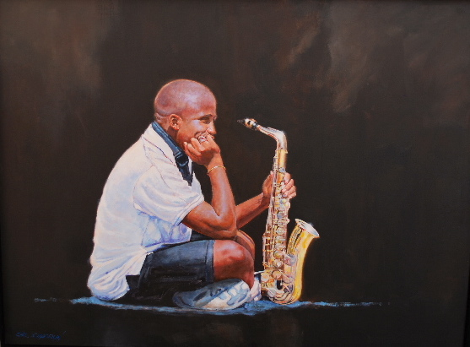
Thank you Questions

