Slide 1
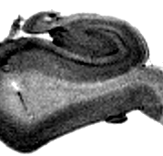
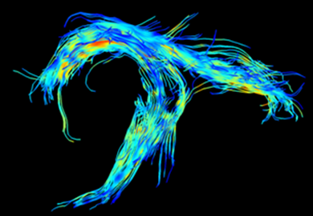
The Pathological Network of Temporal Lobe Epilepsy
Donald Gross
University of Alberta
September 5, 2013

Slide 2
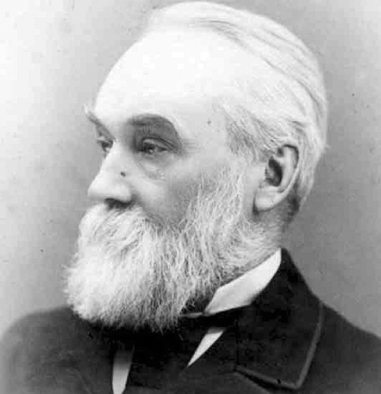
John Hughlings Jackson
“Epilepsy is the name for the occasional, sudden, excessive, rapid and local discharges of grey matter”
West Riding Lunatic Asylum Medical Reports 1873

Slide 3
Temporal Lobe Epilepsy
With access to surgical specimens, recognition of the striking relationship between TLE and mesial temporal sclerosis most of the attention focused on mesial temporal structures

Slide 4
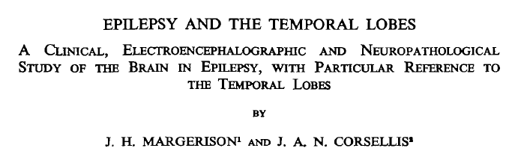
Autopsy study 55 patients with chronic epilepsy (1966)
  21/55 MTS, clinical TLE, TL EEG

Slide 5
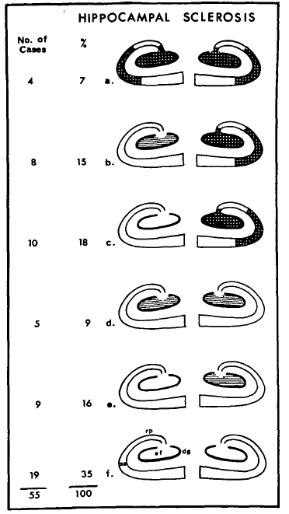
Margerison & Corsellis 1966

Slide 6
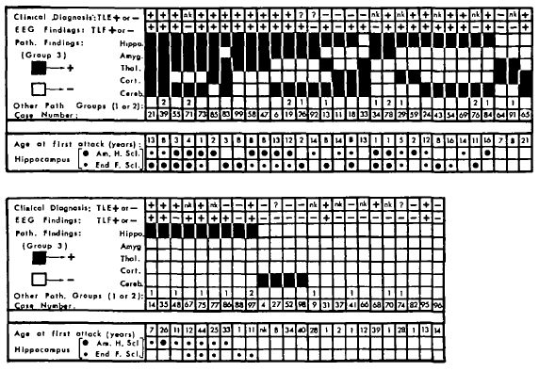
9/21 TLE (MTS, clinical & EEG) had thalamic pathology
Margerison & Corsellis 1966

Slide 7
  Margerison & Corsellis 1966
The study of the brain as a whole has reinforced the core of clinical, EEG and pathological information around which the concept of temporal lobe epilepsy has developed. At the same time it has emphasized the need to see beyond the temporal lobes and to take into account the possible importance of damage in other parts of the brain as well.
In many ways, therefore, the present work has made a complex situation more complicated.

Slide 8
Extratemporal Abnormalities
Cause, incidence & implications uncertain
Unlike temporal lobe / hippocampus, tissue not readily available outside of autopsy studies
Quantitative neuroimaging (MRI) has provided a means of exploring extratemporal regions

Slide 9
Extratemporal Abnormalities in TLE
Thalamus
  DeCarli ‘98, Dreifuss ‘01, Natsume ‘03, Bonilha ’05, Gong ‘08
Cortical grey matter
  Hermann ’03, Bernasconi ’04, Cormack ‘05
White matter
  Hermann ’03, Seidenberg ‘05
Fornix
  Kuzniecky ‘99

Slide 10
Diffusion Tensor Imaging
An MRI technique that allows indirect assessment of white matter structural integrity through the diffusion properties of water

Slide 11
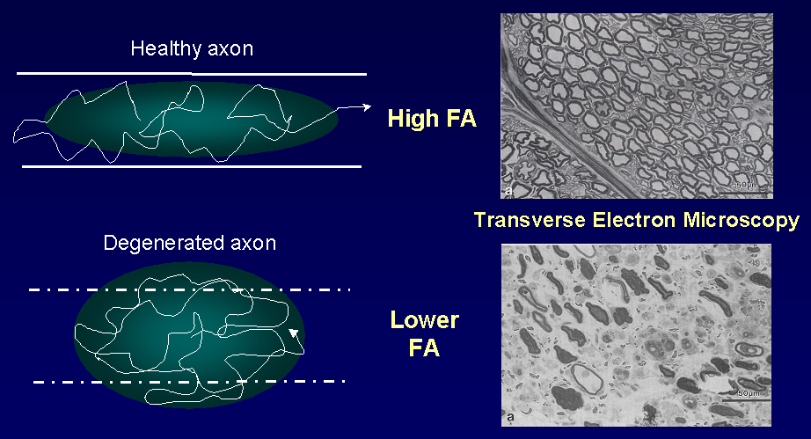
DTI and Axonal Degeneration
Beaulieu et al. 1996

Slide 12
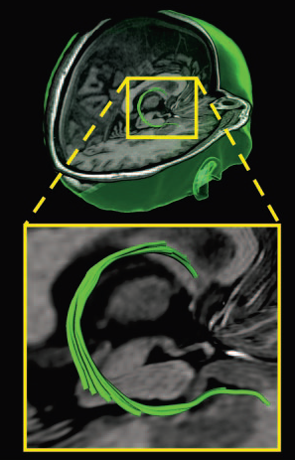
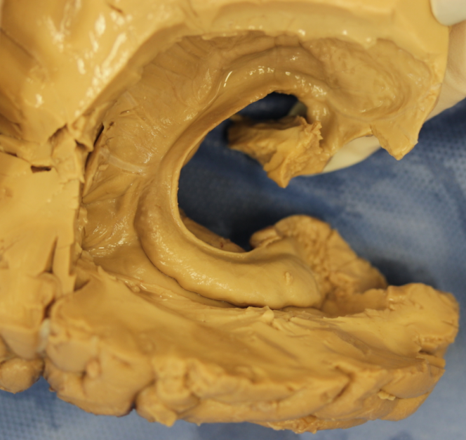
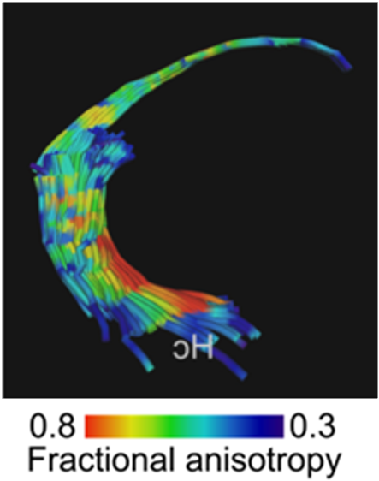

Slide 13
DTI TLE+MTS
Concha et al. Annals Neurol 2005
8 patients TLE+MTS (T2>2SD)
9 controls
FLAIR DTI (2x2x2mm³, 6 directions)
Tractography - fornix and cingulum

Slide 14
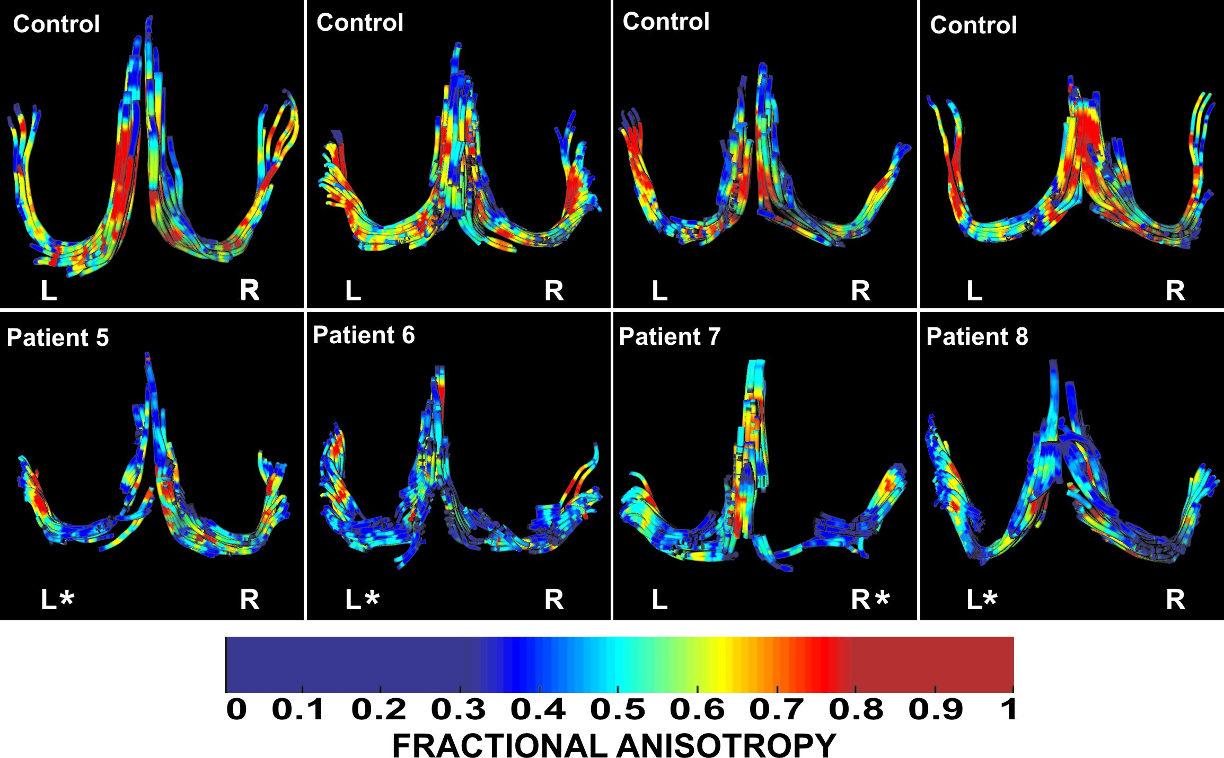
FA of the Fornix in TLE+MTS
Concha et al. Annals Neurol 2005

Slide 15
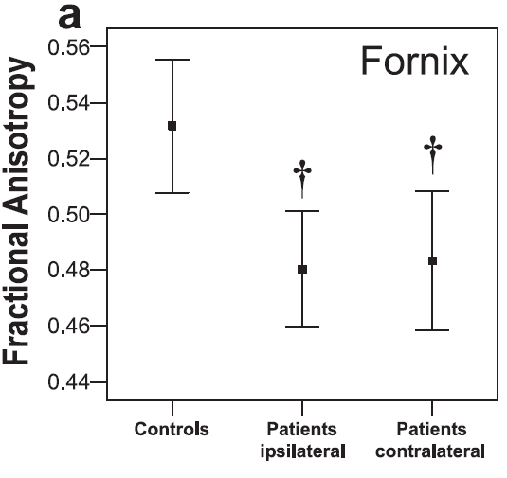
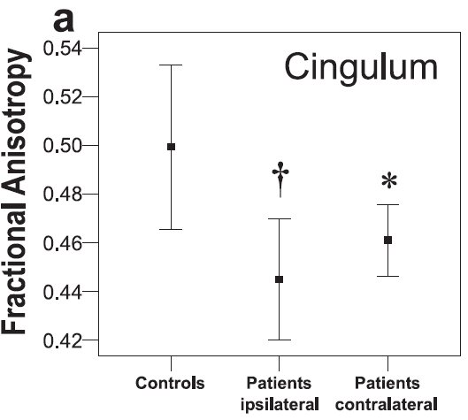
Results

Slide 16
Extent of DTI abnormalities
Are DTI abnormalities restricted to limbic circuitry?
Arkfanakis et al. 2002:
  ↓ FA of: corpus callosum and external capsule in TLE
Gross et al. 2006:
↓ FA of: Genu and external capsule in TLE+MTS

Slide 17
Are DTI changes unique to TLE patients with MTS?

Slide 18
TLE+MTS vs nlTLE
Concha et al. JNNP 2009
Subjects
17 TLE+MTS (T2>2SD of controls)
13 nl TLE
25 controls

Slide 19
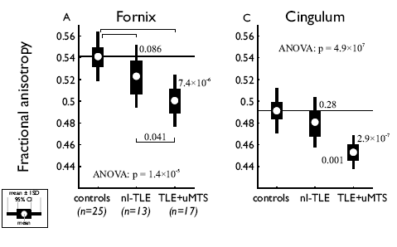

Slide 20
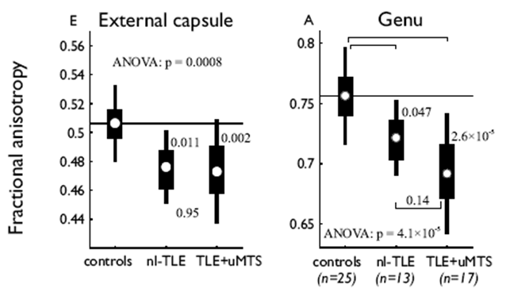
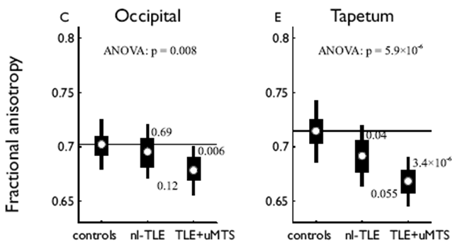

Slide 21
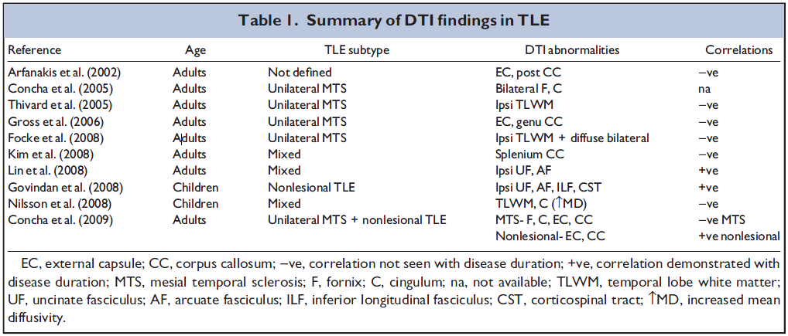

Slide 22
Are white matter changes a consequence of seizures?

Slide 23
DTI correlations with TLE
Positive correlations
  Govindan 2008 (nl TLE): UF, AF vs disease duration
  Lin 2008 (7/12 nl TLE): UF vs age of seizure onset
No correlations
  Arfanakis 2002 (?MTS)
  Thivard 2005 (TLE+MTS)

Slide 24
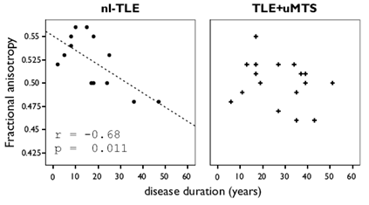
Fractional Anisotropy of the fornix
TLE+MTS: 17, nlTLE: 13
Concha et al. JNNP 2009

Slide 25
Do white matter changes correlate with cognitive function?

Slide 26
Correlations: DTI vs neuropsychology
McDonald et al. Neurology 2008
  17 TLE (mixed) vs 17 controls
  ↑MD left UF, cingulum, IFOF vs verbal memory
Diehl et al. Epilepsia 2008
  28 TLE (mixed) vs 10 controls
  Correlations DTI UF vs verbal and figural memory (LTLE)

Slide 27
TLE- structure vs function
Structure | PS | RMW | CVMT
FA Left Fornix | 0.67 (0.001)** | 0.54 (0.012)* | 0.52 (0.013)*
FA Right Fornix | 0.32 (0.167) | 0.34 (0.134) | 0.34 (0.122)
FA Left Cingulum | 0.39 (0.088) | 0.40 (0.070) | 0.14 (0.525)
FA Right Cingulum | 0.33 (0.152) | 0.34 (0.127) | 0.07 (0.752)
Alexander et al. 2014

Slide 28
Left fornix- nlTLE vs TLE+MTS
Group | PS | RMW | CVMT
nlTLE | 0.93 (0.007)** | 0.75 (0.09)* | 0.38(0.4)
TLE+MTS | 0.42 (0.15) | 0.39 (0.17) | 0.41 (0.15)

Slide 29
Do white matter abnormalities predict worse surgical outcome?

Slide 30
Surgical outcomes
Gross et al. Epilepsia (2006)
  TLE “unilateral MTS”
  8/11 TLE+MTS seizure free
Liu et al (2016)
  Superficial DTI abnormalities predicted surgical success

Slide 31
White Matter Abnormalities
Extensive bilateral white matter abnormalities in patients with TLE with “unilateral” MTS
White matter abnormalities extend beyond limbic circuitry
TLE+MTS vs nlTLE
  More extensive in TLE+MTS
  Differences in disease duration / cognition
  Different clinical entities

Slide 32
White Matter Abnormalities
Hypothesis
  Secondary to recurrent seizures
    Variable for structure / syndrome
    Possibility of different mechanisms for FA change
  Predict poor surgical outcome- ?
    Bilateral MT /extratemporal abnormalities probably the norm
    Temporal DTI abN associated with good outcome
  Correlated with cognitive deficits- Yes (nlTLE)

Slide 33
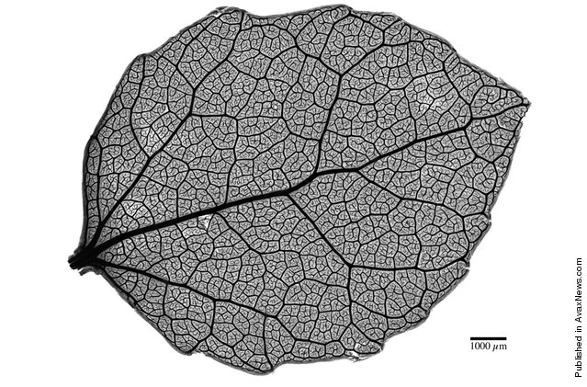

Slide 34
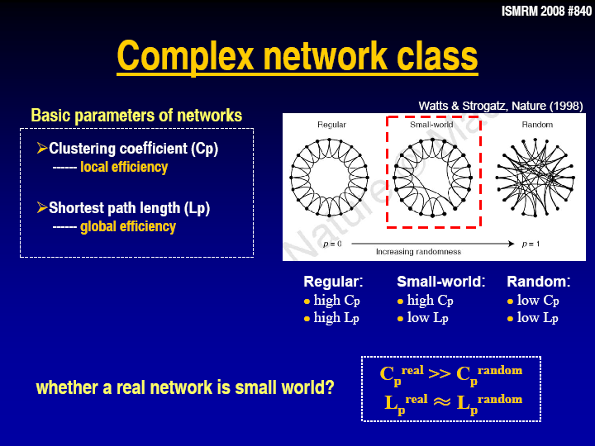

Slide 35
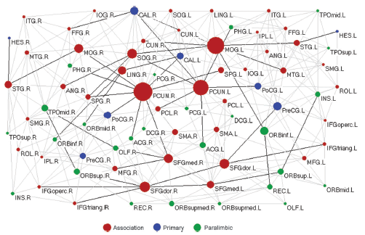
DTI derived topological map- Normal controls
Small world attributes
(Shortest path length- 2.32, clustering coefficient- 0.49)
Gong et al. Cerebral Cortex 2009

Slide 36
Epilepsy- Small World
Liao et al. 2010
  Resting state fMRI – TLE
  ↑ Temporal connections
  ↓ Frontal Parietal connections
Bernhardt et al. 2011
  Cortical thickness – TLE
  ↑ path length / clustering, altered hubs

Slide 37
Liu et al. Epilepsia 2014
16 Left TLE+MTS, 21 controls
MPRAGE (1mm³)
DTI (6 directions, 2mm³)
78 regions
Weighted network
  Fiber # x FA / volume of regions

Slide 38
Results
Small World properties
Global network abnormalities
Overlap in hubs with two differences TLE
Reduced regional efficiency

Slide 39
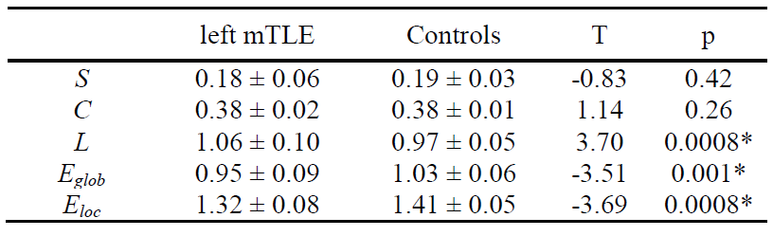
Global Network Properties

Slide 40
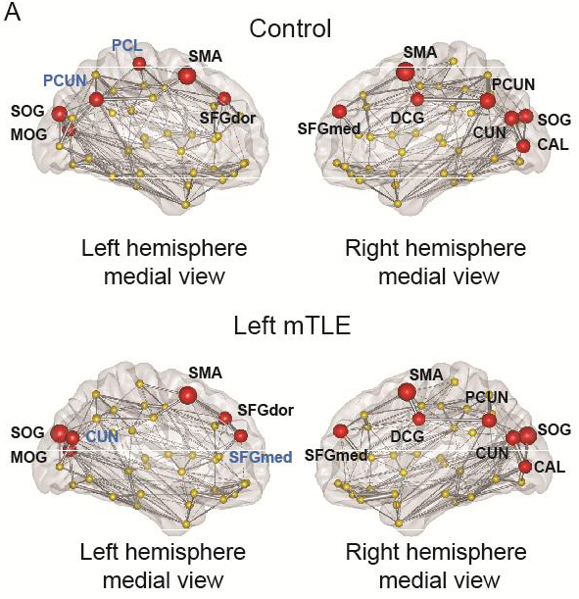
Network Hubs

Slide 41
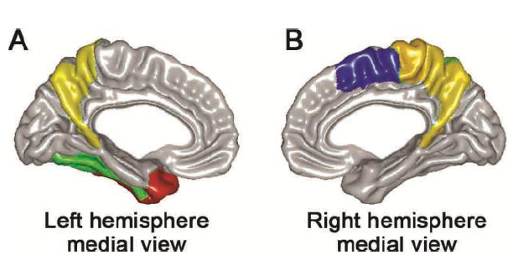
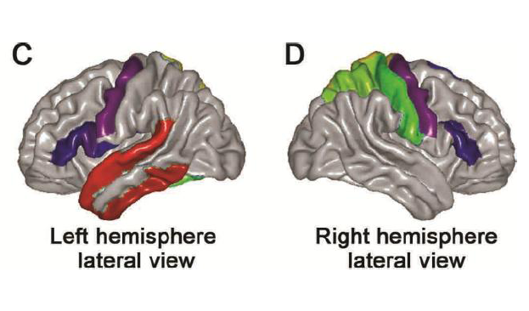
Reduced Regional Efficiency

Slide 42


Slide 43
Bonilha et al. Neurology 2015
35 TLE patients treated surgically / 18 controls
DTI Limbic sub network abnormalities predicted seizure free outcome

Slide 44
Interpretation of DTI findings
Jones et al. 2012
  The only thing that we can say with absolute certainty is that DW-MRI measurements reflect the amount of hindrance experienced by water molecules moving along the axis of the applied gradient… anything more involves modeling which means extrapolating beyond the data.

Slide 45
Specificity of DTI
Reduced FA
  Axons, myelin, density, microtubules
  Fiber orientation
  Parallel & perpendicular diffusion can provide additional insight but still need to be cautious in conclusions

Slide 46
Other white matter imaging modalities
Myelin water fraction (multicomponent T2)
Magnetization Transfer Ratio

Slide 47
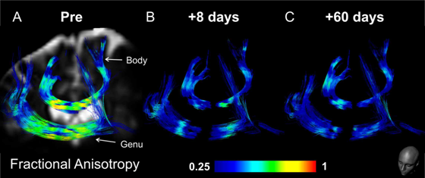
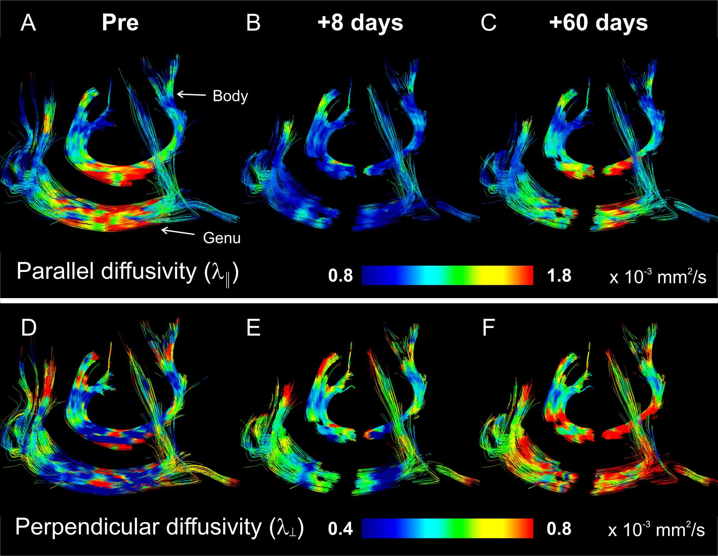
Concha et al. Neuroimage 2006

Slide 48
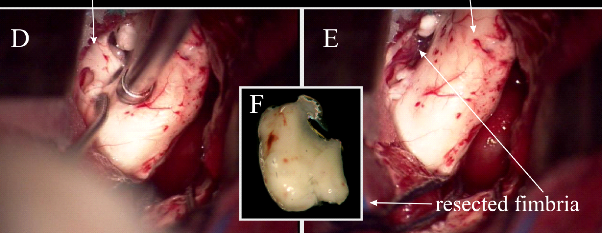
Fimbria
Hippocampus

Slide 49
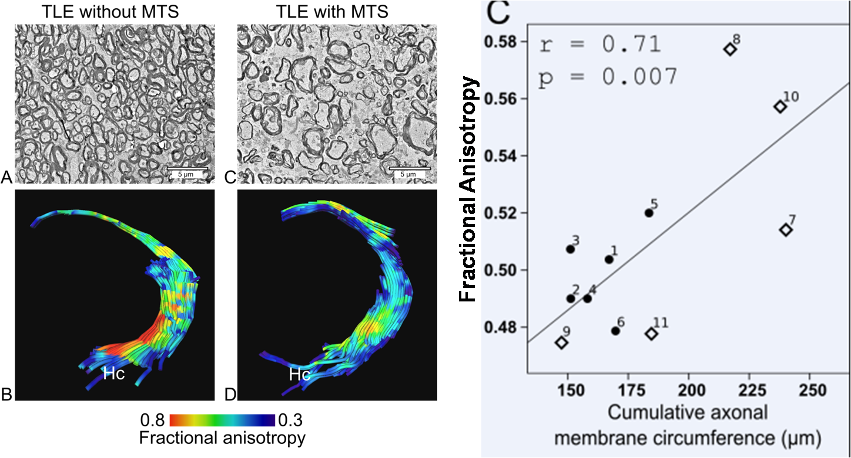
Concha et al. J Neuroscience (2010)

Slide 50
Challenges
Spatial resolution
Specificity of DTI

Slide 51
Gross. Epilepsia 2011

Slide 52
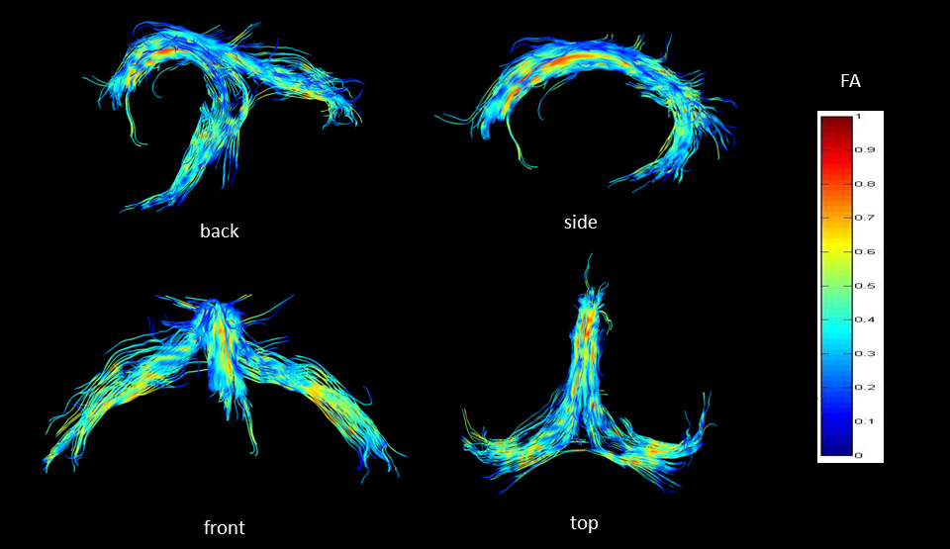
1.5x1.5x1.5 mm (3.4 mm³) isotropic resolution at 4.7T

Slide 53
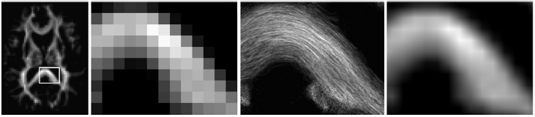
Calamante et al. 2010- Track density imaging

Slide 54
Collaborators
T Steve, C Yasuda, C Elliot, M Liu
Z Chen, C Baron
C Andrade, B Campos, G Beltramini, F Cendes
R Alexander, G Gong, L Concha
C Beaulieu, BM Wheatley, D Livy, A Wilman, T Snyder, J Jirsch, SN Ahmed, DB Sinclair
L Collins, A Evans

Slide 55




Funding
Notes:
55

