Slide 1
Genetics for the epileptologist
CLAE 2016
Danielle M. Andrade, MD, MSc, FRCPC
Medical Director, Epilepsy Program
Director, Epilepsy Genetics Research Program
Director Epilepsy Transition Program
Associate Professor, Neurology
University of Toronto

Slide 2
Outline
The landscape of epilepsy genetics today
Why do genetic testing?
What are the options for testing?

Slide 3
in the 70’s: 9 planets
October 2016: 3,532 planets

Slide 4
The landscape of epilepsy genetics today
Helbig & Lowenstein, 2013

Slide 5
Evolution of Genetics: impact on Epilepsies

Slide 6
Single gene epilepsies
Familial
De novo (as in epileptic encephalopathies)

Slide 7
266 new genes per year!
 | Mendelian diseases | Genes causing Mendelian diseases | Variant-diases associations
2004 | 6,000 | 1,636 | 51,790
2015 | 6,212 | 4,570 | 147,728
Wenger, Genet Med 2016.

Slide 8
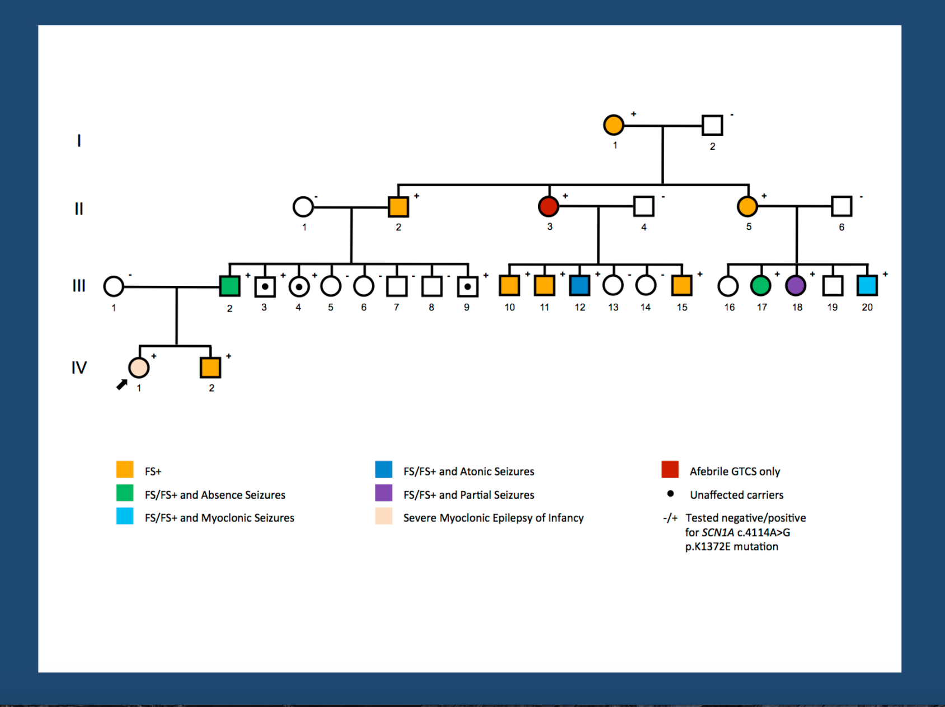
Modifiers and Susceptibility genes
SCN2A & CACNA1G & KCNV2
SCN1A & SCN8A, SCN5A
post-traumatic epilepsy

Slide 9
Complex inheritance
Idiopathic generalized epilepsies
Temporal lobe epilepsy
Several genes with variable influence on phenotype + environmental factors

Slide 10
Genomic deletions, duplications…

Slide 11
Genomic MICRO deletions, duplications…

Slide 12
Genomic MICRO deletions, duplications…

Slide 13
Genomic MICRO deletions, duplications…
Copy number variations associated with: GGE, GGE + ID, BECTS, LKS, West syndrome, neonatal convulsions, infantile convulsions,
Study (Year) | Main reasons for CMA referral | Sample (n) | 15q11.2 microdeletion | 15q13.3 microdeletion | 16p13.11 microdeletion
Nascimento et al. (2016) | ID,DD, ASD, congenital anomalies/dysmorphism | 15,850 | 9/20 (45.0%) | 2/8 (25%) | 1/6 (16.7%)
Hashemi et al. (2015) | ID, congenital anomalies/dysmorphism | 7,221 | 6/35 (17.1%) | n/a | n/a
Vanlerberghe et al. (2015) | ID, congenital anomalies, behavioural issues | 9,852 | 9/48 (18.7%) | n/a | n/a
Cafferkey et al. (2014) | ID, behavioural issues, congenital anomalies/dysmorphism, growth abnormalities | 14,605 | 13/83 (15.6%) | n/a | n/a
Previously published 15q11.2 deletion cohorts * | n/a | n/a | 19/90 (21.1%) | n/a | n/a
Lowther et al. (2015) | n/a | n/a | n/a | 69/246 (28.0%) | n/a

Slide 14
Why do genetic testing?
1) Improve diagnostic accuracy (and possibly accuracy for prognosis)
2) Limit the diagnostic odyssey and limit costs
3) Genetic counselling

Slide 15
Diagnostic odyssey and costs
 | Description | Diagnostic yeld | Cost
Tier 1 | Pyridoxine trial, plasma amino acids, urine organic acids, homocysteine, CMA, CSF for amino acids and glucose. | 5-7% | $ 2,000-3,000
Tier 2 | Epilepsy gene panels/WES | 30 - 40% * | $3,000-6,000
Tier 3 | Muscle and skin biopsies | 1% | $10,000
*reanalyzed panels increased yield by 10%
Joshi, BioMedResearchIntl, 2016; Mercimek-Mahmutoglu, Epilepsia 2015;

Slide 16
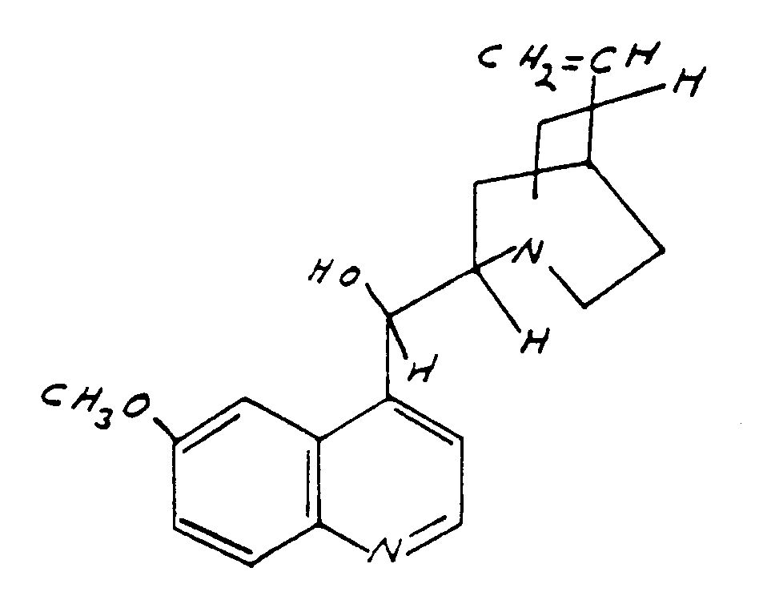
Treatment of genetic epilepsies
orphan drugs
repurposing drugs
small molecules (Nav1.6 inhibitors)
antisense olygonucleotides
other forms of genetic therapy (Minassian)
Quinidine

Slide 17
Genetic testing
Who should be tested?
EPILEPTIC ENCEPHALOPATHIES
PROGRESSIVE MYOCLONUS EPILEPSY
?INTRACTABLE EPILEPSY WITHOUT STRUCTURAL ABNORMALITIES
INTRACTABLE EPILEPSY WITH MALFORMATION OF CORTICAL DEVELOPMENT
who should not be tested?
BENIGN EPILEPSIES
EPILEPSIES WITH COMPLEX INHERITANCES (GGEs)
ACQUIRED EPILEPSIES

Slide 18
Genetic testing: what are the options?
NO SINGLE MUTATION DETECTION TECHNIQUE IS PERFECT IN IDENTIFYING ALL MUTATIONS
Genome-wide chromosome microarray: epilepsy +
intellectual disability,
autism spectrum disorder
dysmorphism and/or congenital abnormalities.
Single gene: not very useful nor cost-effective
Focused panel: PME, MCD, ?EOEE?
Whole exome sequencing (Sweet spot)
Whole genome sequencing

Slide 19
Considerations when doing GT:
INCIDENTAL FINDING
PHENOTYPE (not completely developed)
ETHNICITY
PARENTS AVAILABILITY

Slide 20
Conclusion
Quickly evolving field, gradually becoming part of clinical care
A negative result is not always negative
Constant new knowledge and need to frequently reanalyze results

Slide 21
Acknowledgements
Felippe Borlot
Cory Tam
Berge Minassian
Fabio Nascimento
Alexandra Silberberg
Steve Scherer
Danah Al-Jafaari
Craig Chong
Patrick Cossette
Albert Kim
Brigid Reagan
New Initiatives Program

