Slide 1
Non-structural evidence of the seizure focus: the role of functional imaging
Paolo Federico MD, PhD, FRCPC
University of Calgary
15 Oct 2016
Canadian League Against Epilepsy
Quebec City, QC

Slide 2
Disclosures
None

Slide 3
Epilepsy surgery
Surgery rarely has > 70% success rate
Identifying epileptogenic zone is key
Epileptogenic lesion: structural MRI
Irritative zone: interictal EEG, MEG, PET, SPECT
Seizure onset zone: ictal EEG, ictal SPECT, HFOs
Novel methods of identifying the seizure onset zone are needed.

Slide 4
Scalp EEG-fMRI
Scalp EEG is limited by need for large areas of cortical activity
Intracranial EEG has limited spatial coverage that depends on electrode placement
fMRI provides whole brain coverage
EEG-fMRI overcomes these limitations.

Slide 5
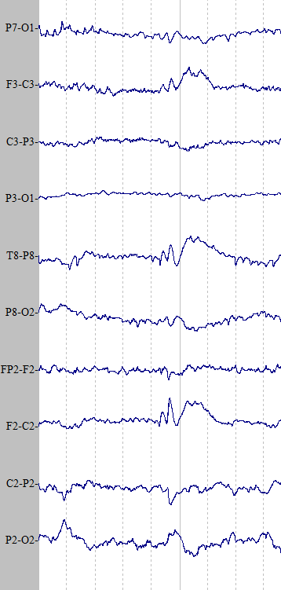
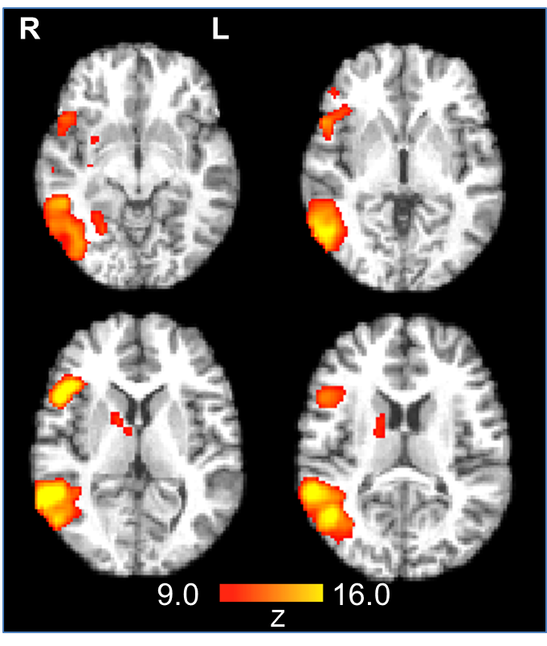
Simultaneous scalp EEG-fMRI
Discharge
Canonical HRF
Provided insight into networks underlying the generation of interictal discharges

Slide 6
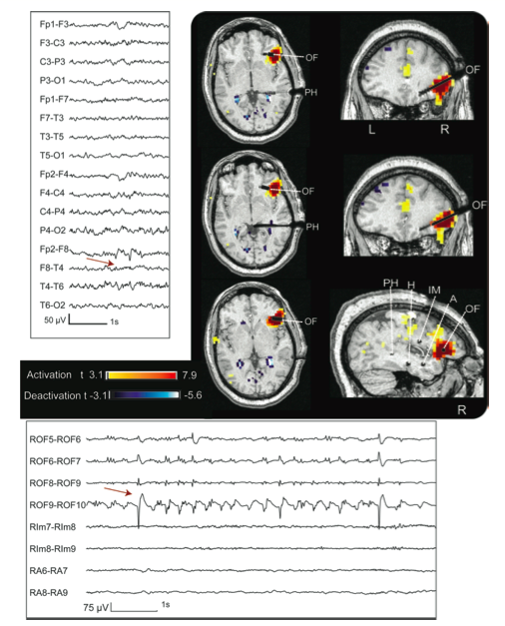
Definition of the seizure onset zone
33 pts underwent EEG-fMRI
29/33 (88%) BOLD response concordant with EEG localization
21/33 (64%) BOLD response contributed to defining focus
12/14 (86%) BOLD response validated by structural MRI or intracranial VEM
Pittau et al. 2012 (Neurology 78:1479)
Notes:
How Gotman defined “contribution to defining focus”:
BOLD response able to more accurately localize the corti- cal region responsible for the generation of a spike within a lobe (for example, BOLD response to F7-T3 spikes pin- pointing to the anterior part of the left first temporal gyrus).
BOLD response with maximum t value in deep brain struc- tures likely to be, according to anatomo-electroclinical infor- mation, part of the epileptogenic zone (for example, the BOLD response to F7-T3 spikes with maximum in the left hippocamps).

Slide 7
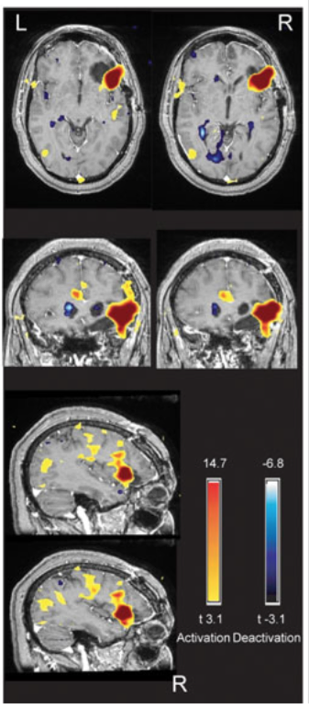
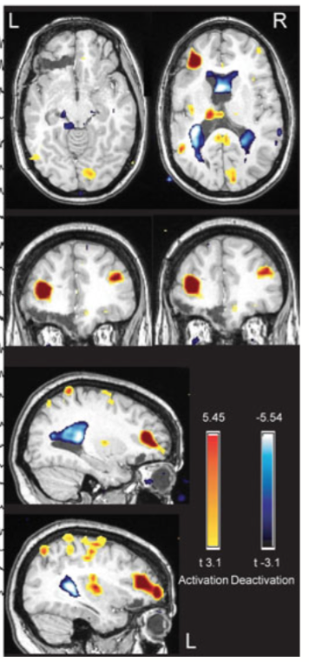
Post-surgical outcome
35 pts underwent EEG-fMRI and surgery
4 groups (based on location of BOLD response and resection):
fully concordant
partially concordant
partially discordant
fully discordant
For fully concordant and fully discordant groups
Sensitivity - 87.5%
Specificity -76.9%
PPV – 70.0%
NPV – 90.9%
(7/10 Class I & II)
(4/9 Class I & II)
(3/5 Class I & II)
(1/11 Class I & II)
An et al. 2013 (Epilepsia 54:2184)
Notes:
Class I - free of disabling seizures
Class II - rare disabling seizures
Class III - worthwhile improvement
Class IV - no worthwhile improvement

Slide 8
Pre-operative workup
29 patients deemed ineligible for surgery
8 had BOLD responses concordant with interictal discharges
Unclear SOZ
(n = 3)
Both
(n = 3)
Presumed multifocality
(n = 2)
EEG-fMRI (n = 6)
- Improved localization in 4 patients
EEG-fMRI (n = 5)
Advocated for a single SOZ in 1 patient
Confirmed multifocality in 4 patients
4 patients underwent intracranial VEM
Intracranial VEM data supported the EEG-fMRI results in 2 patients
Zijlmans et al. 2007 (Brain 130:2343)

Slide 9
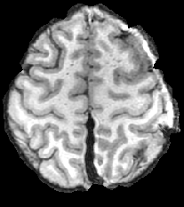
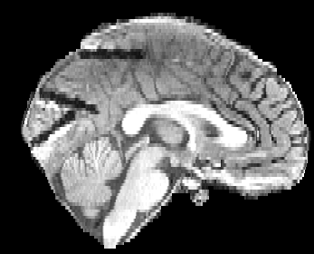
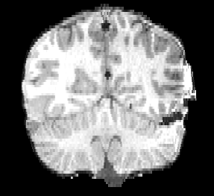
Intracranial EEG-fMRI (iEEG-fMRI)
Intracranial EEG allows more precise recording of epileptiform discharges
Increased number of discharges for analysis

Slide 10
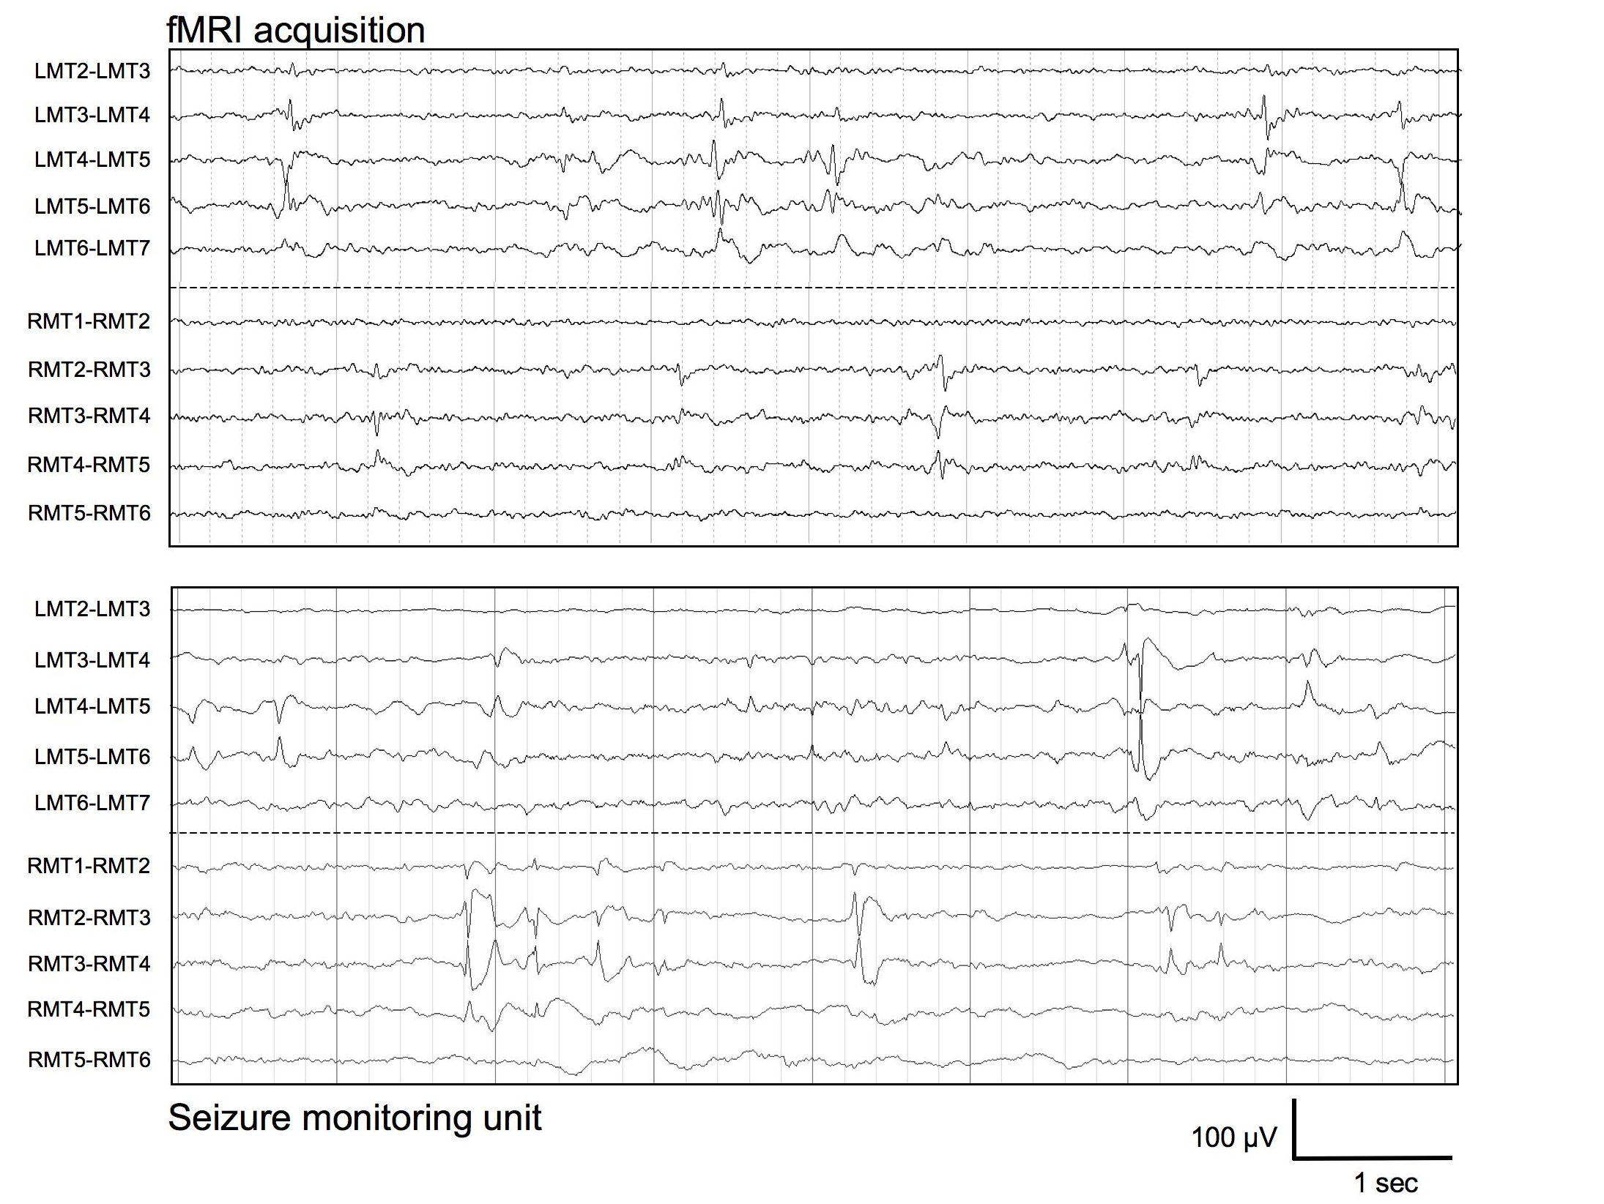
29 y.o. female, bitemporal seizures, MR –ve
Cunningham et al. (2012) Epilepsia 53:1636-1648.

Slide 11
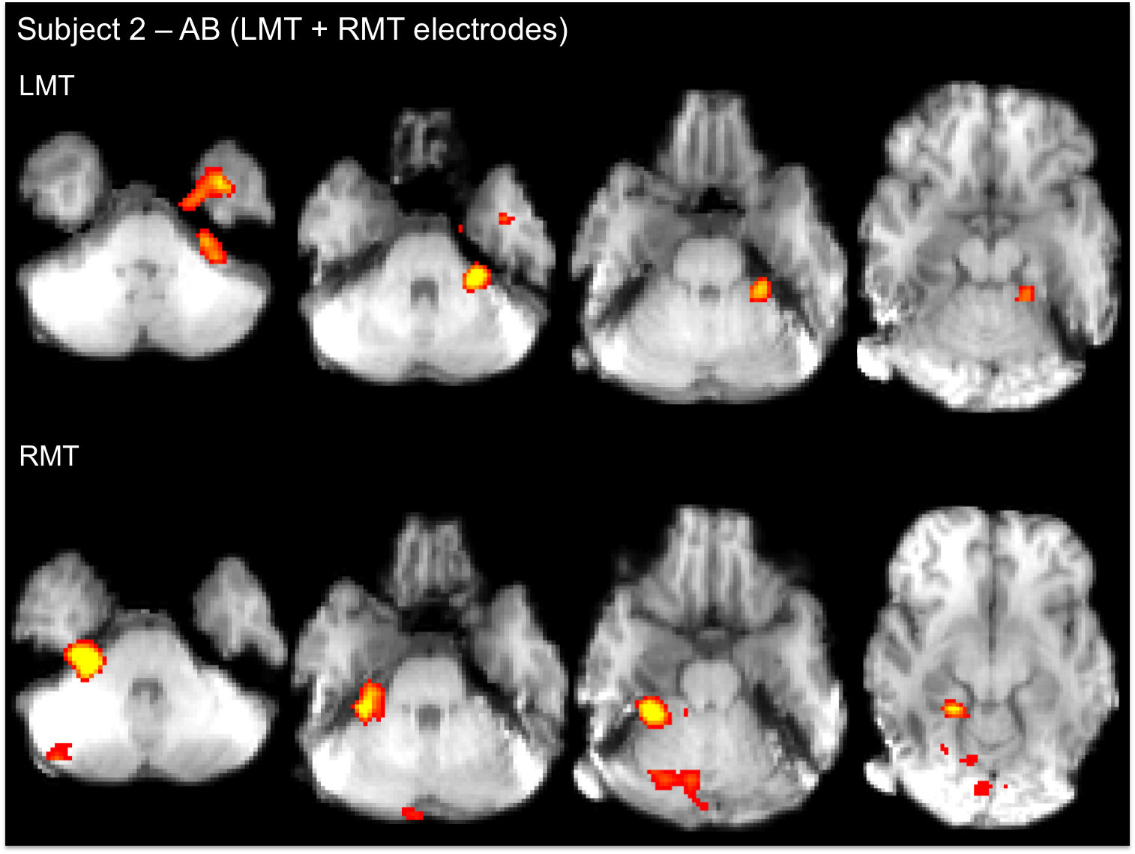
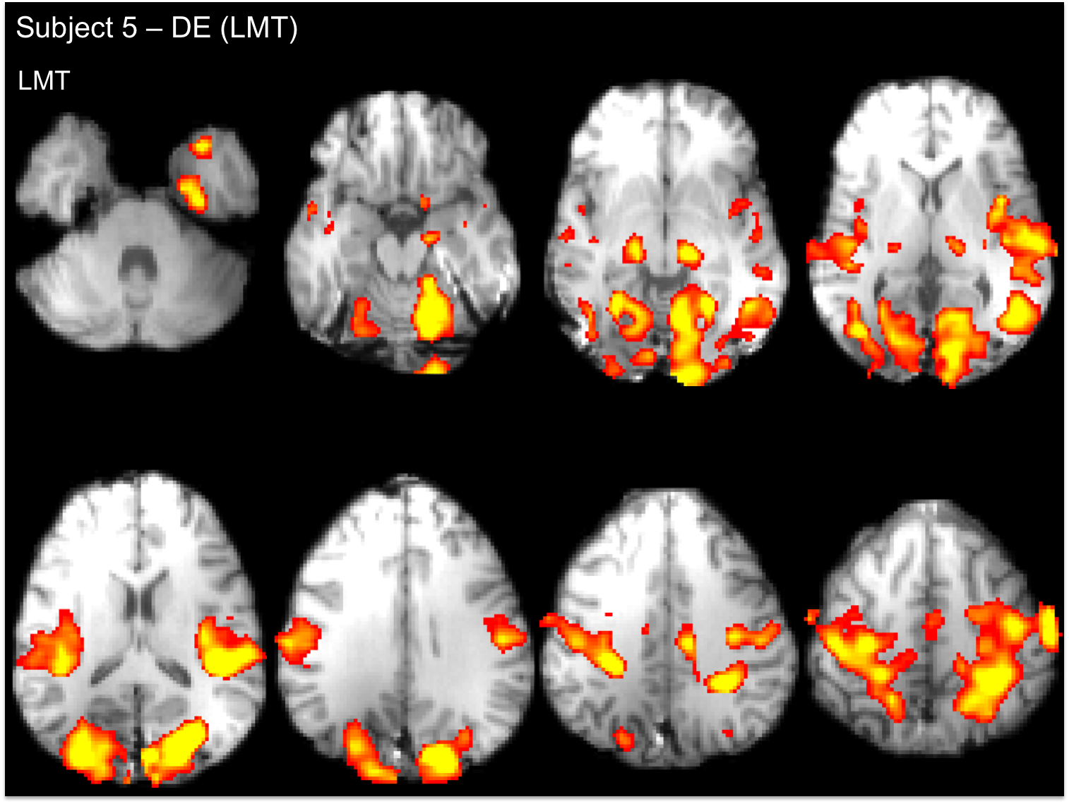
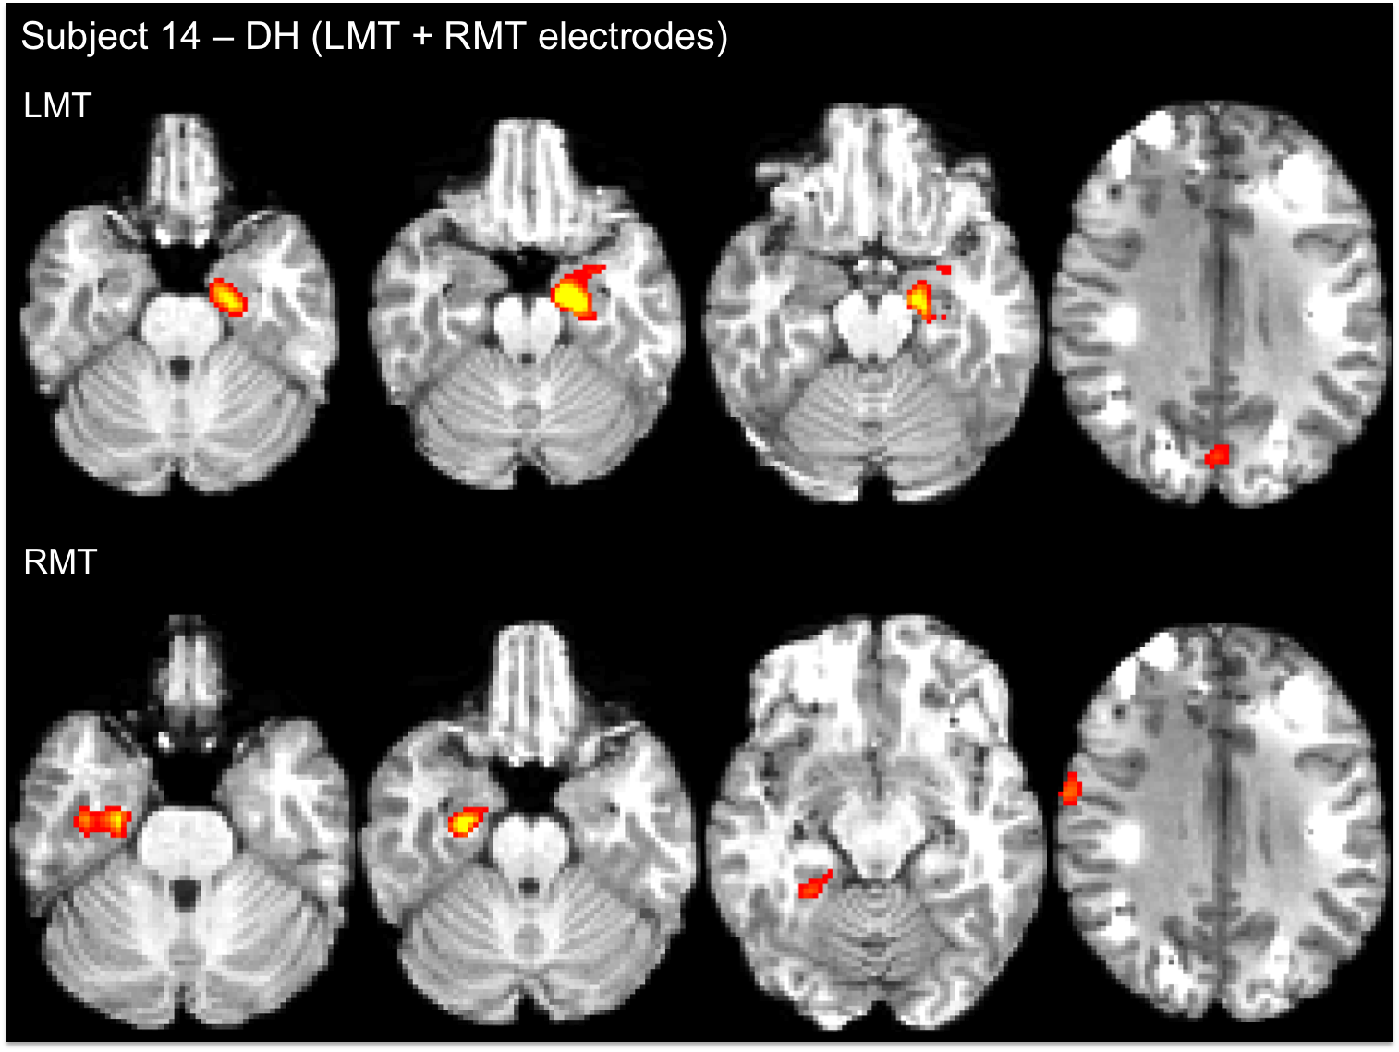
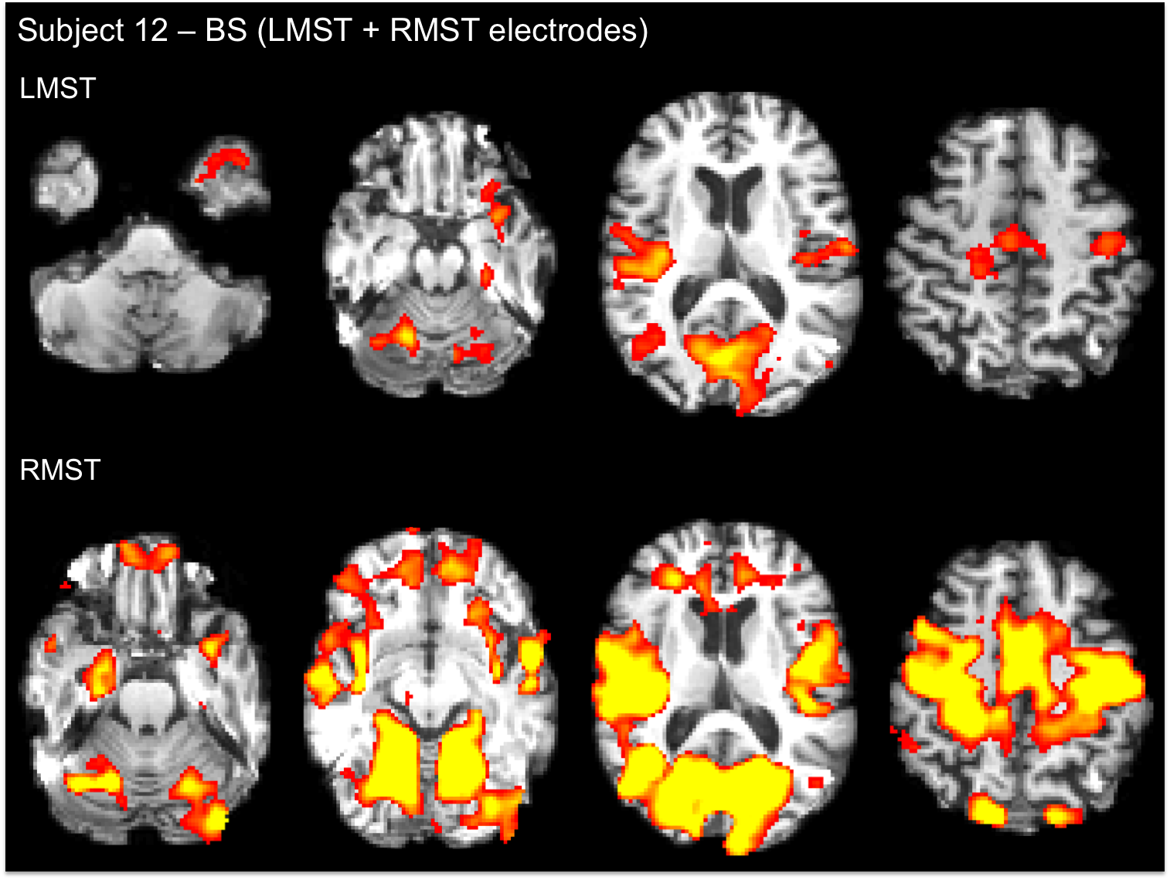
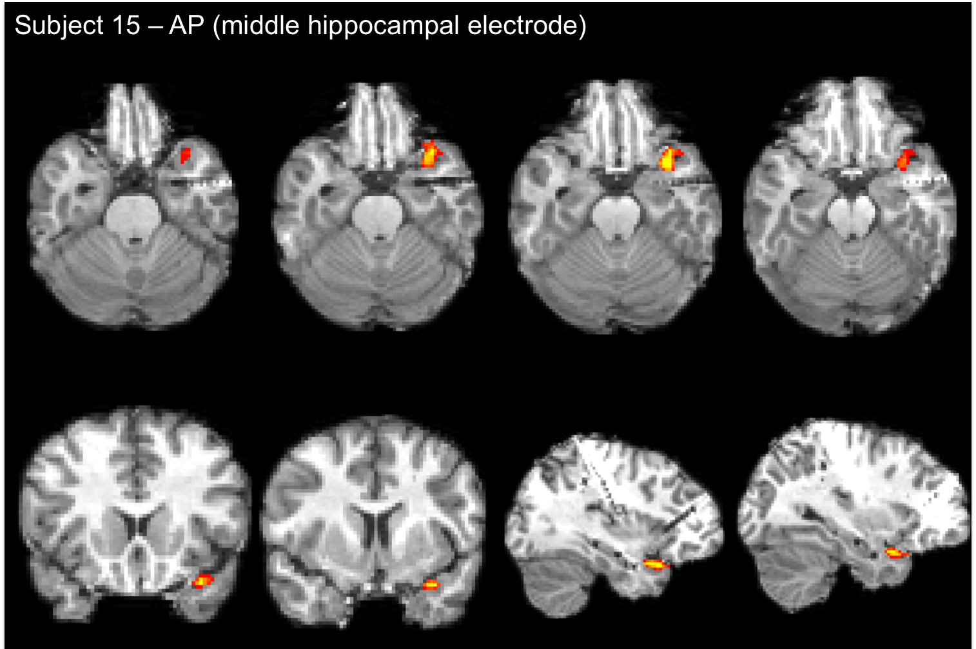
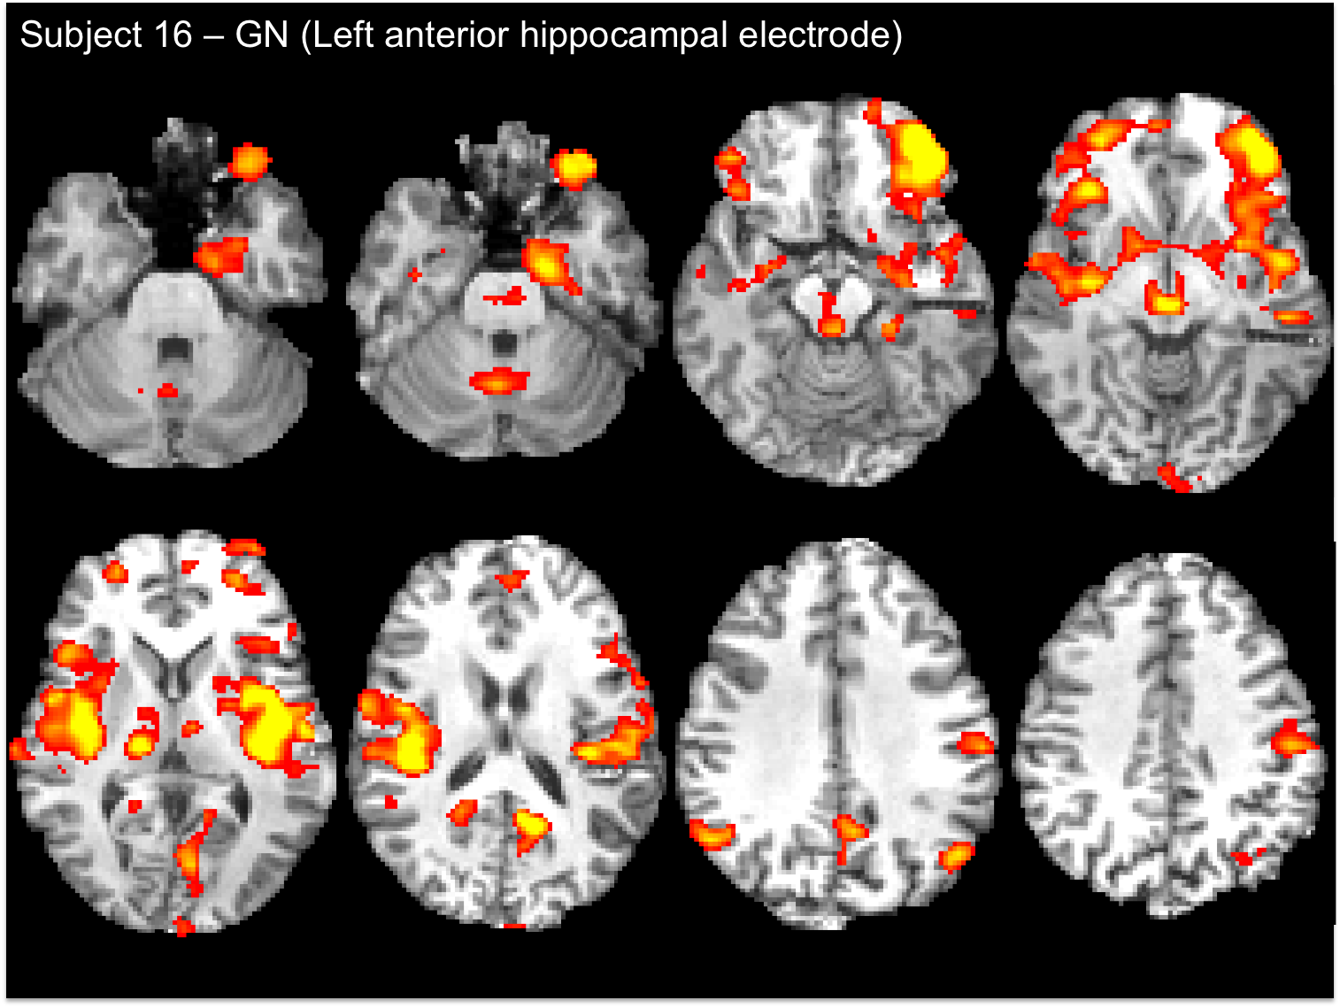
Local activation
Widespread activation
2° GTC: weekly-monthly
2° GTC: yearly-never
4.0
2.3

Slide 12
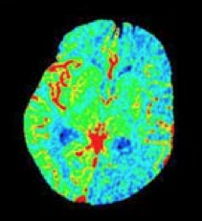
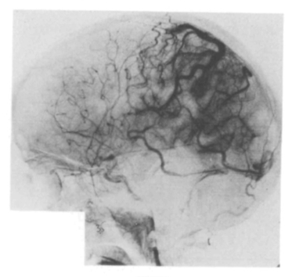
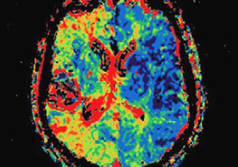
Post-ictal vascular changes
Seizures can be followed by transient neurological impairments (e.g., Todd’s paresis, post-ictal aphasia)
Several case reports of post-ictal hypoperfusion exist (Penfield & Jasper 1954, Yarnell 1975, Matthews et al. 2008, Rupprecht et al. 2010)
MR perfusion
CT perfusion

Slide 13
Seizures are associated with prolonged post-ictal hypoxia in rats (Teskey lab)

Slide 14
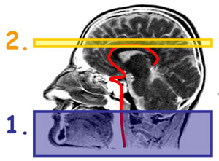
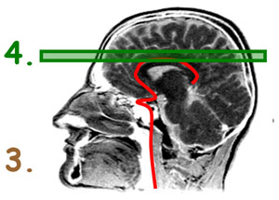
What is Arterial Spin Labeling (ASL)?
MR technique that quantifies cerebral blood flow
Involves collecting pairs of images: one with labeled-blood and another without
Labeled image is subtracted from control image to produce an overall perfusion image
Labeled image
Control image
Image credit: University of Michigan, Functional fMRI Laboratory http://fmri.research.umich.edu/research/main_topics/asl.php
Notes:
Similar to PET techniques, ASL utilizes a tracer of sorts. In ASL, arterial blood water is magnetically labeled then imaged. First, arterial blood water is magnetically labeled just below the region (slice) of interest by applying a 180 degree radiofrequency (RF) inversion pulse. The result of this pulse is inversion of the net magnetization of the blood water. In other words, the water molecules within the arterial blood are labeled magnetically. After a period of time (called the transit time), this 'paramagnetic tracer’ flows into slice of interest where it exchanges with tissue water. The inflowing inverted spins within the blood water alter total tissue magnetization, reducing it and, consequently, the MR signal & image intensity. During this time, an image is taken (called the tag image). The experiment is then repeated without labeling the arterial blood to create another image (called the control image). The control image and the tag image are subtracted to produce a perfusion image. This image will reflect the amount of arterial blood delivered to each voxel within the slice within the transit time.

Slide 15
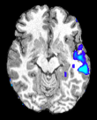
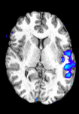
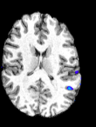
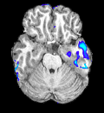
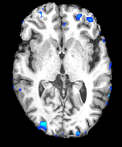
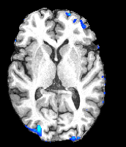
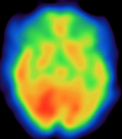
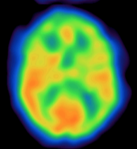
PATIENT 1
33 yr old female
MRI: Left mesial temporal dysplasia
Sz Type: FDC
Onset: F7, Sp1, T3, T5
Sz dur: 70 sec
ASL time: 54 min
R L
PATIENT 6
33 yr old male
MRI: Normal
Sz Type: FDC
Onset: F7, F3
Sz dur: 114 sec
ASL time: 53 min
R L
PATIENT 8
42yr old male
MRI: Right amygdalar enlargement
Sz Type: GTC
Onset: T6
Sz dur: 155 sec
ASL time: 60min
R L
Ictal SPECT
20 ml/100g/min 50

Slide 16
Conclusions
Scalp EEG-fMRI can provide information about the seizure onset zone and possibly predict post-surgical outcome
Scalp EEG-fMRI can be used for complex cases to direct subsequent investigations
Intracranial EEG-fMRI may provide further information about the seizure onset zone
Prolonged post-ictal hypoperfusion can be measured by ASL and may be a marker of the seizure onset zone

Slide 17
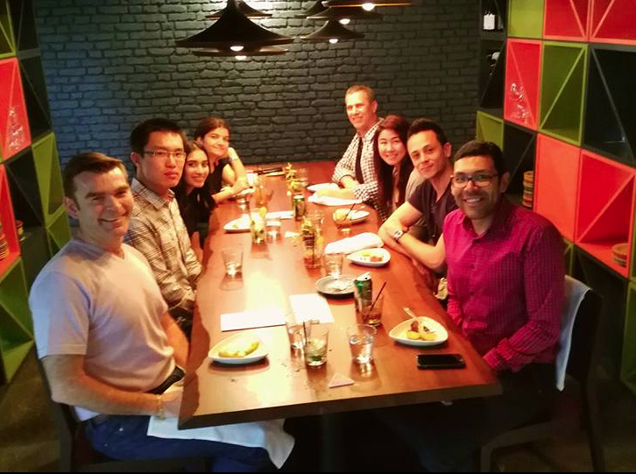
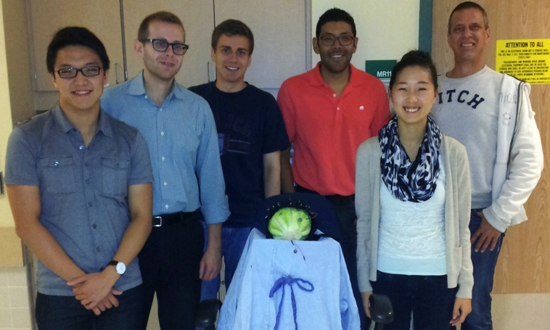
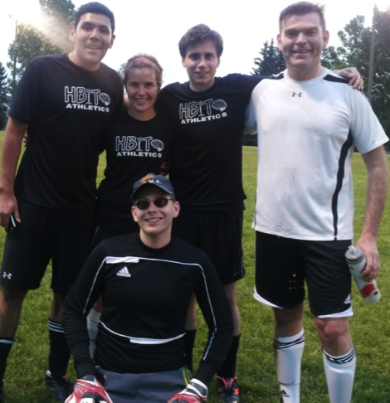
Thank you
Dr. GC Teskey (Calgary)
Dr. JF Dunn (Calgary)
Dr. BG Goodyear (Calgary)
Dr. R Frayne (Calgary)
Federico Lab
Dr. Shaily Singh
Daniel Pittman
Ismael Gaxiola-Valdez
Craig Beers
Xing Wang
Aaron Spring
Tefani Perera
Madison Milne-Ives (former)
Anita Kang (former)
Sarah Vinette (former)
Kristine Woodward (former)
Ted Slone (former)
Robert Kosior (former)
Steven Shin (former)
Aaron Cull (former)
David Mainprize (former)
Shahleen Premji (former)
Robin Bessemer (former)
Michael Wong (former)
2016
2014
2013
2012

