Slide 1
How Brain Somatic Mutations Lead to Epilepsy
Dr. Cyrus Boelman
Neurology, BC Children’s Hospital
CLAE Biennial Meeting 2016

Slide 2
Disclosures
None

Slide 3
Case A
Germline Mutation

Slide 4
Case A
3.5 month old term, non-dysmorphic boy
West syndrome:
Infantile spasms
Hypsarrhythmia EEG
Development regression
Vigabatrin → effective; continues 6 months
Investigations: MRI, Metabolic, Microarray - Normal

Slide 5
Infantile Epilepsy Panel – (Blood)
Genes Tested: ADSL, ALDH7A1, ALG13, ARHGEF9, ARX, ATP6AP2, CACNA1A, CDKL5, CHD2, CHRNA7, CLN3, CLN5, CLN6, CLN8, CNTNAP2, CTSD, DNM1, DYRK1A, EEF1A2, FOLR1, FOXG1, GABRA1, GABRB2, GABRB3, GABRG2, GAMT, GATM, GRIN1, GRIN2A, GRIN2B, IQSEC2, KANSL1, KCNB1, KCNJ10, KCNQ2, KCNQ3, KCNT1, KCTD7, MAGI2, MBD5, MECP2, MEF2C, MFSD8, NR2F1, NRXN1, PCDH19, PIGA, PIGO, PIGV, PNKP, PNPO, POLG, PPT1, PRRT2, QARS, SCN1A, SCN1B, SCN2A, SCN8A, SLC13A5, SLC25A22, SLC2A1, SLC6A8, SLC9A6, SPTAN1, STXBP1, TBC1D24, TCF4, TPP1 (CLN2), TSC1, TSC2, UBE3A, WDR45, WWOX, ZEB2
STXBP1: de novo hemizygous partial deletion of exons 3-4
EIEE/Otahara, West, Dravet, atypical Rett syndromes
Refractory Epilepsy, Movement disorder, ID, ASD

Slide 6
Infantile Epilepsy Panel – (Blood)
Genes Tested: ADSL, ALDH7A1, ALG13, ARHGEF9, ARX, ATP6AP2, CACNA1A, CDKL5, CHD2, CHRNA7, CLN3, CLN5, CLN6, CLN8, CNTNAP2, CTSD, DNM1, DYRK1A, EEF1A2, FOLR1, FOXG1, GABRA1, GABRB2, GABRB3, GABRG2, GAMT, GATM, GRIN1, GRIN2A, GRIN2B, IQSEC2, KANSL1, KCNB1, KCNJ10, KCNQ2, KCNQ3, KCNT1, KCTD7, MAGI2, MBD5, MECP2, MEF2C, MFSD8, NR2F1, NRXN1, PCDH19, PIGA, PIGO, PIGV, PNKP, PNPO, POLG, PPT1, PRRT2, QARS, SCN1A, SCN1B, SCN2A, SCN8A, SLC13A5, SLC25A22, SLC2A1, SLC6A8, SLC9A6, SPTAN1, STXBP1, TBC1D24, TCF4, TPP1 (CLN2), TSC1, TSC2, UBE3A, WDR45, WWOX, ZEB2
STXBP1: de novo hemizygous partial deletion of exons 3-4
EIEE/Otahara, West, Dravet, atypical Rett syndromes
Refractory Epilepsy, Movement disorder, ID, ASD
Germline Mutation

Slide 7
Somatic Mutation

Slide 8
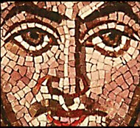
Mosaic Somatic Mutation
Genes (Basel). 2014 Dec; 5(4): 1064–1094.

Slide 9
Brain Development
Antenatal:
>100K divisions/min
Postnatal:
700 neuron/day
1/3 hippocampal exchange over life
Exp Mol Med. 2016 Jun; 48(6): e239.

Slide 10
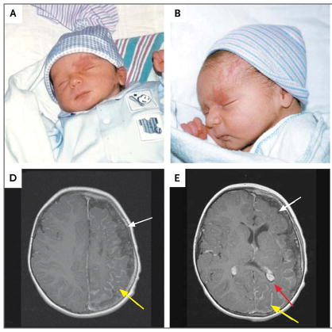
Somatic Mosaicism: Timing
When = Where
Example: Sturge-Weber Syndrome
Port-wine stain
GNAQ gene (WGS, 2013)
6% = S-W (26% if V1 distr.)
EARLY mutation
94% = non-syndromic
LATE mutation
N Engl J Med. 2013; 368(21): 1971-9.

Slide 11
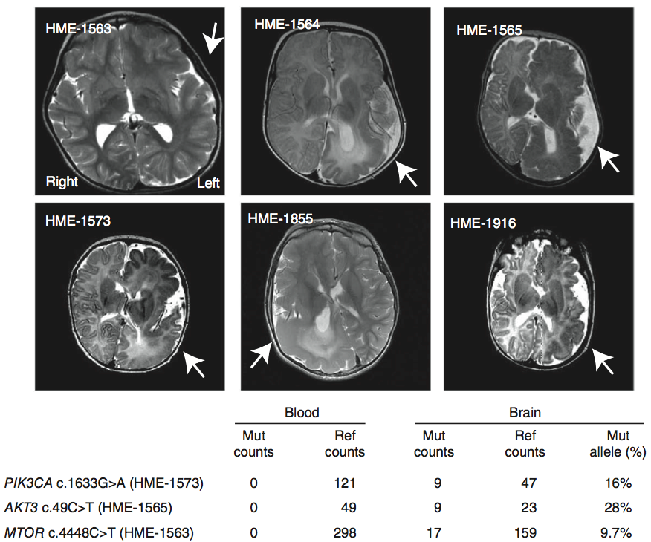
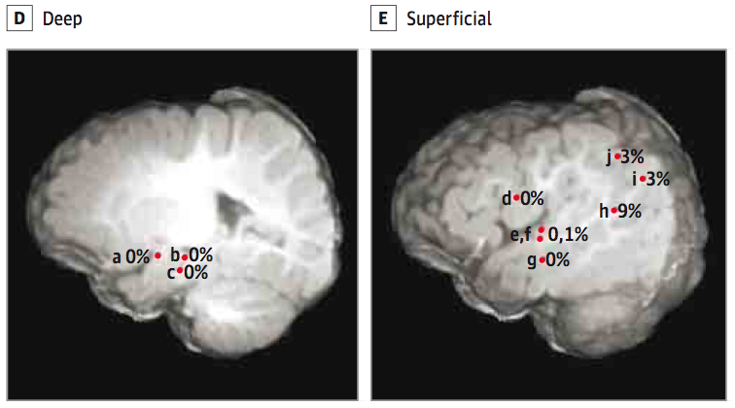
Hemimegalencephaly (HME)
Blood vs brain
PI3K-AKT-mTOR pathway (30%)
20-80% HME cells
Region variable
MTOR
JAMA Neurol. 2016;73(7):836-845.
Nature Genetics 2012; 44(8):941-6.

Slide 12
HME: 36% mTOR Pathway genes
PTEN
17% (9/53)
Adapted: Ann Neurol. 2015 Apr; 77(4): 720–725.

Slide 13
Case B
5-year old boy
Intellectual disability; autism spectrum disorder
Focal dyscognitive seizures +/- 2nd generalization
Refractory to multiple medications
EEG: bilateral independent temporal foci
MRI: left anterior temporal
suspected focal cortical dysplasia
MEG: dipole cluster concordant with MRI

Slide 14
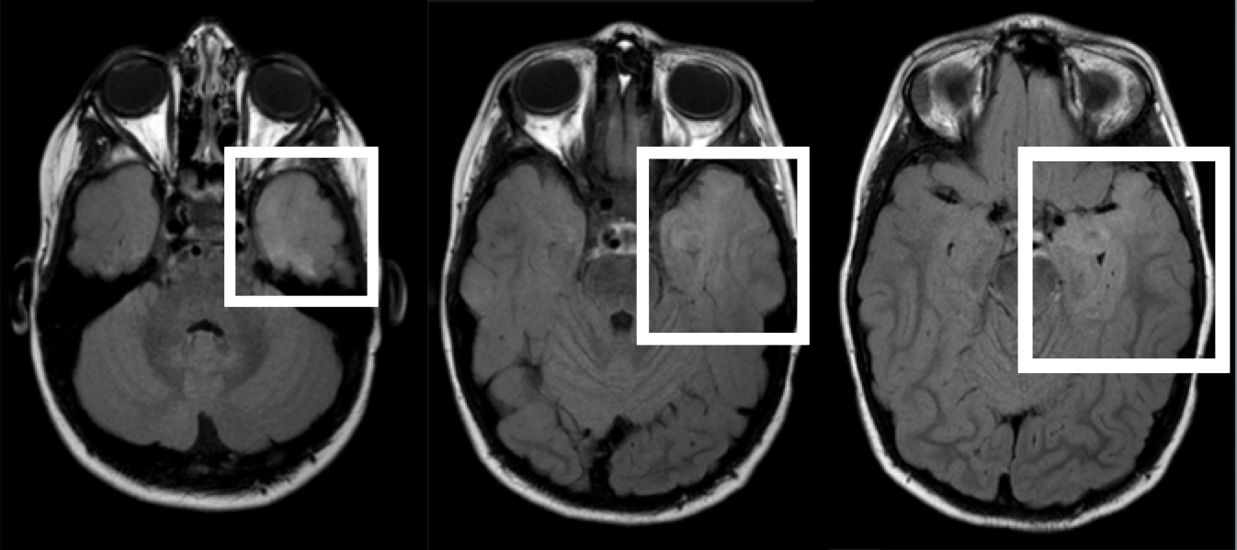
Case B: MRI

Slide 15
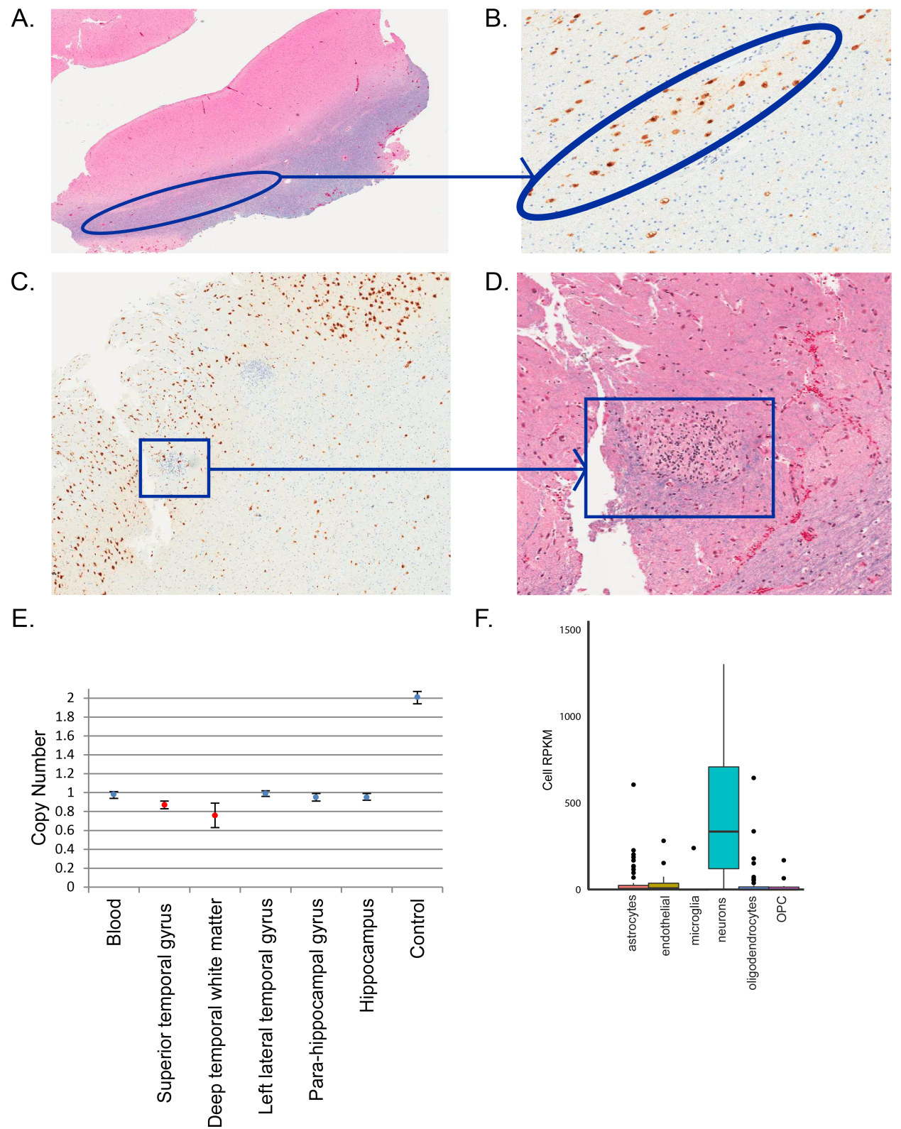
Case B: Pathology
Heterotopic
Neurons
Nodular
Heterotopic
Immature
Neurons

Slide 16
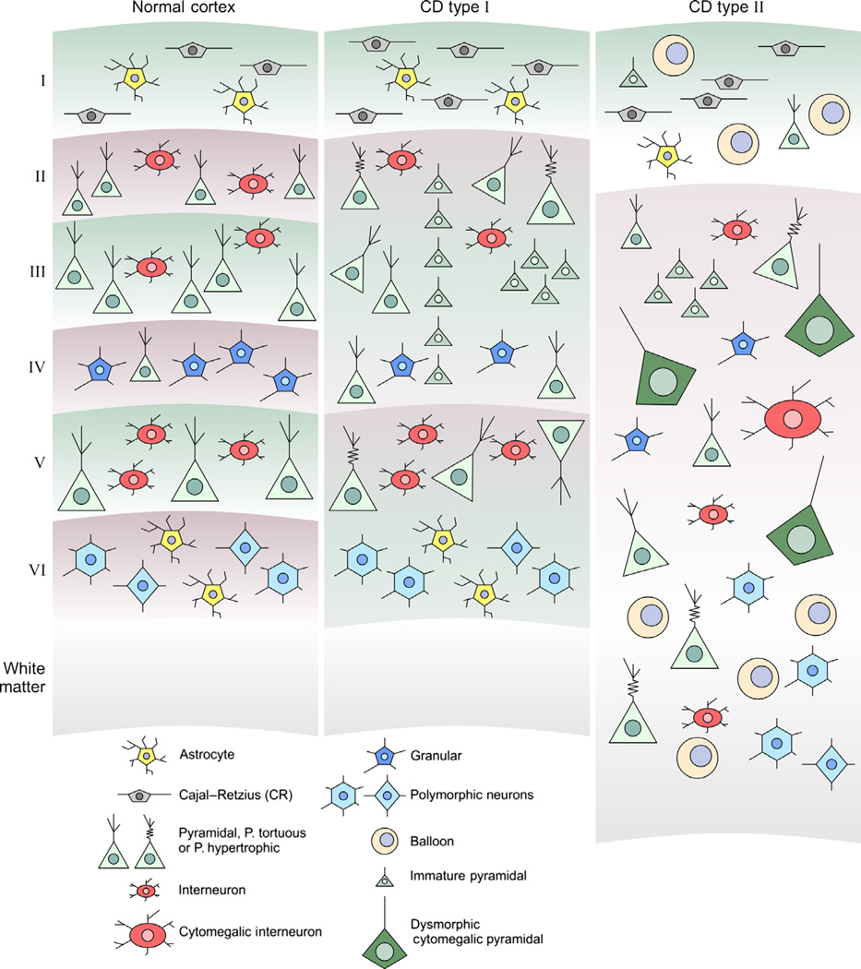
Focal Cortical Dysplasia
CNS Neurosci Ther. 2015 Feb; 21(2): 92–103.

Slide 17
Focal Cortical Dysplasia
Kuzniecky & Barkovich, 1996: “The mechanisms underlying FCD are hypothetical at best”
Becker, 2002: Balloon cells in FCD – increased TSC1 gene polymorphisms compared to controls
Sequencing FCD focused on mTOR pathway, given pathological similarities to TSC & HME:
20% Somatic: MTOR (22 samples), PIK3(2), DEPDC5 (3)
(D’Gama, 2015; Lim, 2015; Nakashimi, 2015; Leventer, 2015; Baulac, 2015; Mirzaa, 2016)
Blümcke & Sarnat, 2016: FCD2 is a mTORopathy

Slide 18
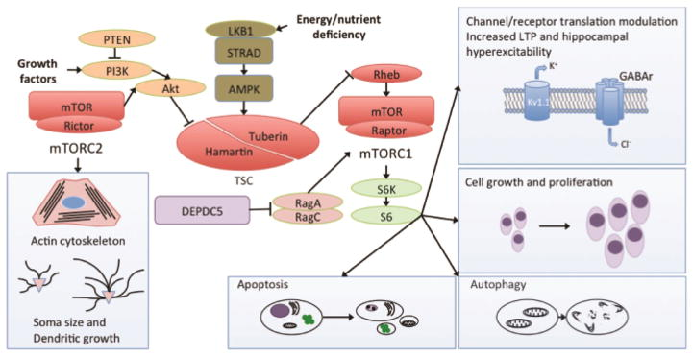

Slide 19
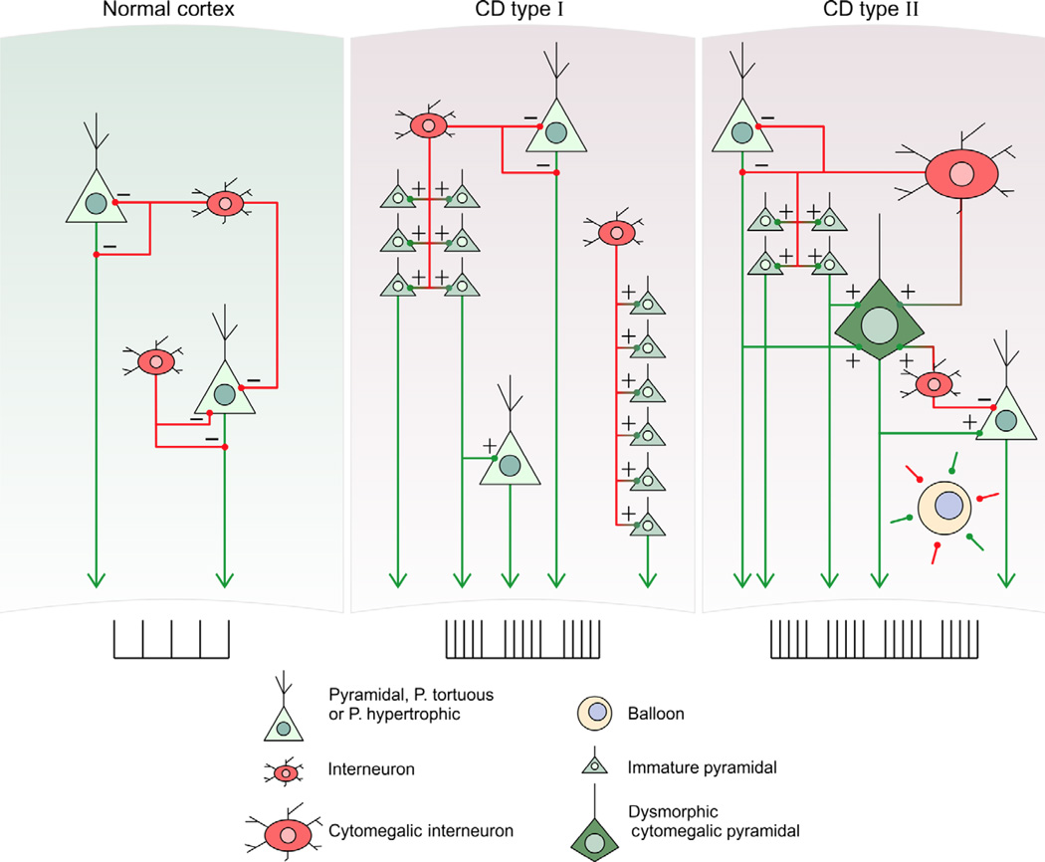
Focal Cortical Dysplasia: Mechanism
CNS Neurosci Ther. 2015 Feb; 21(2): 92–103.

Slide 20
FCD: The other 80%
Challenge: The 1% (mutant allele fraction)
i.e. only 2% of cells carry the mutation
Typical WES: 30-50x
1% requires >1000x
Genes (Basel). 2014 Dec; 5(4): 1064–1094.

Slide 21
FCD and Other Genes
SCN1A:
6 of 9 with FCD: refractory to surgery (Barba, 2014; Skjei, 2014)
STXBP1:
1 of 1 with FCD: significant response to surgery (Weckshuysen, 2013)
No molecular testing of the brain tissue

Slide 22
Case A is Case B
Case A
Case B
STXBP1: de novo hemizygous partial deletion of exons 3-4
Seizure-free 1-year after surgery

Slide 23
STXBP1 FCD: Somatic Mosaicism
FCD
Heterozygous deletion,(1)
Some cells with
Homozygous
Deletion, (<0.9)

Slide 24
FCD: Canadian Work in Progress
Combined cohort of FCD type II:
Largest to date
SickKids & BC Children’s Hospital
Goal to identify pathogenic somatic mosaicism at 1% frequency:
Deep (100x) and Ultra-deep (>1000x) exome sequencing
Preliminary: 42 mutations per sample, at <2% frequency
Goal: expand nationally with retrospective FCD cases
Contact: cyrus.boelman@cw.bc.ca

Slide 25
Summary: Somatic Mutation in Epilepsy
The brain develops through explosive neuronal replication with many opportunities for mutation at different times and cell populations
A somatic mutation in <2% of cells in just a small focal region is sufficient to produce refractory epilepsy
MTOR pathway mutations account for (only) 25% of epilepsy related to malformations of cortical development, such as HME and FCD
Further work is needed to find the other 75%, such as somatic mutations in STXBP1, which may be amenable to epilepsy surgery

Slide 26
Future Thoughts
Genetic Generalized Epilepsy:
Could somatic mutation explain both:
Cortical focus theory
The missing heritability
Treatment:
Disease-modifying drugs:
mTOR inhibitors beyond TSC
CRISPR Cas9-AAV gene editing
Role for pre-surgical brain biopsy for molecular genetics
Define surgical margins by molecular genetics

Slide 27
Thanks
BC Children’s Epilepsy & Epilepsy Genetics Programs
SickKids Epilepsy Program
Personalized Medicine in Treatment of Epilepsy
SickKids Genetics & Genome Biology:
Dr. Berge Minassian
Dr. Adam Shlien
Dr. Mohammed Uddin
Research Coordinators:
Dr. Ledia Brunga
Giselle Hunt & Jantzen Fan
Contact: cyrus.boelman@cw.bc.ca

