Slide 1
Faculty/Presenter Disclosure
Faculty: Peter Carlen
  Relationships with commercial interests:
  Grants/Research Support: none from companies,
  but receives funding from CIHR, NSERC, and OBI.
  Speakers Bureau/Honoraria: none
  Consulting Fees: none
  Other: -Employee UHN Hospital Group
  -Co-Founder of Avertus Inc., a neurotechnology startup making a wireless, dry electrode, EEG- based home monitoring system

Slide 2
WHY DO SEIZURES START AND STOP?
Chair: Dr. Peter Carlen, University of Toronto
LEARNING OBJECTIVES:
To appreciate the EEG measured dynamics of seizure onset and offset.
To appreciate the many relevant cellular and local network properties and activities related to seizure phases.
To appreciate the relevance of brain metabolic changes that can lead to and result from seizure activity both in relationship to seizure onset and seizure termination.
To consider how our understanding of seizure onset and offset can lead to better preventative and therapeutic strategies.

Slide 3
TOPICS AND SPEAKERS:
Intra and Extracranial EEG Dynamics in Relationship to Seizure States and Strategies for Modulating Seizure Activities
Dr. Berj Bardakjian, University of Toronto
Neuronal and Ionic Dynamics in Relation to Seizure Onset and Termination
Dr. Igor Timofeev, Université Laval
Local Neuronal Network Involvement in Seizure Onsets and Offsets
Dr. Massimo Avoli, McGill University
Presynaptic Mechanisms Determining Seizure Onset and Offset
Dr. Peter Carlen, University of Toronto
Metabolic and Glia Changes in Relationship to Seizure Phases
Dr. Paolo Bazzigaluppi, Toronto Western Hospital

Slide 4


Slide 5
Jacobus Schroeder von der Kolk (1797 –1862)
On the Medical Treatment of Epilepsy
Amsterdam, C. G. van der Post 1858 / London, The New Sydenham Society 1859
“In no department of medicine does a more rude empi-ricism prevail. All kinds of… remedies are tried without distinction, and a proper rational treatment… can scar-cely be said to exist…
Everything rests upon loose conjectures, upon the tem-porary fame – now of this, now of another remedy; …
…many physicians, when called on to treat epilepsy, take refuge in a great box full of all kinds of medicines… Now, they close their eyes, grope blindly in the box, take out a remedy, and compel the unfortunate to venture the slight chance that… this is exactly the one suited to his state and the nature of his illness.“

Slide 6
Presynaptic Mechanisms Determining Seizure Onset and Offset

Slide 7
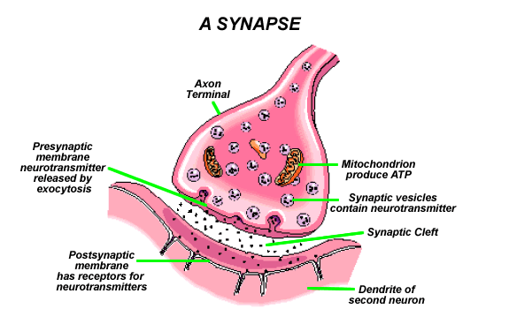
Presynaptic terminal as target for
anticonvulsants
The presynaptic terminal is an under-recognized anticonvulsant target (Rogawski and Bazil, 2008; Barker-Haliski and White, 2015).
Levetiracetam, and a more recently developed anticonvulsant, brivaracetam, are ligands for synaptic vesicle proteins expressed at glutamatergic terminals, and are highly effective in the treatment of a wide range of experimental focal and generalized seizures (Mumoli et al., 2015; Klitgaard et al., 2016).

Slide 8
Presynaptic glutamate release during the neocortical seizure cycle: an anti-seizure target
Vanessa L. Breton
Suzie Dufour, Lihua Wang, Erli Mingomataj,
Berj L. Bardakjian, Peter L. Carlen
We posed the following questions:
What are the dynamics of glutamate responses during
the seizure cycle?
2) Are these changes mainly pre- or postsynaptic?.

Slide 9
A
Low Mg²⁺
1
2
0.2mV
2min
1
0.5mV
2
10s
B
0.1 to 0.4Hz
3-10Hz
Phase domain analysis
of seizure states
-180º
-160º
-120º
-80º
-40º
0º
20º
40º
60º
80º
100º
120º
140º
160º
180º
C

Slide 10
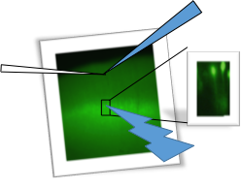
layer V electrically evoked EPSCs measured in layer II/III pyramidal neurons
layer V optogenetically evoked EPSCs and IPSCs measured in layer II/III pyramidal neurons
~80º

Slide 11

Local layer III Electrical Evoked Stimulation is highly potentiated during the seizures.
I_{NaP}?
(Analysis taken from 9 seizures in 3 tissue slices)
Notes:
DA prince 1990 – low Mg + electrical stimulation
Possible causes:
Definitely activating local dendritic network that is potentiated by 0Mg solution
(Shepherd and Svoboda, 2005)
strong direct excitation of postsynaptic dendrites by glutamate uncaging made quantification of local 2/3-2/3 PY projections difficult
Activating the intrinsic bursting property of local pyramidal neurons that synapse onto layer 5 cells.
I(Na)p and local dendritic stimulation and LTP

Slide 12
EPSCs and IPSCs measured in layers II/III during the seizure cycle
Electrically evoked EPSCs from layer V are elevated at seizure onset, and show significant post-seizure depression
optogenetically evoked EPSCs from layer V are depressed at seizure ending and post-ictally, rising significantly pre-ictally
optogenetically evoked iPSCs from layer V are depressed at seizure ending and post-ictally, and show large variability at seizure onset, probably reflecting the difficulty in measuring events in the early rapidly bursting ictal phase
Electrically evoked EPSCs from layers II/III are elevated throughout the seizure, quickly returning to baseline post-ictally. These EPSCs probably reflect orthodromic EPSCs as well as directly evoked dendritic excitatory events (e.g. Ca & Na currents) and possibly astrocytic activation.

Slide 13
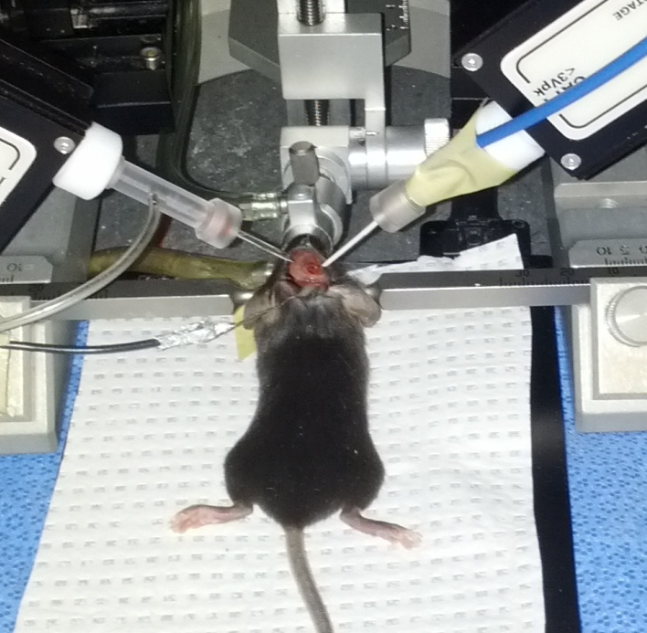
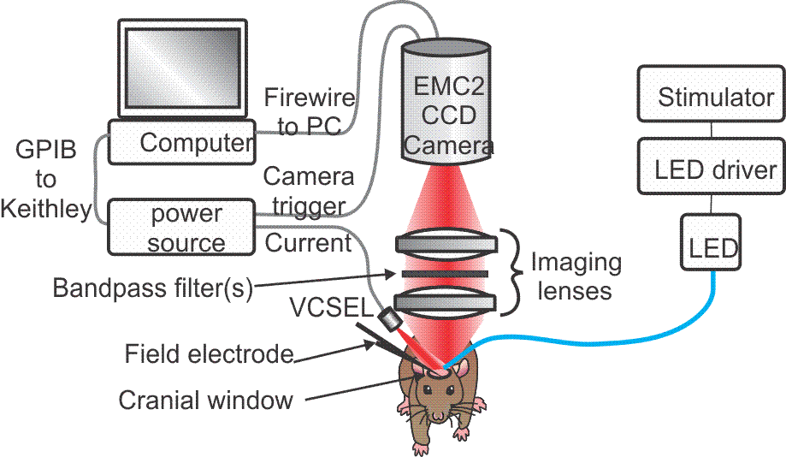
In vivo optogenetic setup
Methods:
-thy1-CHR2-EYFP transgenic mice
-blue light (473 nm LED) stimulation via a 1000 um core fiber
- Ketamine-Xylazine anesthesia
Recordings are performed in the somatosensory cortex
1.5 mM 4 AP is applied topically
Field potential recordings by a glass electrode (layer 5)
Intrinsic optical signal imaging is used to map seizures

Slide 14
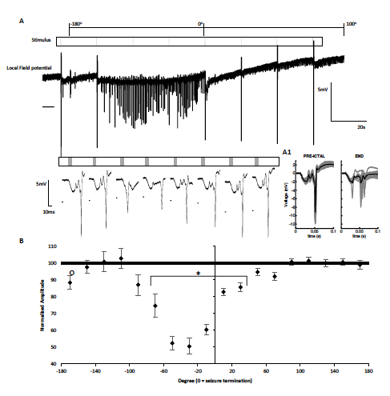
Optogenetically evoked field EPSCs (oefEPSC) are also suppressed during the later phases of the seizure state during 4-AP induced seizures in vivo.
A
%

Slide 15
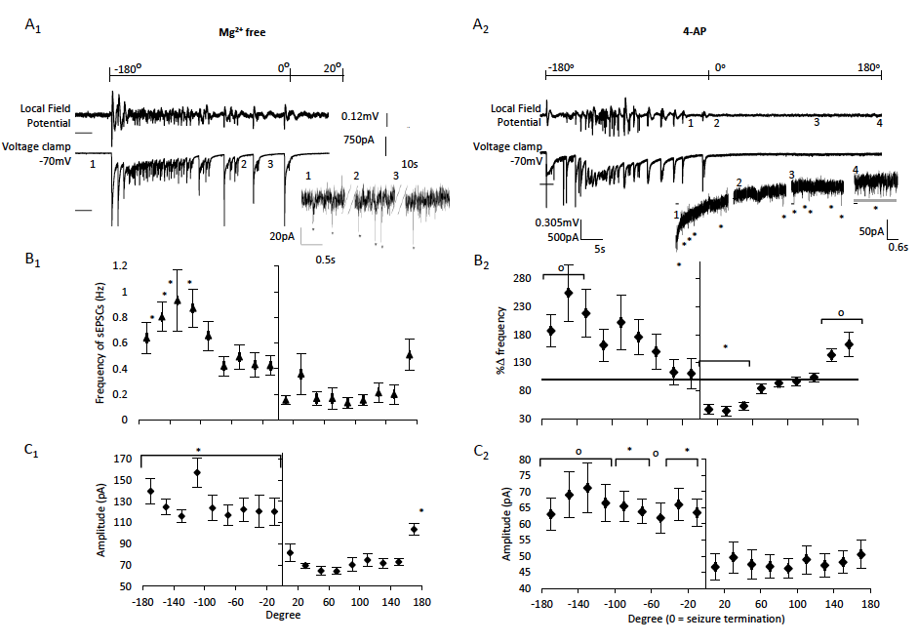
Frequency of spontaneous EPSCs is elevated at seizure onset, returning to interictal baseline at seizure termination in the two seizure models. Amplitude of sEPSCs remains elevated during the entire ictal state.

Slide 16
The frequency of spontaneous excitatory currents increases then recovers during the seizures, which indicates a presynaptic mechanism of control over the seizure-like events.
The stable elevated amplitude of the sEPSCs during the ictal phase, in light of no significant changes in the postsynaptic responses to applied glutamate, further supports this mechanism.

Slide 17
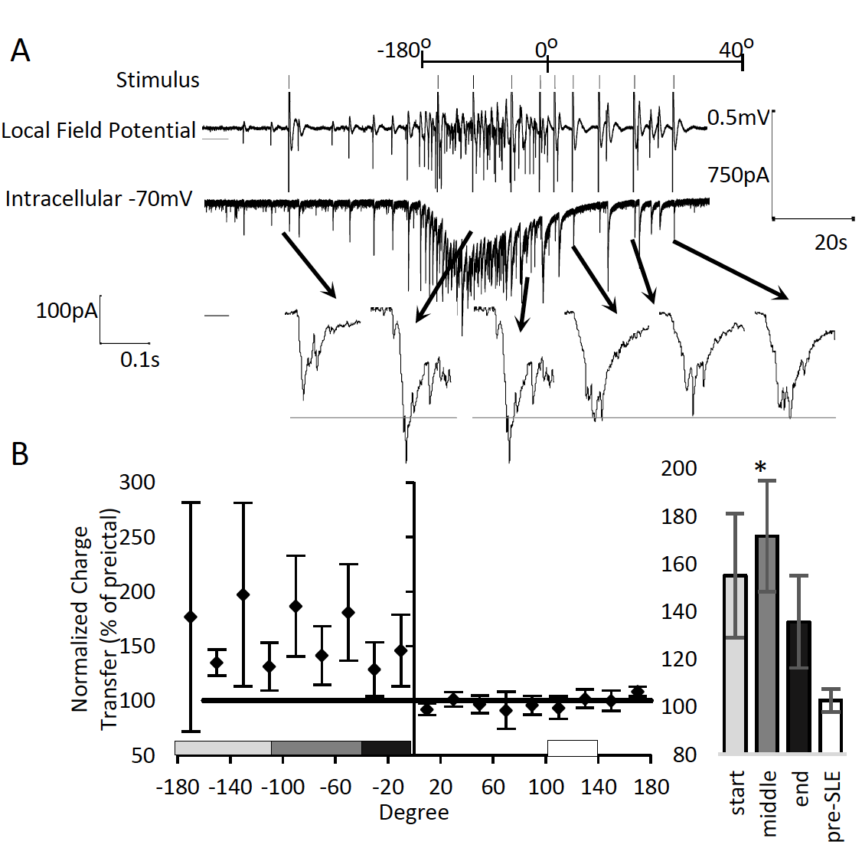
Post-synaptic glutamate receptor sensitivity is elevated during Mg2+ free seizures (but voltage clamped at -70 mV, thereby artificially increasing the driving force)
20-30μm

Slide 18
Adenosine A1R antagonism prolongs the seizure state by enhancing late ictal bursting
In the Mg²⁺ free neocortical model, adenosine biosensors were recently used to record endogenous levels of purines (Wall and Richardson, 2015). They observed that a rise in purines starts midway through the prolonged bursting state and noted that small changes in local adenosine levels will have large effects on the network activity.
One possibility during neocortical seizures is that presynaptic glutamate release is depressed by concomitant adenosine release, thus affecting the bursting events that precede seizure termination (Köhling, 2014).
A1 receptors (A1R) are highly localized to layer V thick tufted pyramidal neurons in the cortex (Kerr et al., 2013). If these receptors are stimulated during the seizures, they may influence the rhythms of these events.

Slide 19
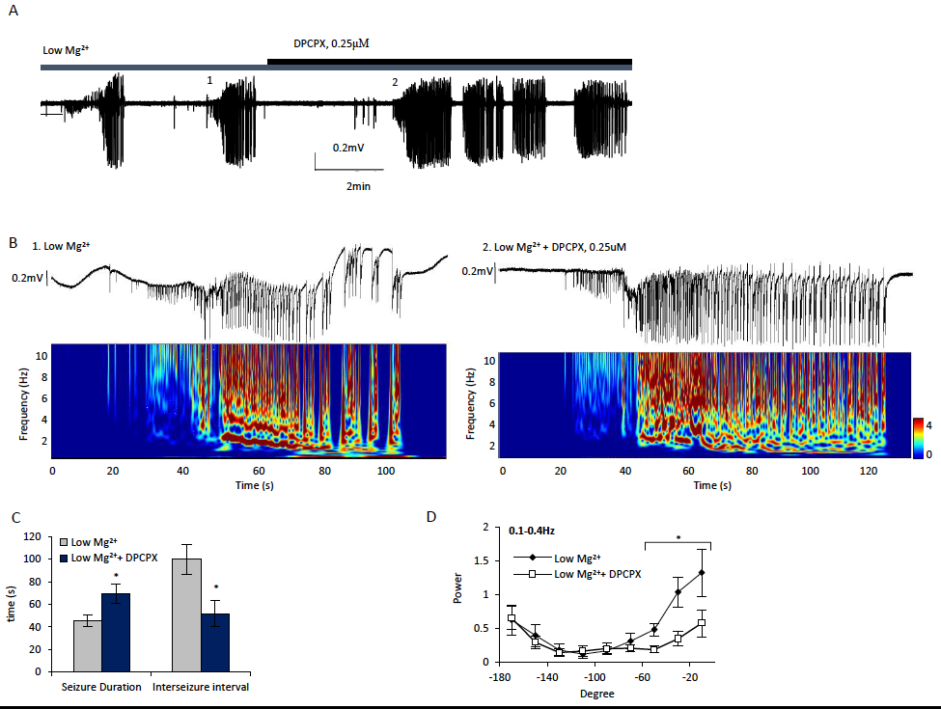
A1 receptor antagonism prolongs seizures, reduces inter-seizure interval and alters underlying spontaneous burst activity.

Slide 20
DPCPX both prolongs seizures and increases the frequency of bursting in our model, linking the modulation of presynaptic release probability to underlying dynamical changes in the seizure state.
To identify whether endogenous adenosine plays a role in this suppression, short duration sucrose evoked puffs were applied over the course of the seizures in the presence of DPCPX, 0.25μM.

Slide 21
Pressure application of hypertonic sucrose solution is suggested to release contents of presynaptic vesicles through a calcium independent process (Rosenmund and Stevens, 1996).
Cells were voltage clamped at -70mV, and short duration puffs of hypertonic sucrose (0.5M) were ejected from a nearby field electrode.

Slide 22
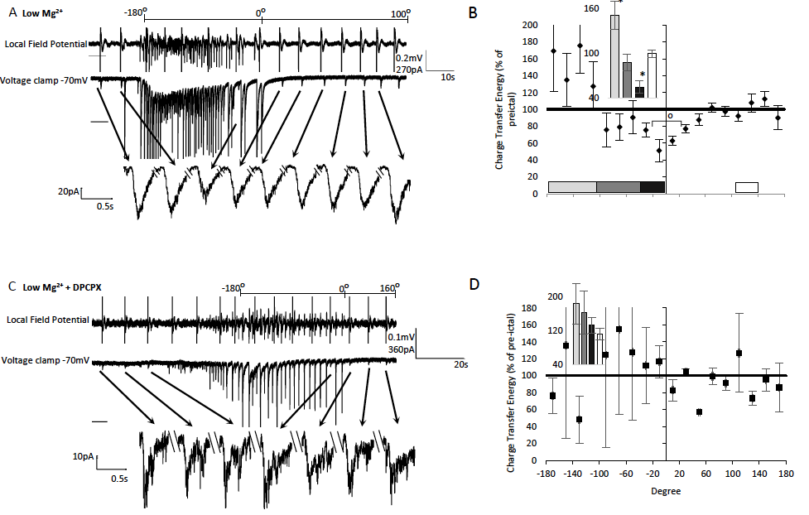
Suppression of hypertonic sucrose-evoked EPSCs at seizure termination is eliminated with DPCPX treatment, suggesting that endogenous adenosine is presynaptically impairing glutamate release during the late seizure phase.
.

Slide 23
Conclusions
Presynaptic glutamate release is elevated at seizure onset, and then depressed during seizures, particularly during the later 40º of the seizure state. This may contribute to seizure termination and may be a primary rate-limiting factor in the post-ictal recovery period.
The final phase of the seizure state is marked by a major reduction in the optically evoked EPSCs from layer V and a similar drop in local sucrose evoked EPSCs. These observations are supported by optically evoked field EPSPs in vivo and by an increase followed by suppression of the electrically evoked EPSCs from the deep layer, with comparable changes in the frequency of the spontaneous EPSCs.
The sucrose-evoked release of the readily releasable pool of glutamate is increased at seizure onset and depressed at seizure termination in the neocortex. This effect is blocked by the adenosine A1 receptor antagonist, DPCPX, which also prolongs seizures and decreases the inter-seizure intervals.
Modulating presynaptic glutamate release is an attractive target for seizure control, now considered a key mechanism for some recently developed anticonvulsants.

Slide 24
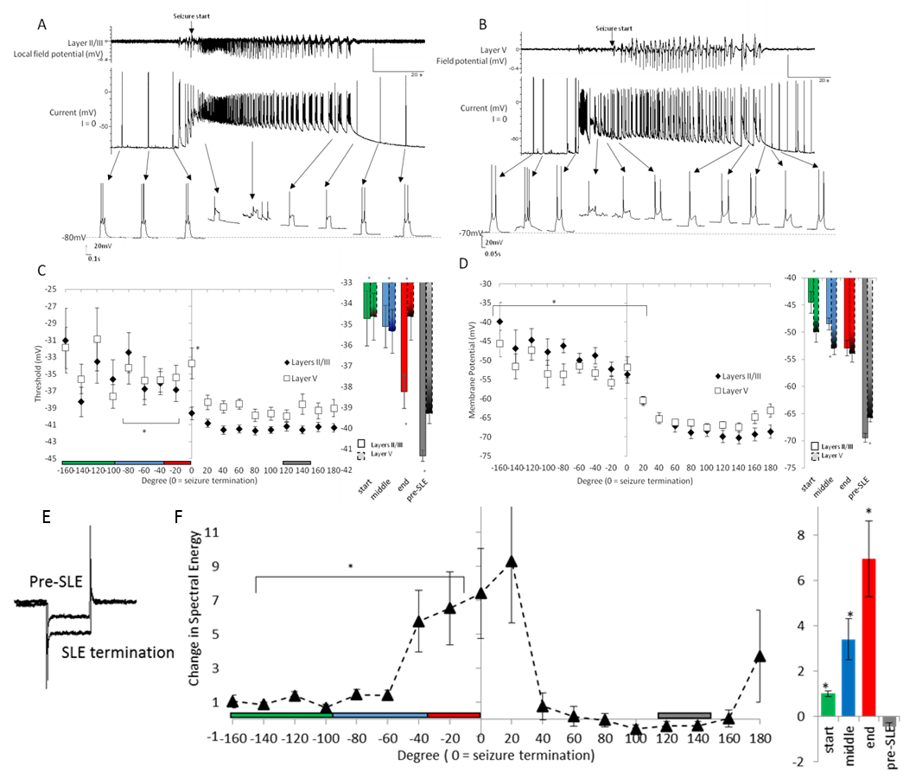
Layer II/III and layer V pyramidal neurons show a reduction in excitability and depolarization throughout the entire seizure. A major increase in neuronal conductance (and decreased excitability) occurs during the later ictal phase and early post-ictal phases
layer II/III
layer V

Slide 25
Instantaneous firing rate of layer 5 and 2/3 neurons.
- indication of inhibitory control mechanisms.
Normalized instantaneous firing rate of layer 5 and layer 2/3 pyramidal neurons N = 5 layer II/III N = 5 layer V.* p<0.001 # p<0.008; Seizure termination shows similar pattern of reduced firing rate between layers.
t₀
t₁
Instantaneous firing rate = 1/Δt = 1/(t₁ – t₀)

Slide 26
Probability of getting a second spike is much lower, and there is a large change in threshold of the second spike relative to the first spike approaching the end of seizure.
→ Greatest change in excitability approaching seizure termination

Slide 27
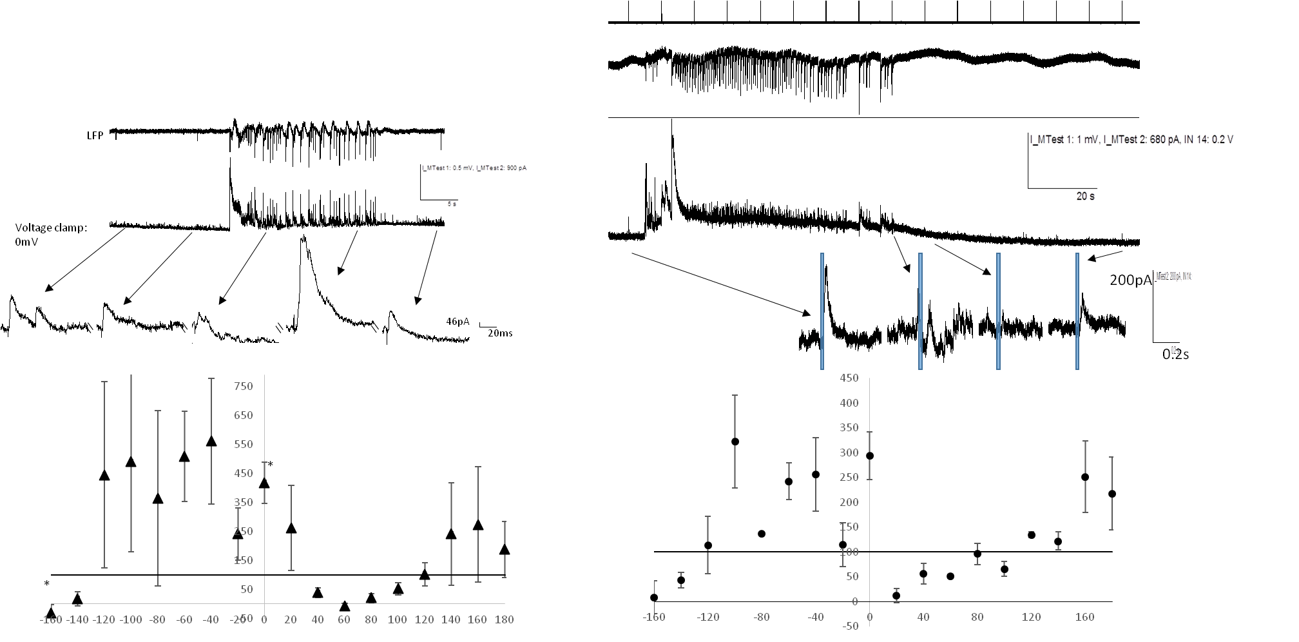
Deep layer Evoked IPCSs measured in layer II/III pyramical neurons
Spontaneous IPCSs
A
LFP
B
initial IPSC burst
0.5mV
900pA
5s
1mV
680pA
Voltage clamp: 0mV
20s
//
//
//
//
46pA
20ms
0.2s
eIPSCs run rampant at seizure termination. A) Representative example of the spontaneous local field potential seizure like event and intracellular excitatory currents. The intracellular recordings are expanded from the top trace voltage clamp data. B) Average charge transfer energy calculated at each phase of the seizure. -180 degrees is seizure start, 0 is seizure end and 180 is the start of the next seizure. Normalized to pre-ictal values. * p<0.008 n = 6 eIPSCs.
C) Representative example of the spontaneous intracellular inhibitory currents. D) Charge transfer energy of the inhibitory currents normalized to pre-ictal evoked responses.

Slide 28
Seizure onset and offset factors:
Neocortical seizure onset is associated with increased glutamate and GABA release.
Seizure termination is associated with depressed glutamate release which is adenosine-mediated, increased evoked and spontaneous GABA release, decreased neuronal excitability, increased postsynaptic conductance (from many potential sources), increased K+, decreased Ca++, cell swelling, increased presynaptic metabotropic glutamatergic activation, etc…..

