Slide 1
New Intracranial EEG Markers: High Frequency Oscillations, Very Slow Activity
Jean Gotman, PhD
Montreal Neurological Institute
McGill University

Slide 2
Disclosures Jean Gotman
Member of the Scientific Advisory Board of Precisis Inc.
No commercial support for this presentation

Slide 3
Outline
HFOs: definitions and recording
HFOs at seizure onset and interictally
HFOs and sleep
HFOs and surgery
DC shifts at seizure onset
DC shifts and HFOs at seizure onset

Slide 4
Definition and Context
The standard EEG, recorded from the scalp or intracranially, includes activities between 0.5 and 70 Hz. Filters are used to eliminate activities above 70 Hz (mostly EMG from scalp muscles) and below 0.5Hz.
High Frequencies
High Frequency Oscillations (HFOs) are short oscillations, lasting 10 to 100 ms, recorded in the intracranial EEG of patients and experimental animals in the range of 80 to 600 Hz. They are typically of very low amplitude (a few microvolts).
Requires filter at 500 to 700 Hz and sampling at 2000 Hz or more.
Low frequencies
DC shifts are variations in the EEG baseline. They theoretically require DC amplifiers but can be recorded if the amplifier has a very low frequency high pass filter rather than the usual 0.5Hz
Filters at approximately 0.01Hz have been used

Slide 5
Recording HFOs
HFOs were originally recorded with microelectrodes, first in experimental animals and then in humans. Microelectrodes have a diameter of 10 to 40 microns.
It was thought that the size of the HFO generators, approximately 100 or 200 microns, was too small to allow recording with clinical macroelectrodes, which have a diameter of 1 to 4 mm.
It was found, however, that it is possible to record HFOs with intracerebral clinical electrodes (Jirsch et al, 2006).

Slide 6
Subdural electrode
D=2.5mm; S=5mm²
HFO generator: 100 to 200μm
Experimental microelectrode (5μm)
Human microelectrode (40μm)

Slide 7
Marking HFOs
80 Hz high-pass
80 Hz 250 Hz
1 uV/mm
10 sec/page
0.8 sec/page
Ripple Fast ripple

Slide 8
HFOs often occur at the same time as spikes
Can result from filtering of a fast transient
Notes:
figure2

Slide 9
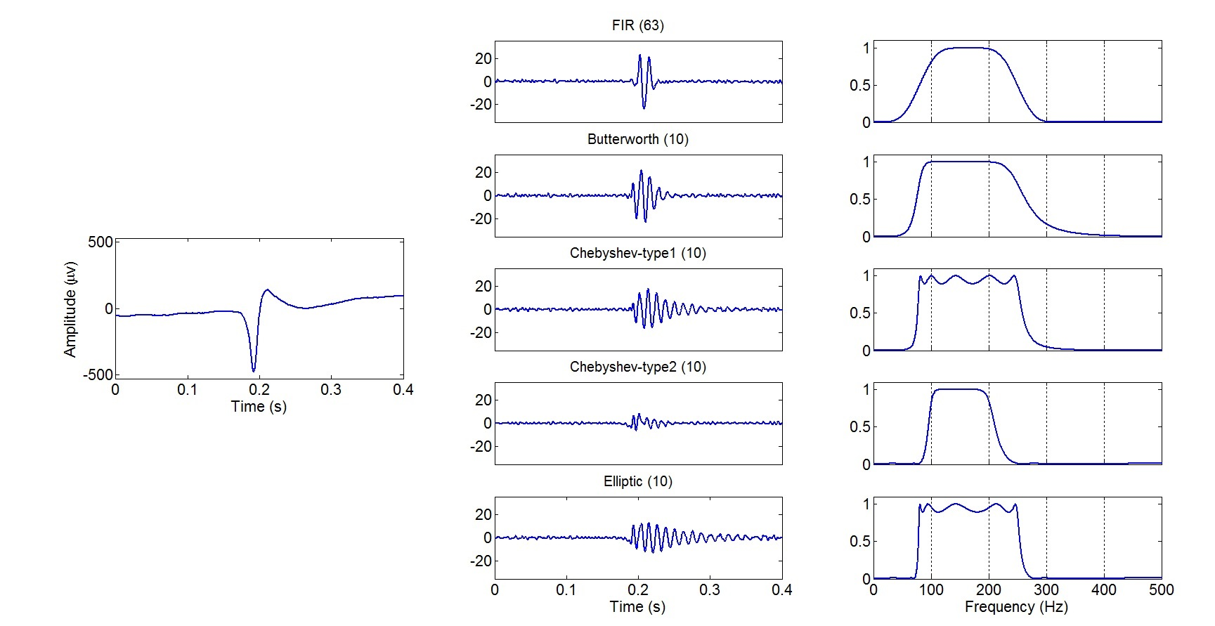
Different Types of Filter Filtering a sharp transient results in “false” oscillations; some filters are worse than others
FIR filter is highly recommended
Sharp transient without any HFO

Slide 10
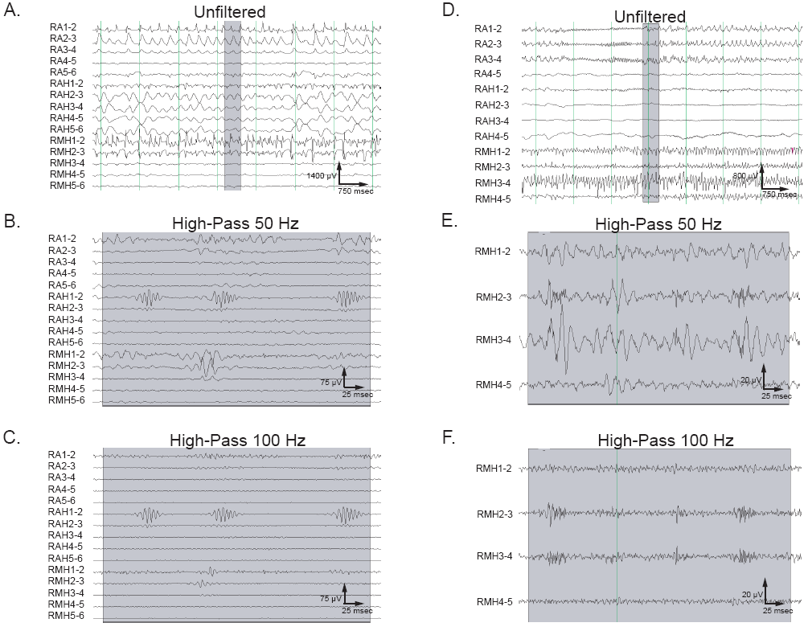
HFOs at seizure onset: in a subset of the seizure onset zone
160-210 Hz
285-375 Hz
Jirsch et al, 2006, Brain
Notes:
Figure 3. Discrete high frequency oscillations are identified in the EEG through visual inspection of the digitally filtered signal. A) Unfiltered ictal EEG at standard time-scale (patient 4). Highlighted sample for further visual analysis in B and C. Ictal EEG is shown at an expanded time-scale and increased vertical gain with high-pass filtering at 50 Hz and 100 Hz in B and C. A brief 160-210 Hz (HF band) segmental oscillation is well-visualized in the RAH1-2 channel at both filter settings. D) Unfiltered ictal EEG at standard time-scale (patient 1). A highlighted sample is shown at increased vertical and horizontal gain in parts E and F with filtering. A discrete 285-375 Hz (VHF band) segmental oscillation is clearly visualized in RMH2-3 and to a lesser extent RMH3-4 at both filter settings.

Slide 11
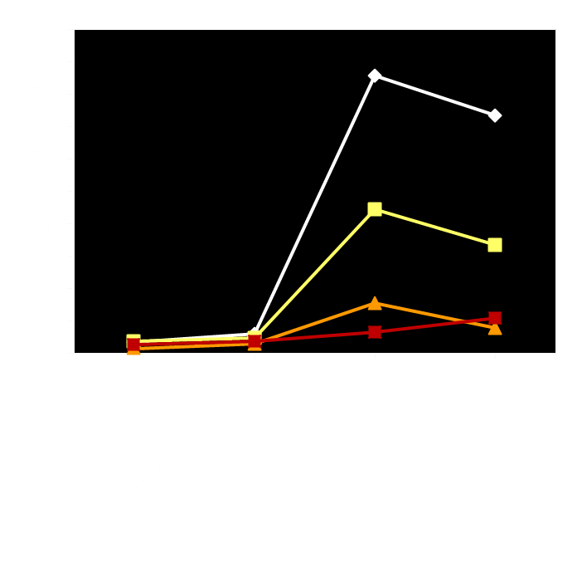
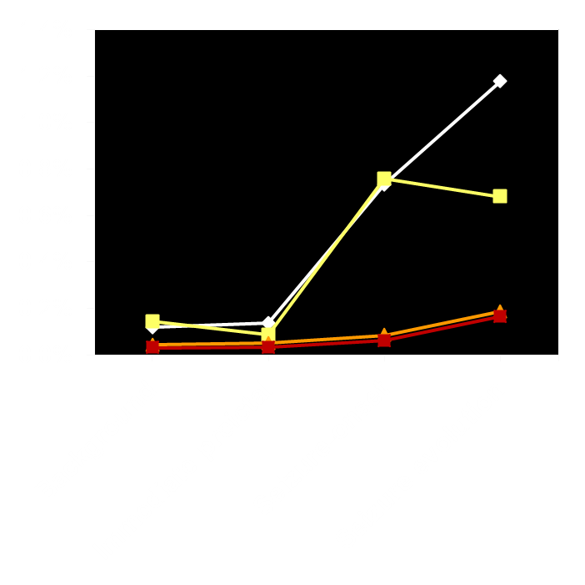
Ictal HFOs correlate with SOZ, not with presence of pathology
Ripples
Fast ripples
*
*
Rate / min
Rate / min
**
**
Inside the lesion and the SOZ
Inside the SOZ only
Outside the lesion and the SOZ
Inside the lesion only
**p<0.001; *p<0.05
Perucca et al, PloS One, 2013

Slide 12
Interictal HFOs
Right mesial temporal seizure onset, right MT spike: HFO
Right mesial temporal seizure onset, left MT spike: no HFO
Notes:
Patient mit SOZ im rechten HC (Hilliard)
12

Slide 13
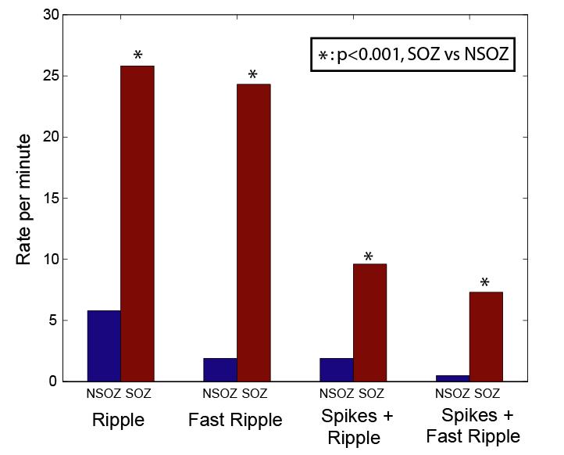
Interictal HFOs and the Seizure Onset Zone
Jacobs et al, Epilepsia, 2008

Slide 14
Outline
HFOs: definitions and recording
HFOs at seizure onset and interictally
HFOs and sleep
HFOs and surgery
DC shifts at seizure onset
DC shifts and HFOs at seizure onset

Slide 15
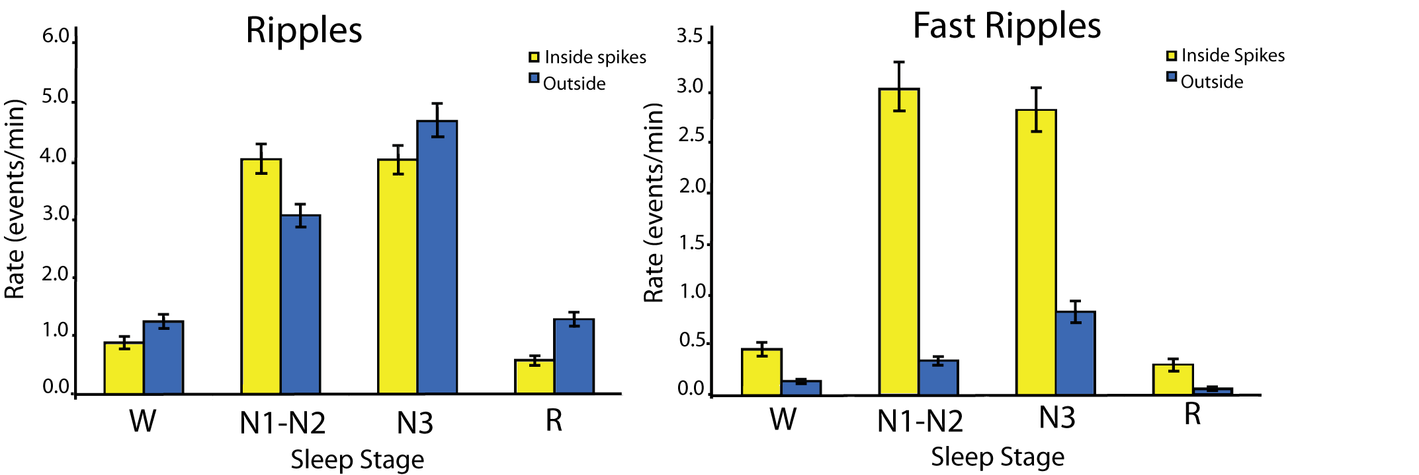
Effect of Sleep Stages on HFO Rates in Human Mesial Temporal Lobe Structures
Bagshaw et al. Epilepsia 2009

Slide 16
Are spikes and HFOs facilitated by specific events during Slow Wave Sleep?
Quantification of spike and HFO occurrence in SEEG during stages N2/N3, during two types of events (defined in scalp EEG) :
1. Large amplitude widespread slow waves
2. “Non slow waves”, i.e. small slow waves or absence of slow waves (but still during slow wave sleep)
Same total duration of large slow waves and of non slow waves.
If the state of slow wave sleep activates spikes and HFOs, we should find an equal number of spikes and HFOs during large slow waves and non slow waves.

Slide 17
Epileptic Discharges are Activated by
Slow Waves rather than by Slow Wave Sleep
442 epileptic spikes
8487 high frequency oscillations (HFOs)
Epileptic spikes
HFOs
P ≈ 0
P ≈ 0
21%
21%
35%
79%
65%
79%
during slow waves
during slow waves
during “non slow waves”
during “non slow waves”

Slide 18
Outline
HFOs: definitions and recording
HFOs at seizure onset and interictally
HFOs and sleep
HFOs and surgery
DC shifts at seizure onset
DC shifts and HFOs at seizure onset

Slide 19
Are HFOs useful in defining the region to resect?
20 patients operated independently of HFO results
Determined with post-op MRI which electrode contacts were in the region subsequently removed
Measured the proportion of channels with HFOs that were in removed regions.

Slide 20
Removing the HFO generating regions: surgical follow up Jacobs et al, Annals of Neurology, 2010
Good results in 8 patients: in 7, most regions generating ripples AND regions generating fast ripples were removed
Poor results in 12 patients: in 11, either the region generating most ripples OR the region generating most fast ripples was not removed

Slide 21
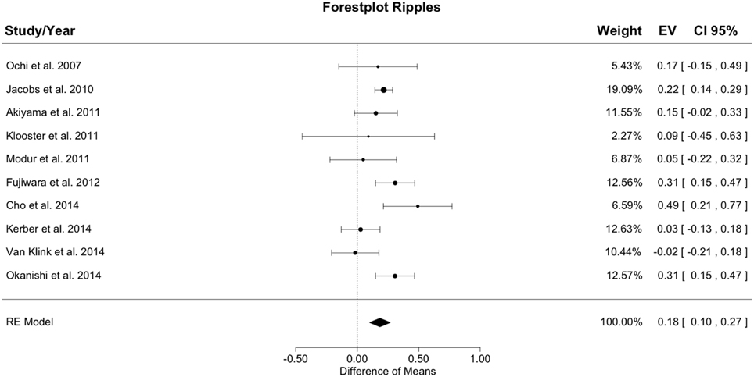
Patients with higher ripple resection ratio are more likely to have a good surgical outcome
Difference in mean resection ratio between good and bad outcome
Höller et al, Front Hum Neurosci, 2015

Slide 22
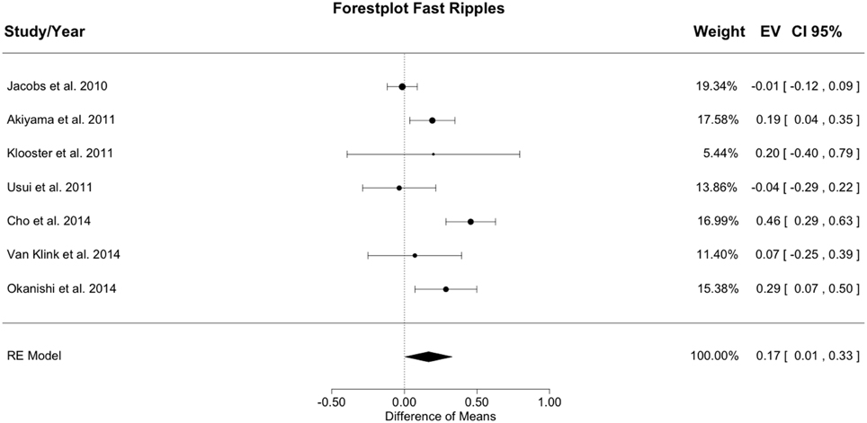
Patients with higher fast ripple resection ratio are more likely to have a good surgical outcome
Difference in mean resection ratio between good and bad outcome
Höller et al, Front Hum Neurosci, 2015

Slide 23
Outline
HFOs: definitions and recording
HFOs at seizure onset and interictally
HFOs and sleep
HFOs and surgery
DC shifts at seizure onset
DC shifts and HFOs at seizure onset

Slide 24
ELECTROENCEPHALOGRAPHY AND CLINICAL NEUROPHYSIOLOGY ₆₃
CHANGES IN DIRECT CURRENT ACTIVITY DURING EXPERIMENTAL FOCAL SEIZURES
ROBERT J. GUMNIT, M.D. AND TAKEO TAKAHASHI, M.D.
Department of Neurology .and Division of Electroencephalography and Neurophysiology ( Department of Psychiatry) State University of Iowa College of Medicine, Iowa City, Iowa and the Division of Neurology, University of Minnesota School of Medicine, Minneapolis, Minn. ( U.S.A.)
(Accepted for publication: December 14, 1964)

Slide 25
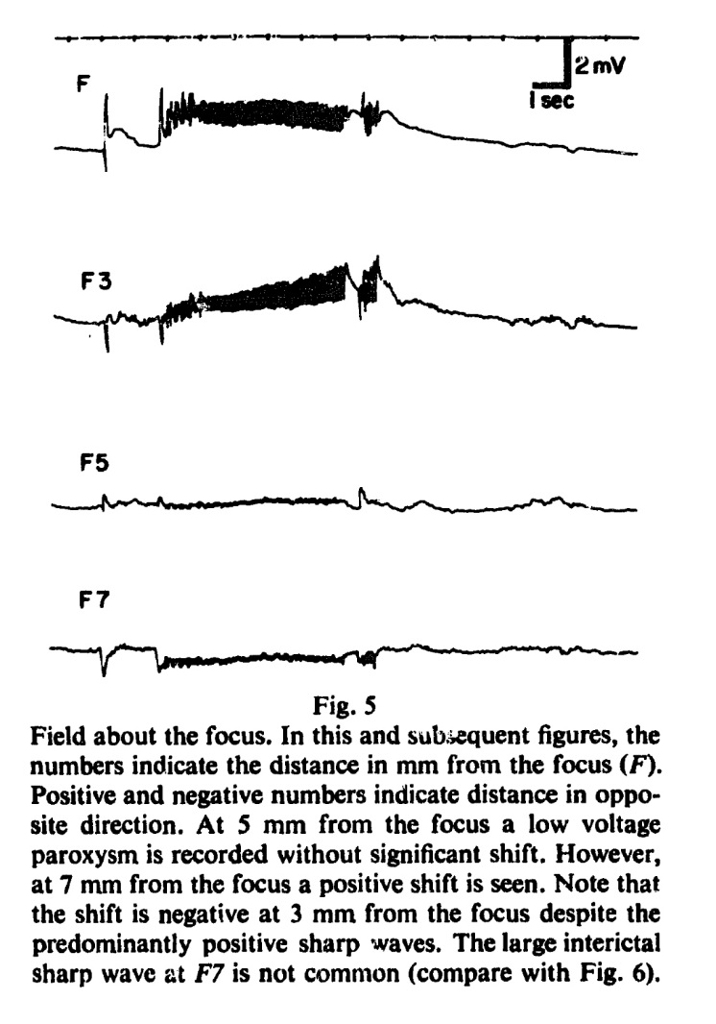
Focus
3 mm
5 mm
7 mm

Slide 26
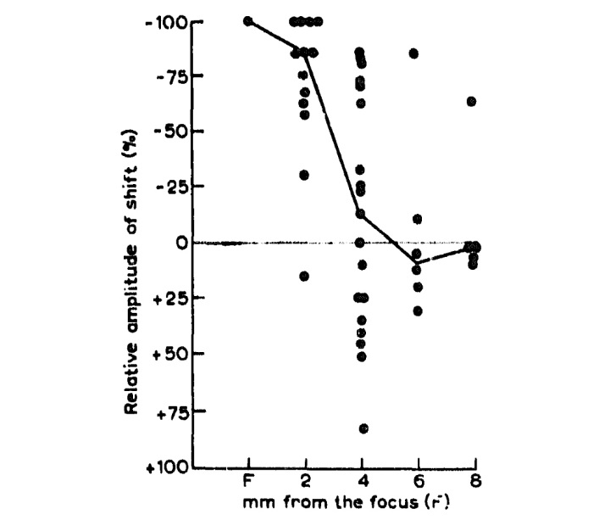

Slide 27
Subdural Recording of Ictal DC Shifts in Neocortical Seizures in Humans
Akio Ikeda, Kiyohito Terada, Nobuhiro Mikuni, Richard C. Burgess, Youssef Comair, Waro Taki, Toshiaki Hamano, Jun Kimura, Hans O.Luders, and Hiroshi Shibasaki
Departments of Brain Pathophysiology , Neurosurgery, and tNeurology , Kyoto University School of M edicine, Shogoin, Sakyo-ku, Kyoto, Japan; and Departments of :f:Neurology and §Neurosurgery , The Cleveland Clinic Foundation, Cleveland, Ohio, U.S .A.
Summary: Purpose: Invasive ictal EEG recording is often necessary to delineate epileptogenic areas in patients with intractable partial epilepsy, but even intracranial ictal re­ cordings often reveal ill-defined onset zones in neocortical epilepsy. We studied the physiologic significance of ictal direct current (DC) potentials recorded intracranially in human epilepsy.
Methods: We made intracranial ictal EEG recordings in three patients with intractable partial seizures arising from frontal, lateral temporal, and parietal neocortical areas by using closely spaced subdural electrodes (platinum in two patients and stainless steel in one patient) with both standard (1.5 Hz) and open (0.016 Hz) low-frequency filter (LFF) settings.
Results: The initial ictal pattern was localized to two to nine subdural electrodes and characterized by very low voltage and high-frequency rhythmic activity ("electrodecremental pattern"). A slow-rising negative potential (DC potential) was seen in a slightly more restricted area (two to six electrodes) and occurred 1-10 s before the initial ictal EEG discharges in two patients.
Conclusions: These results agree with those of previous studies of ictal DC shifts in animals and suggest that ictal DC shifts may be helpful in delineating the epileptogenic area more precisely in human epilepsy.
Epilepsia 1996;32:662-674

Slide 28
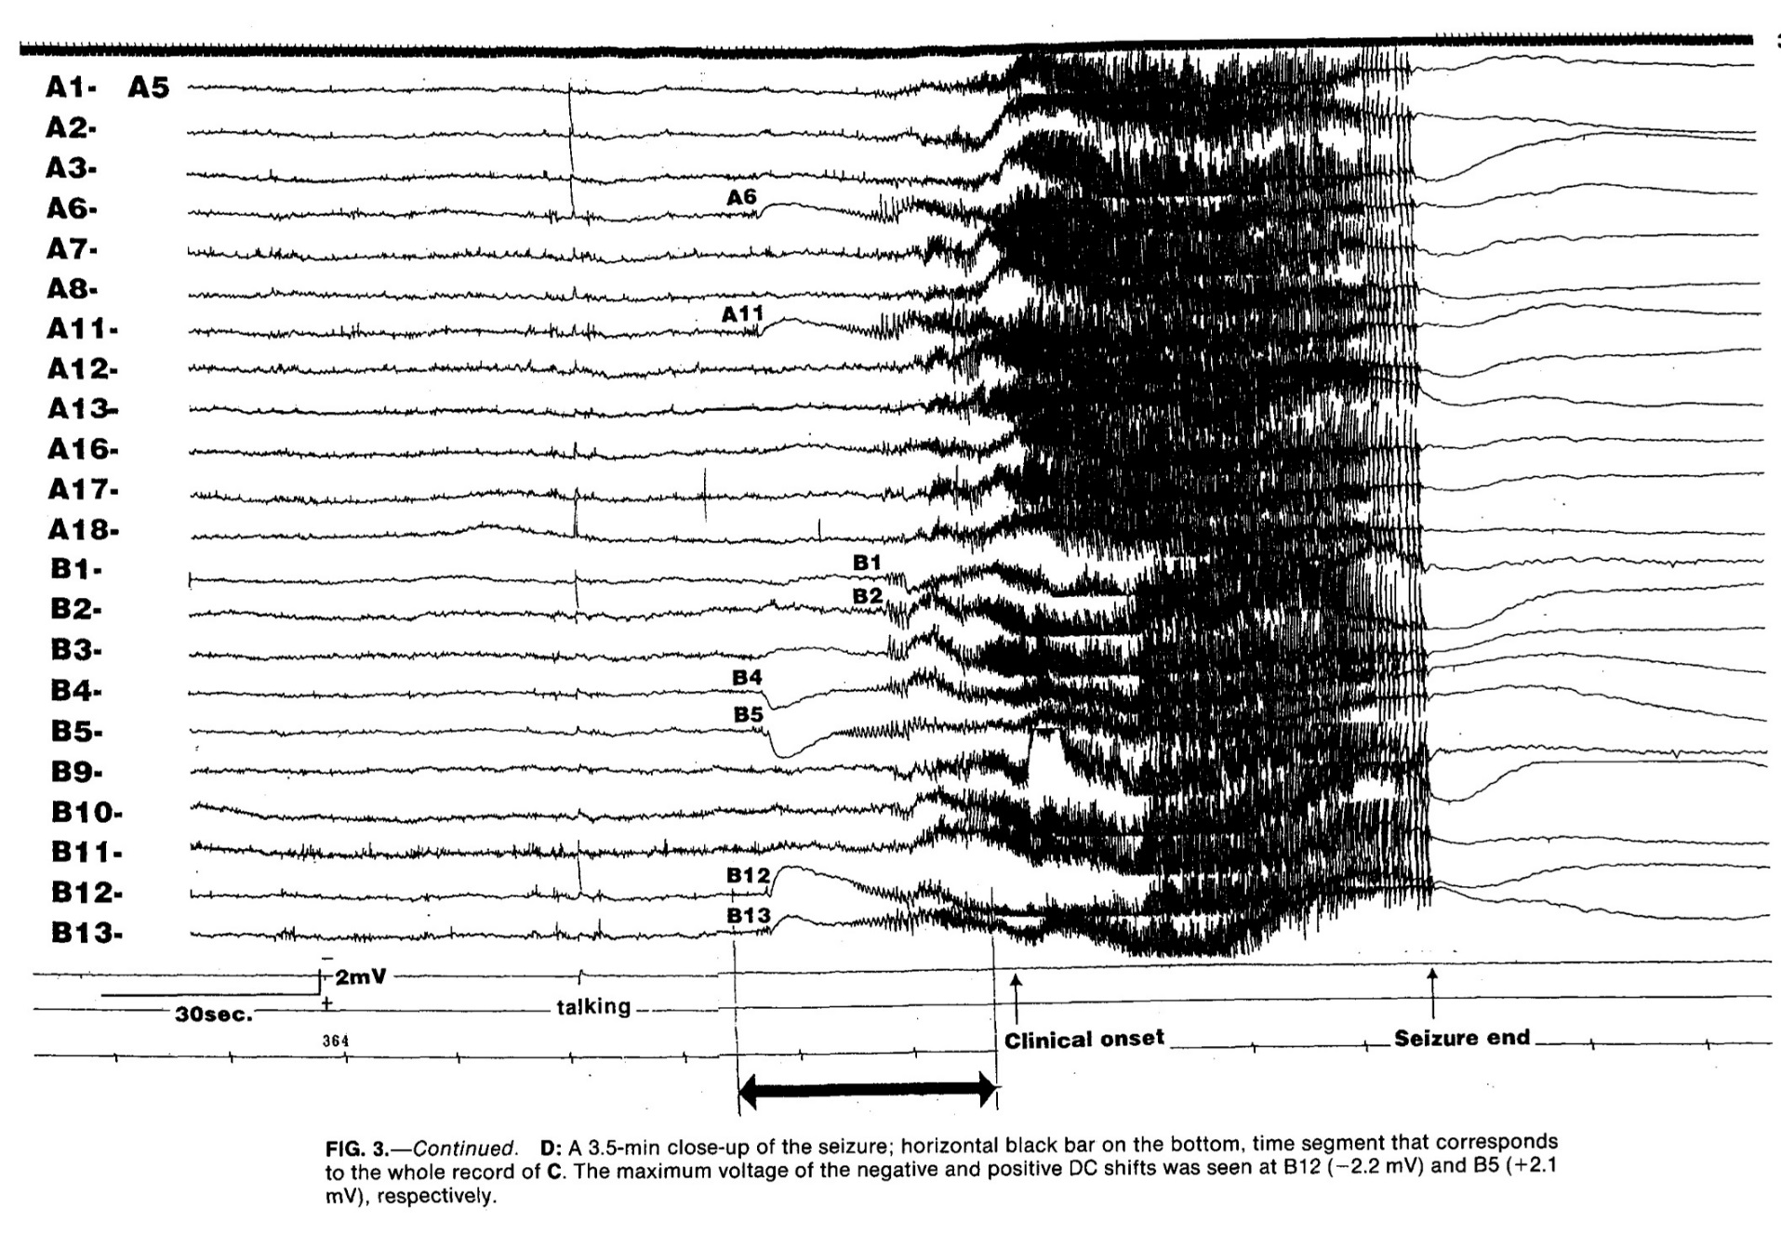

Slide 29
Very slow EEG responses lateralize
temporal lobe seizures
An evaluation of non-invasive DC-EEG
S. Vanhatalo, MD, PhD; M.D. Holmes, MD; P. Tallgren, MSc; J. Voipio, PhD; K. Kaila, PhD; and
J.W. Miller, MD, PhD
Abstract—Background: This study tested the idea that very slow EEG responses (direct current [DC] potential shifts) could be detected noninvasively during temporal lobe (TL) seizures, and that these shifts give lateralizing information consistent with that obtained by other methods. Methods: Seven patients with TL epilepsy (TLE) were recorded with scalp DC-EEG technique at bedside. All recordings were performed simultaneously with conventional EEG (scalp in five, and intracranially in two; two patients with scalp recordings were recorded intracranially later). Seizures in five patients originated in the mesial TL. Ictal DC shifts were evaluated by comparing them to the temporal evolution of ictal discharges, and by comparing the laterality of these shifts to the side of seizure onset defined by routine EEG and other presurgical diagnostic tests. Results: All seizures (35/35) were associated with negative DC shifts at temporal derivations (30 to 150 µV relative to vertex), beginning at the electrical seizure onset, and lasting for the whole seizure. In eight seizures (five patients) with documented mesial TL onset, the polarity of the DC shift was initially positive followed by a negative one after lateral spread of seizure activity. In all cases, the side of the EEG shift agreed with other diagnostic tests, and, at times, was more clearly lateralized than the conventional scalp EEG. Conclusions: DC-EEG recordings are practical and achievable at the bedside. Ictal DC shifts are consistently observed in scalp recordings in TL seizures, and reliably lateralize them. This method may hold promise in reducing the need for invasive monitoring in patients with TLE where other noninvasive tests are equivocal.
Neurology 2003;60:1098 –1104

Slide 30
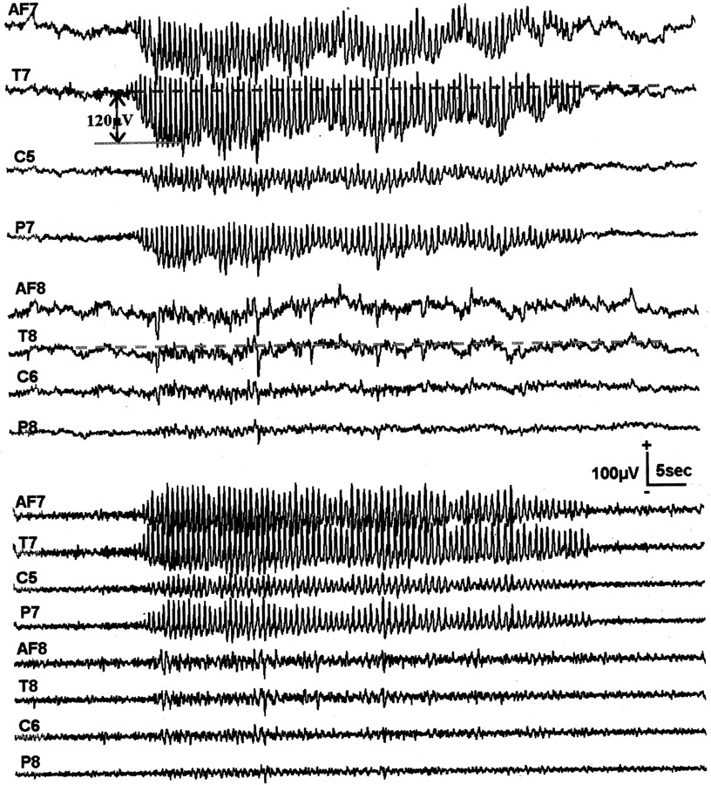
Unilateral direct current (DC) shift during a subclinical partial seizure on the left side (Patient 1).
Filter
0.016Hz
Vanhatalo et al. Neurology 2003;60:1098-1104
Notes:
Figure 1. Unilateral direct current (DC) shift during a subclinical partial seizure on the left side (Patient 1). Traces above show the seizure with DC-EEG recording (no high pass filter), and the traces below show the same EEG with a conventional high pass filter (0.5 Hz). Note the rapid and prominent DC shift on the side of seizure. The amplitude of the DC shift is seemingly higher in the derivations with higher spiking activity (e.g., T7 vs C5). All derivations are referred to a linked Cz + Oz. Positivity is upwards in all figures.

Slide 31
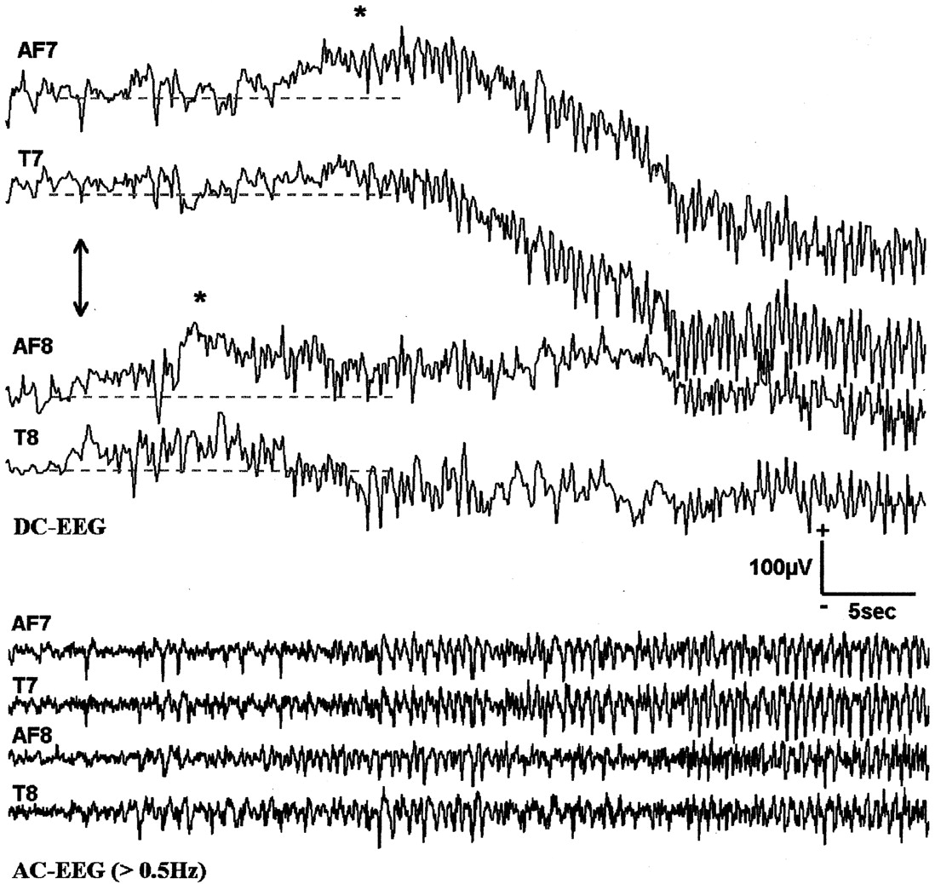
Complex partial seizure with subsequent bilateral spread after right side seizure onset (Patient 4)
Filter
0.016Hz
Vanhatalo et al. Neurology 2003;60:1098-1104
Notes:
Figure 2. Complex partial seizure with subsequent bilateral spread after right side seizure onset (Patient 4). Traces above show the seizure with direct current (DC)–EEG recording (no high pass filter), and the traces below show the same EEG with a conventional high pass filter (0.5 Hz). Seizure onset at scalp EEG is shown with an arrow. Note a positive DC shift (asterisk) first at right side, followed by a positive DC shift on the left side. Negative DC shift is observed only much later. Intracranial recording of this patient at a later time (not shown; see table 2) demonstrated a right mesial temporal lobe onset. Hence positive DC shifts likely reflect sequential (right followed by left) mesial temporal lobe activation. All derivations are referred to Pz.

Slide 32
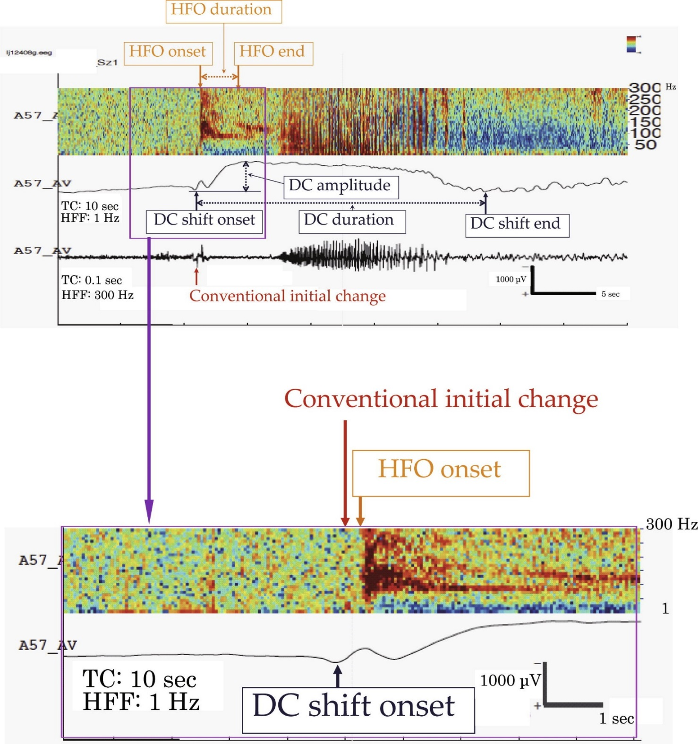
Intracranially recorded ictal direct current shifts may precede high
frequency oscillations in human epilepsy
Kyoko Kanazawa b, Riki Matsumoto a, Hisaji Imamura b, Masao Matsuhashi c, Takayuki Kikuchi d, Takeharu Kunieda d, Nobuhiro Mikuni e, Susumu Miyamoto d, Ryosuke Takahashi b, Akio Ikeda
Clinical Neurophysiology 126 (2015) 47–59

Slide 33
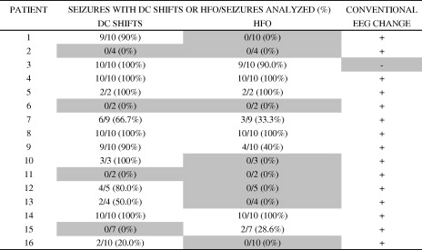

Slide 34
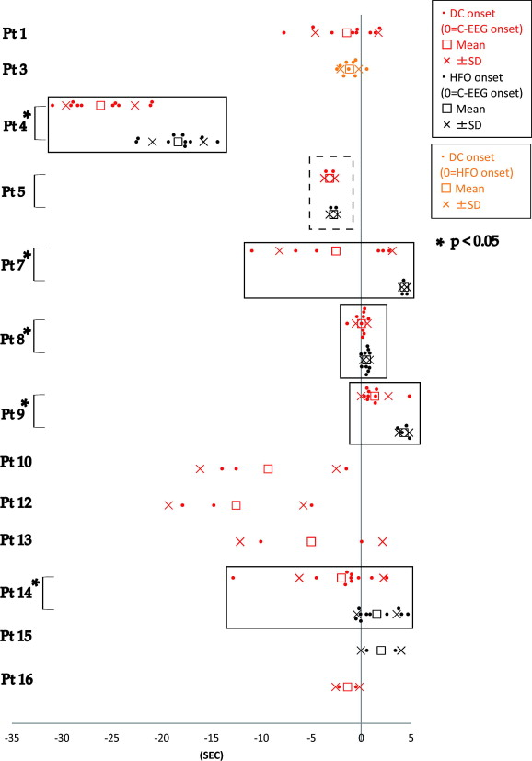
DC shift precedes
HFOs at seizure onset
Kanazawa et al,
Clinical Neurophysiology 126 (2015) 47–59

Slide 35
Index combining measures of:
Flattening at onset
Slow polarizing shift
Activity in the 95 to 105 Hz band
Gnatkowsky et al, Epilepsia, 2014

Slide 36
Collaborators
Jeff Jirsch, MD
Elena Urrestarazu, MD, PhD
Rina Zelmann, PhD
Julia Jacobs, MD
Maeike Zijlmans, MD, PhD
Claude-Edouard Châtillon, MD
Francesco Mari, MD
Luciana Andrade-Valenca, MD, PhD
Piero Perucca, MD
Federico Melani, MD
Birgit Frauscher, MD
Nicolas von Ellenrieder, PhD
Nicole Drouin, REEGT, Telemetry technologist
Lorraine Allard, REEGT, Telemetry technologist
Natalja Zazubovits, MSc, Research Assistant
André Olivier MD, PhD, Neurosurgeon
Jeffery Hall, MD, Neurosurgeon
François Dubeau, MD
FUNDING
Canadian Institutes of Health Research
Savoy Foundation for Epilepsy

Slide 37
The End

Slide 38
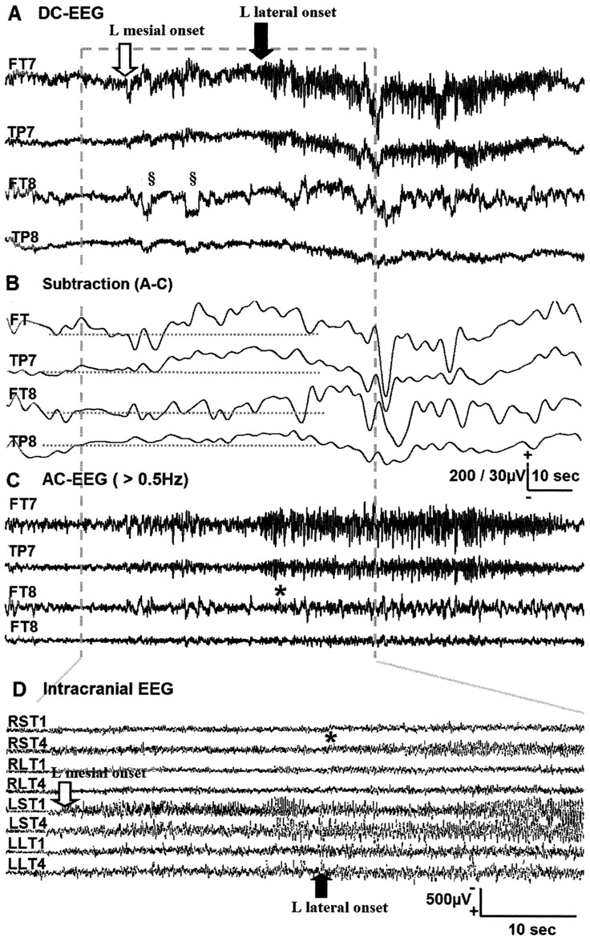
Comparison of direct current (DC)–EEG recordings (A–C) to an intracranial recording with subdural strip electrodes (D) during a complex partial seizure with left mesial temporal lobe (TL) onset (Patient 6).
Filter
0.016Hz
Vanhatalo et al. Neurology 2003;60:1098-1104
Notes:
Figure 3. Comparison of direct current (DC)–EEG recordings (A–C) to an intracranial recording with subdural strip electrodes (D) during a complex partial seizure with left mesial temporal lobe (TL) onset (Patient 6). A through C are all in the same time scale (amplitude bar 200 μV for A and C, 30 μV for B). Traces in A show the seizure with DC-EEG recording. Traces in B show the slow component (subtraction of a high pass [as in C] signal from the DC-EEG) of the same EEG signal. Traces in C demonstrate the same EEG with conventional settings (i.e., high pass filtered at 0.5 Hz). Traces in the bottom (D) are selected channels from an intracranial recording, which has been stretched slightly to better illustrate the changes in fast activity. Seizure onset (mesial) and spread (to lateral) in the intracranial EEG are shown with respective arrows, and seizure spread to right mesial TL is shown with an asterisk. Note the prominent positive DC shift in the left temporal derivations after mesial TL activation, and the negative DC shift later after neocortical spread. All derivations in DC-EEG are referred to a linked Cz + Pz, whereas traces in the intracranial recording are referred to a scalp electrode at vertex. Lateral eye movement artifacts before the seizure (marked with § in trace A) have been removed offline in trace B before A − C subtraction in order to improve the visual clarity of the later occurring DC shift. RST = right mesial TL; RLT = right lateral temporal lobe; LST = left mesial TL; LLT = left lateral temporal lobe.

Slide 39
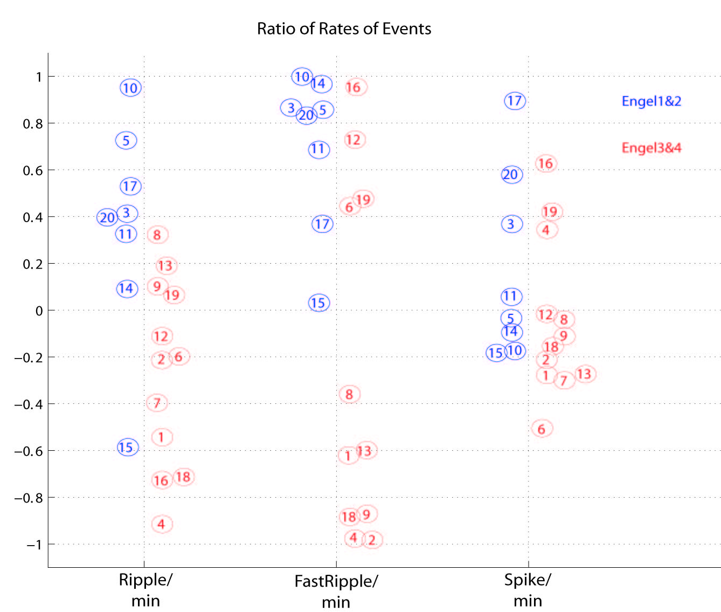
Removing the HFO generating regions: surgical follow up Jacobs et al, Annals of Neurology, 2010
All channels with HFOs removed
No channel with HFOs removed

Slide 40
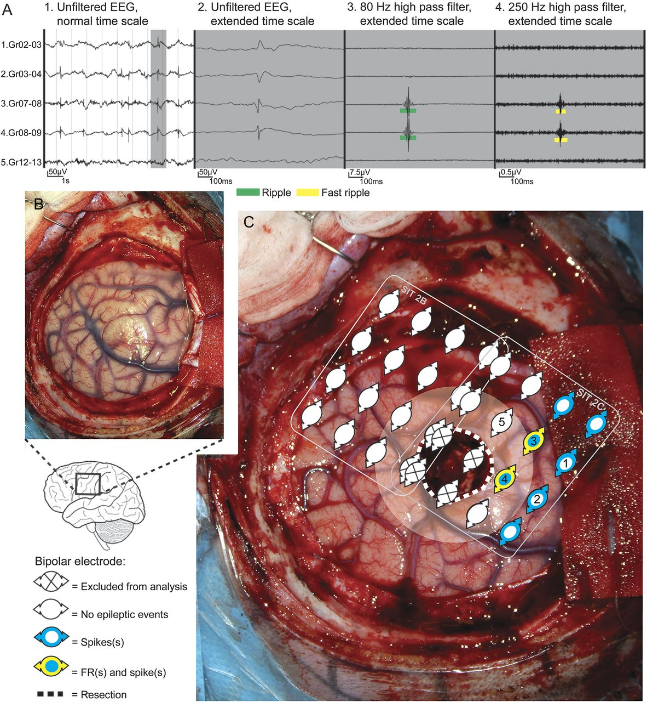
Residual fast ripples in the intraoperative corticogram predict epilepsy surgery outcome.
van
Patient with a left central lesion, with fast ripples in post-resection ECoG and recurrent seizures after surgery.
van 't Klooster et al, Neurology 2015
Notes:
Patient example Patient 26 with a left central lesion, with fast ripples (FRs) in post-electrocorticography (ECoG) and recurrent seizures (auras) after surgery. (A) Spike and high-frequency oscillation events in a selection of bipolar channels (indicated as 1–5 in part C). (B) Pre-resection photograph. (C) Post-ECoG. The resected area is delineated by a dotted white line. The area being near the resection (≤1 cm, resection margin) is marked transparent white. Two ECoG recordings post-resection were performed. We represent the location of the bipolar channels analyzed. Note that FRs (rate: 25/min/electrode) (yellow) were present in the margin of the resected lesion (dysembryoplastic neuroepithelial tumor), in a larger region with spikes (range rate: 4–41/min/electrode) (blue). Almost all electrodes showed ripples and are therefore not depicted. Based on the FRs present in the resection margin, a different surgical decision could have been made if FRs would not have been that close to eloquent central cortex. See also table 3 for details on patient characteristics and post-ECoG findings.

Slide 41
Using HFOs to Define the Resection: What are the Issues?
Assuming that HFOs are an accurate marker of the epileptogenic zone, what is « a channel with HFOs »?
HFOs are much more frequent in some pathologies than in others. Should there be a threshold of HFO rate for each pathology? What if the pathology is unknown?
Conservative « reverse » approach: can we use traditional criteria but also resect regions with highest HFO rates?
How to integrate information from HFOs with other information known to be important: lesion, seizure onset zone?

Slide 42
Conclusions
HFOs were first recorded in animals and in patients with microelectrodes
HFOs were then recorded in intracerebral EEG with “small” macroelectrodes
They have now been recorded by several centers with standard intracerebral electrodes
They appear most often in the region of seizure onset
They are more indicative of this region than spikes
They appear to reflect more the presence of epileptogenicity than of pathology
Unlike spikes, they fluctuate temporally like seizures.

Slide 43
Conclusions
HFOs appear to be a better indicator than spikes, and possibly than the seizure onset zone, of surgical outcome
Despite the size of the generator, some appear recordable from the scalp
►HFOs may become a useful biomarker of epileptogenicity (to mark the region to resect) and of epileptogenesis (i.e. to follow the development of epilepsy, to test the effectiveness of medication).

Slide 44
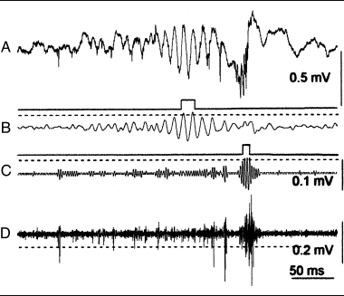
Unfiltered 20kHz
sampling
80-160 Hz Ripples
250-500 Hz
Fast ripples
600Hz-5 kHz
Action potentials
Bragin et al, Ann Neurol, 2002

Slide 45
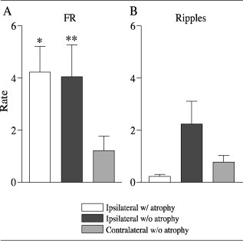
Fast Ripples are frequent ipsilateral to seizure onset and rare contralaterally
Ripples do not show this distinction
Staba et al. Annals of Neurology, 2004

Slide 46
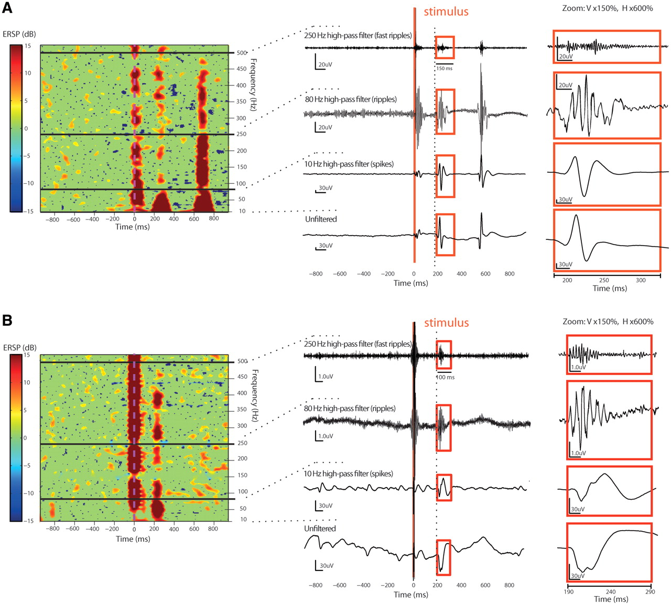
HFOs may be triggered by single pulse electrical stimulation and these HFOs are also a good marker of the epileptogenic zone
van 't Klooster et al., Brain, 2011
© The Author (2011). Published by Oxford University Press on behalf of the Guarantors of Brain. All rights reserved. For Permissions, please email: journals.permissions@oup.com
Notes:
Two examples (A and B) of the correspondence of the same single epoch between (left) a significant ERSP image as result of time–frequency SPES analysis and (centre) time domain electrocorticography data, high pass filtered (Stellate Harmonie FIR filter, order 63) for spike band (>10 Hz), ripple band (>80 Hz) and fast ripple band (>250 Hz), and the unfiltered signal (right) a close up of the evoked oscillations in each frequency band. The example in A (Patient 1) contains, at ∼200 ms, an evoked high amplitude spike (unfiltered 380 μV) with superimposed ripple (72 μV) and fast ripple (15 μV) and a second larger spontaneous spike with accompanying large ripple and fast ripple. Note that the second spontaneous spike shows relatively more ripple component compared with the evoked spike, a phenomenon that is described as a potential side effect of filtering (Urresterazu et al., 2007) in which false high-frequency oscillations show a significant ripple. The example in B (Patient 4) shows, at ∼200 ms, an evoked low-amplitude spike (unfiltered 80 μV) with superimposed ripple (4.3 μV) and fast ripple (1.3 μV). Both evoked spikes result in differentiated small blobs with significant fast ripple blobs in the ERSP, in the absence of large (elongated) blobs in the ripple band.

Slide 47
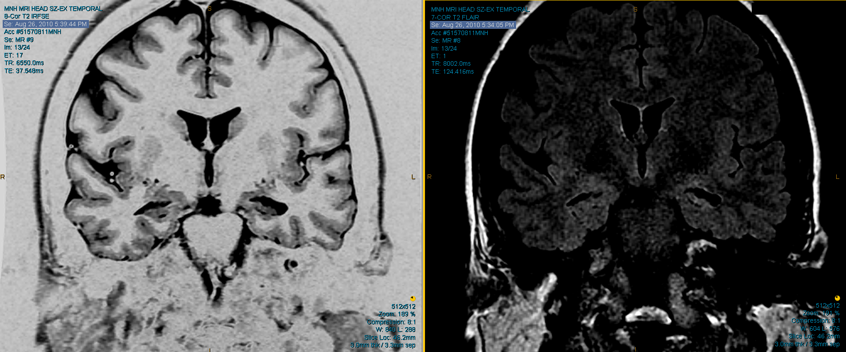
♀, 39 y/o
Bacterial meningitis at 4 months
Age at seizure onset: 4 y/o
MRI: Bilateral hippocampal atrophy

Slide 48
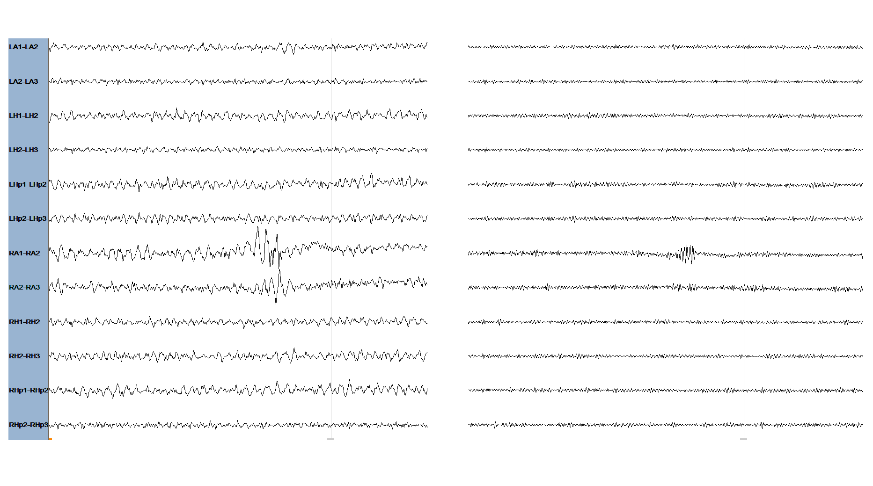
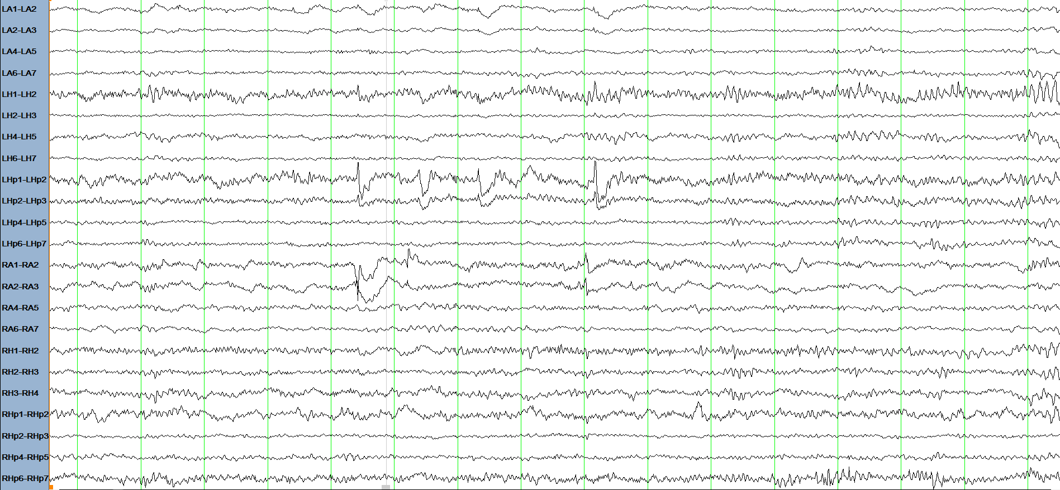
iEEG: Bitemporal spikes and unilateral HFOs
LF 80 Hz
LF 250 Hz
1.5 µV
50 ms
30 µV
1 s

Slide 49
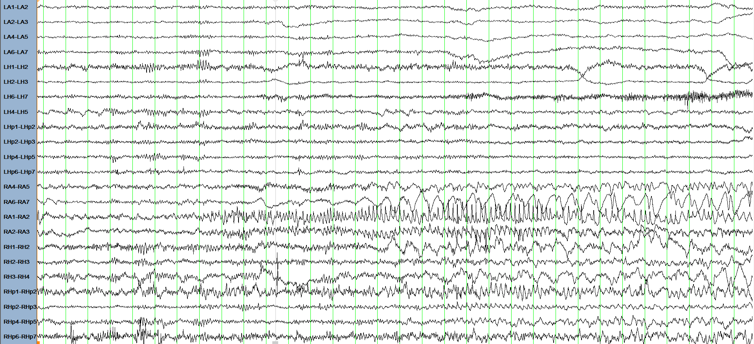
Seizure Onset Zone: Right Amygdala
30 µV
1 s

Slide 50
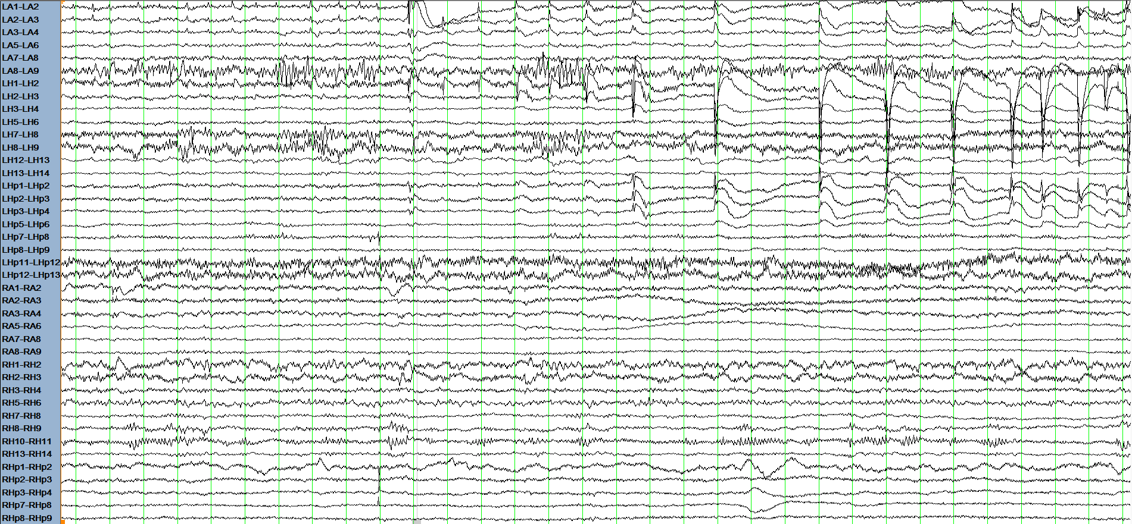
Seizure arising from left amygdala and hippocampus

Slide 51
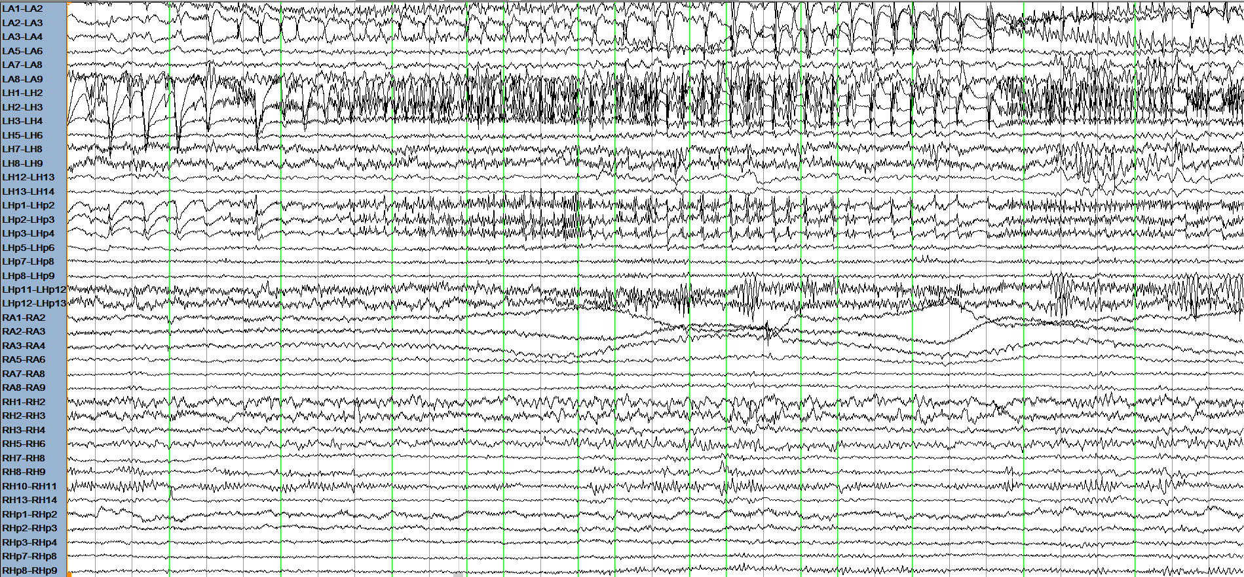

Slide 52
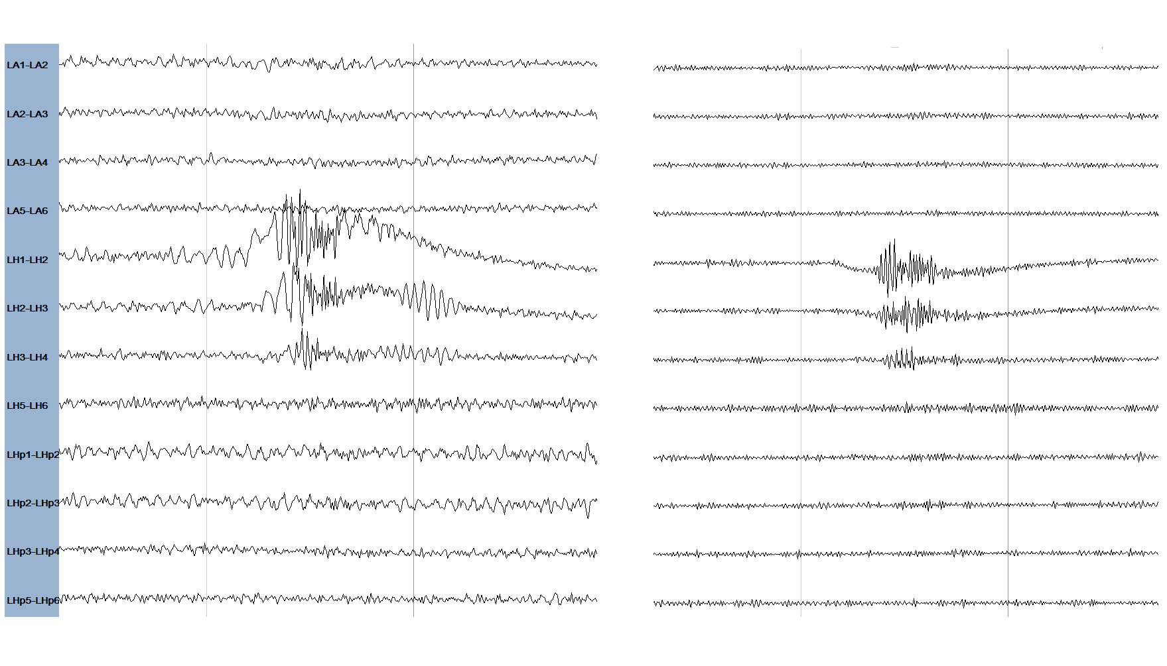
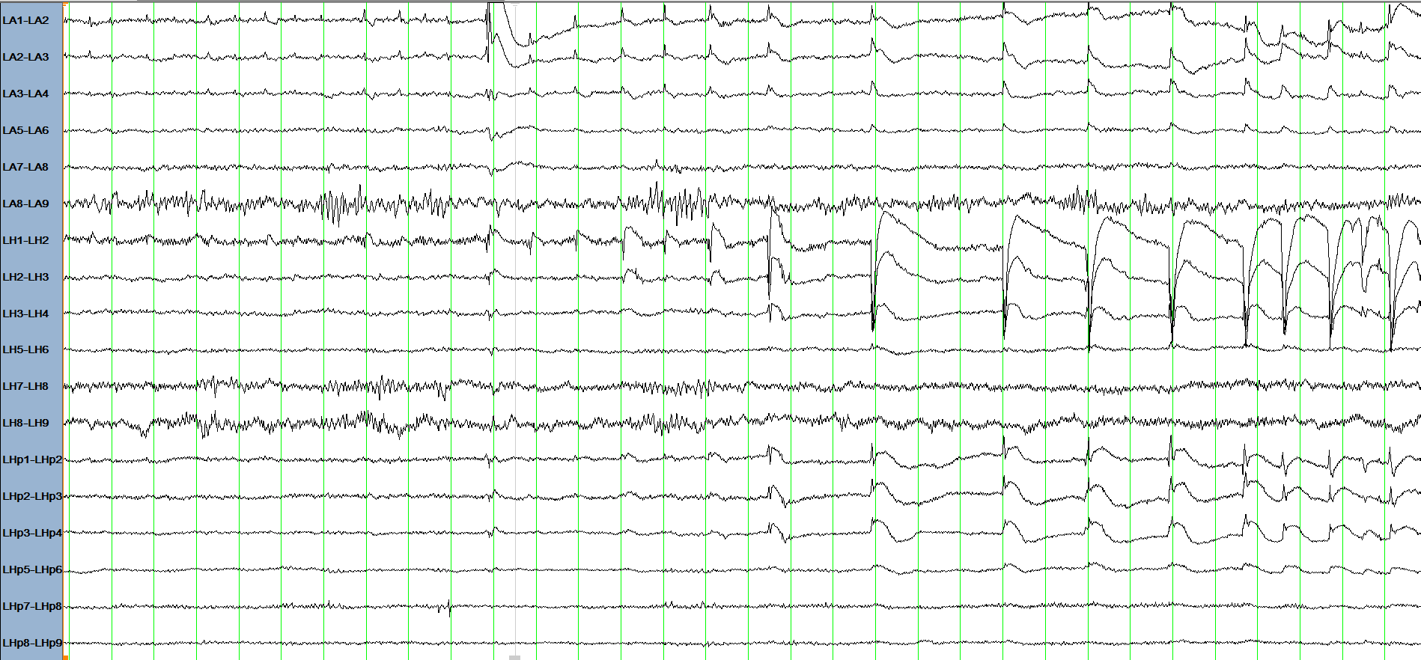
The ictal HFO-generating region is a subset of the SOZ
LF 80 Hz
LF 250 Hz
Am
Am
Hip
Hip
PHip
PHip
Ripples
1.5 µV
50 ms
Fast Ripples
30 µV
1 s

Slide 53
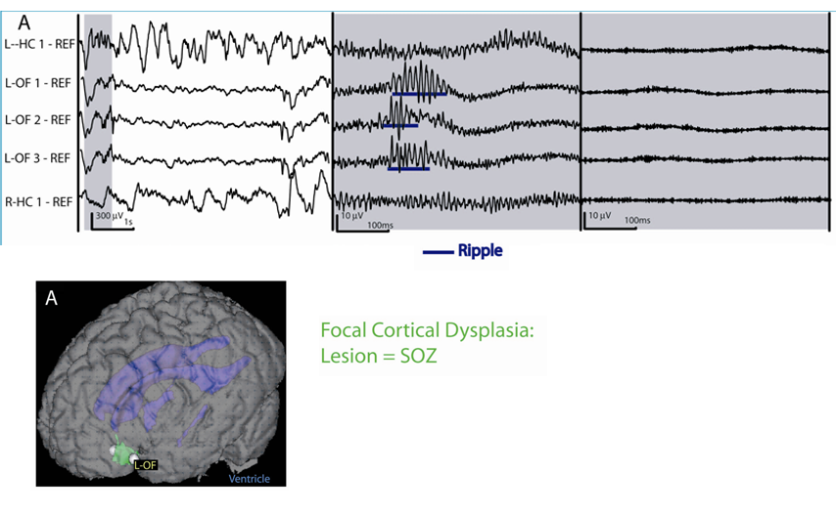
Focal Cortical Dysplasia
Focal Cortical Dysplasia:
Lesion = SOZ

Slide 54
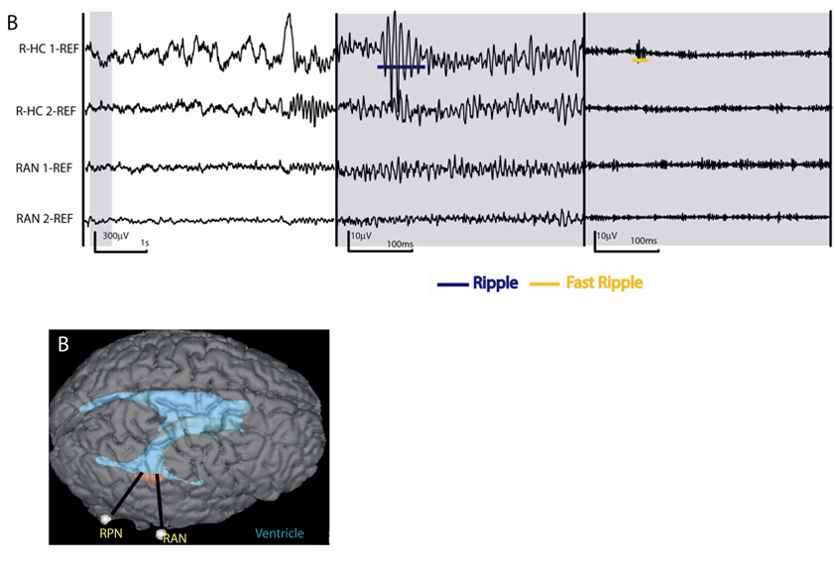
Heterotopic Nodule
Heterotopic Nodule:
Lesion = SOZ

Slide 55
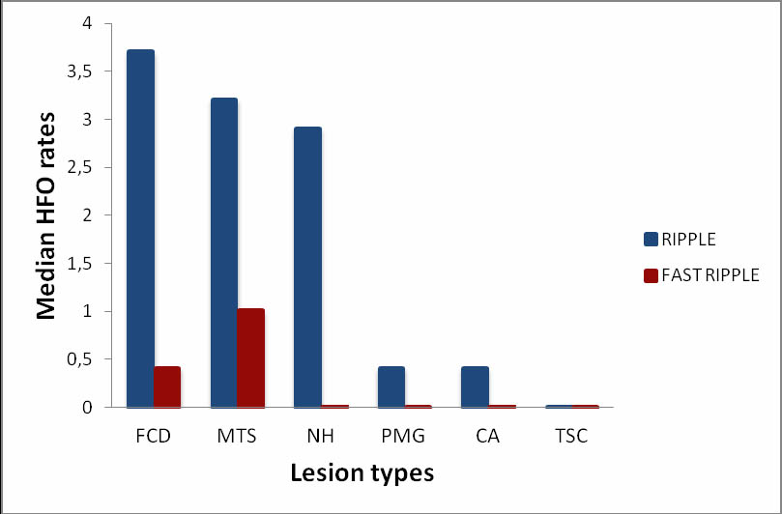
HFOs in Different Lesion Types
Ferrari-Marinho et al, Epilepsia, 2015

