Slide 1



When can interictal activity be a sufficient marker of the epileptogenic zone?
Looking Inside the Brain:
From Intracerebral EEG to Non-Invasive Methods
Richard Wennberg
CLAE meeting, Québec, October 2016

Slide 2


Faculty: Richard Wennberg
Relationships with commercial interests: None

Slide 3
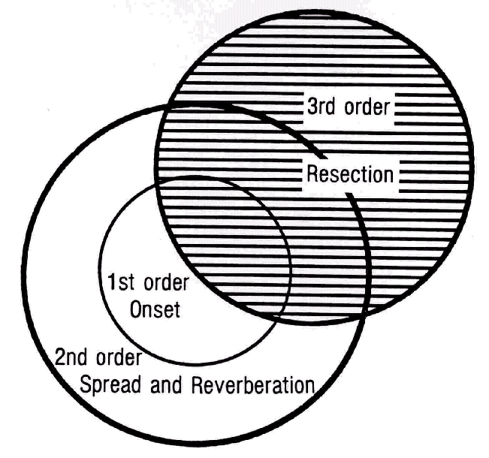
Rasmussen’s levels of localization
1st level; site of seizure onset; gray matter; may not be identical to MRI lesion
2nd level; critical mass of tissue needed for clinical seizure; more gray matter and fiber tracts
1st + 2nd = epileptogenic zone
Volume of surgical resection: success dependent on congruence with level 1 and 2

Slide 4
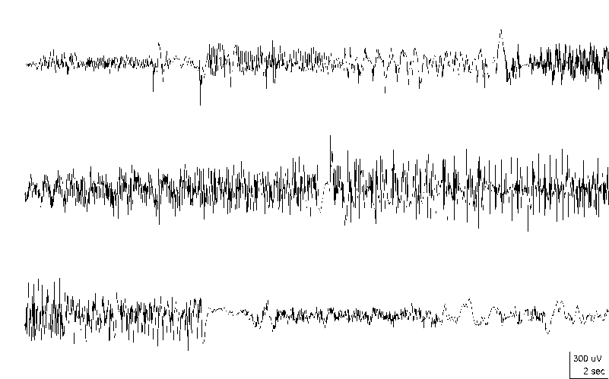
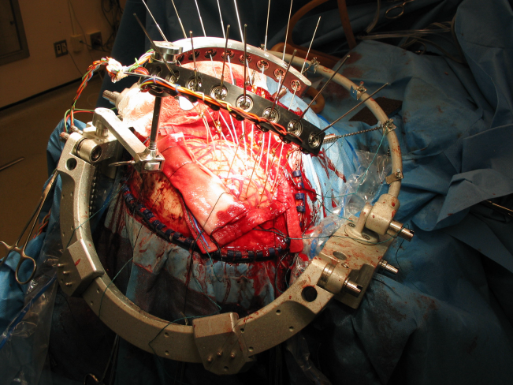
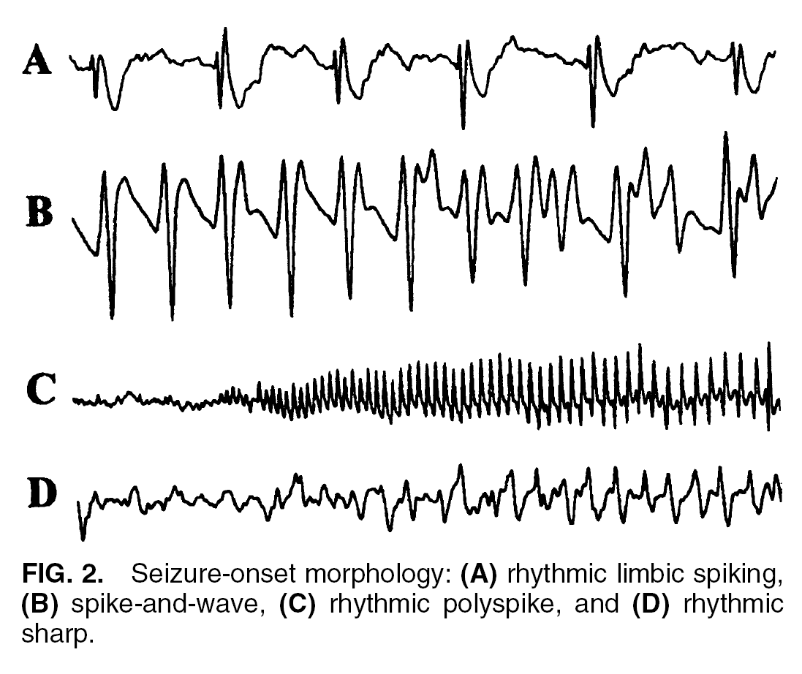
Intra-operative ECoG
ICEEG (depth electrode) ictal onsets ICEEG (depth contact) hippocampal seizure
“[An] important reason for the decreased enthusiasm for intra-operative use of ECoG was the dramatic increase in popularity and widespread utilization of invasive techniques in the pre-operative work-up of medically refractory epileptic patients.”
“In general, one must depend exclusively on interictal phenomena for identification and outline of the epileptogenic process during ECoG. For reasons which are not entirely convincing, a tendency has developed to minimize the localizing significance of the latter changes and hence of the entire procedure itself.”
      C. Ajmone-Marsan, in Electrocorticography: Current Trends and Future Perspectives, 1998

Slide 5
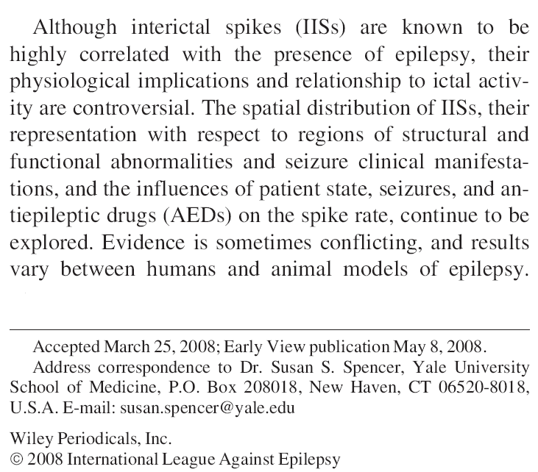
The interictal spike
Spencer et al., Epilepsia, 2008

Slide 6
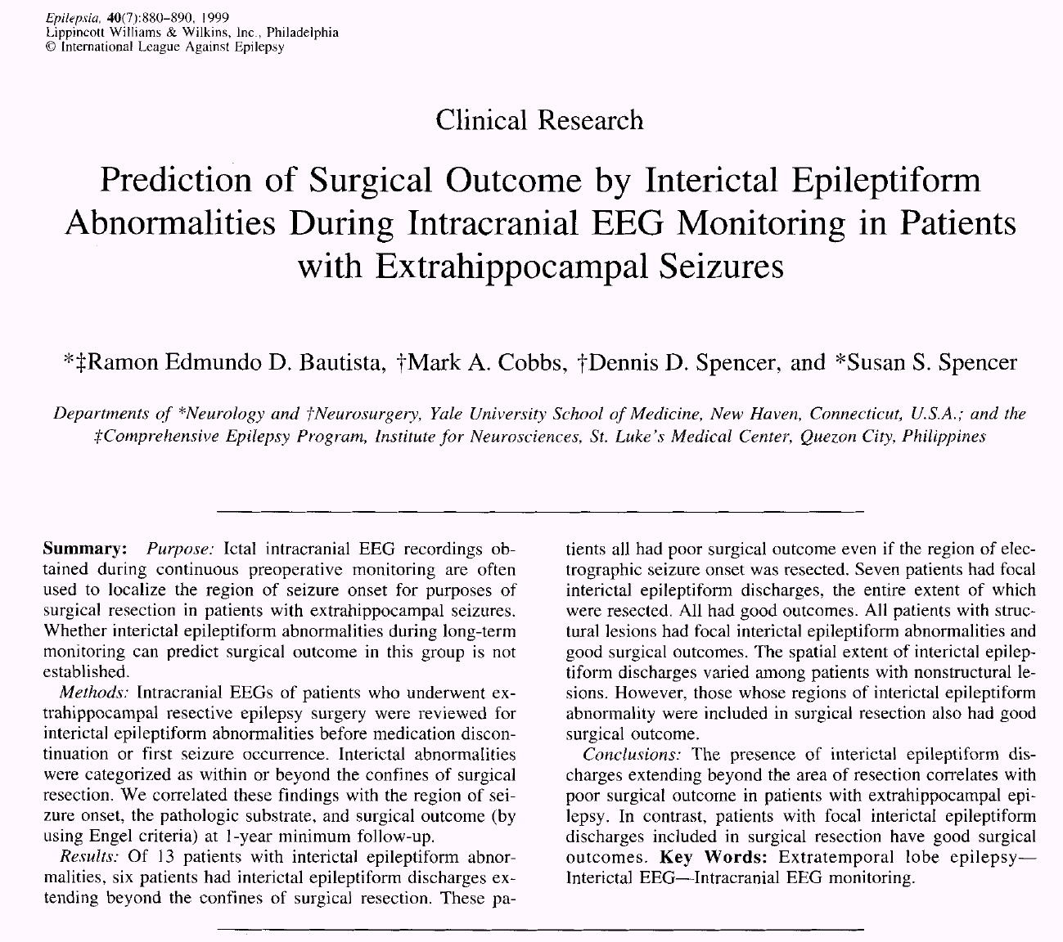
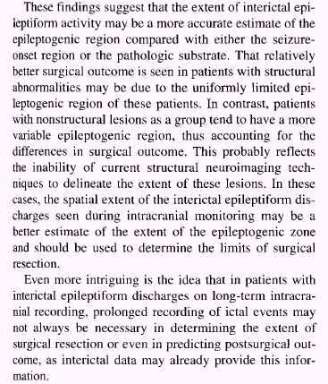

Slide 7
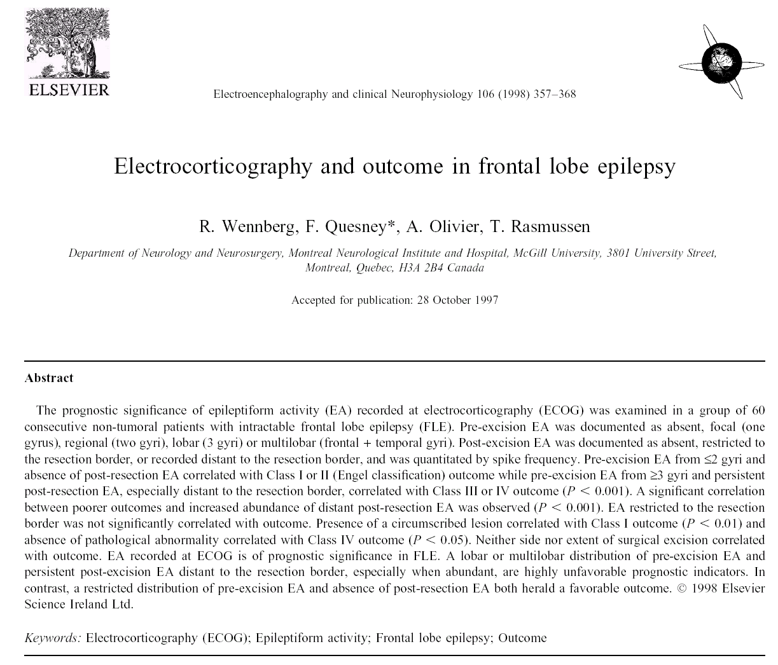
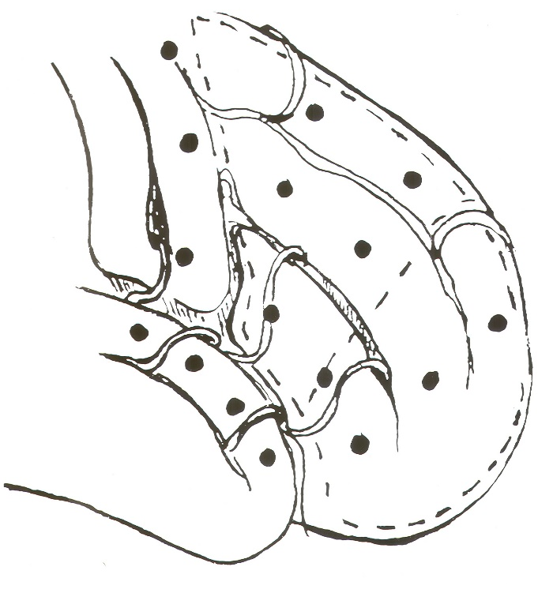
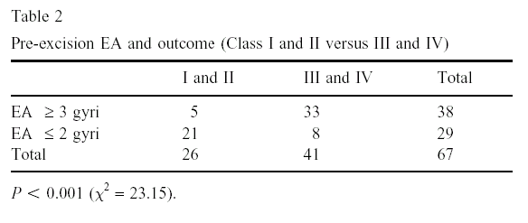
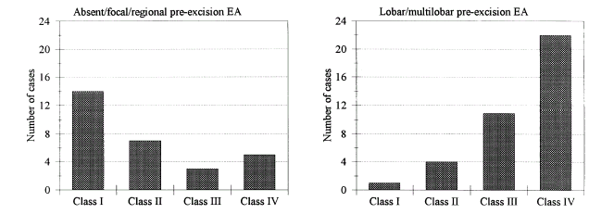
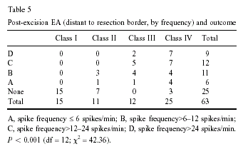

Slide 8
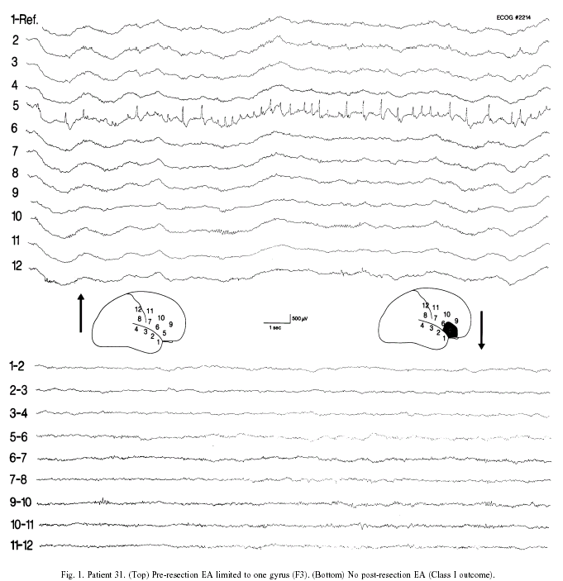

Slide 9
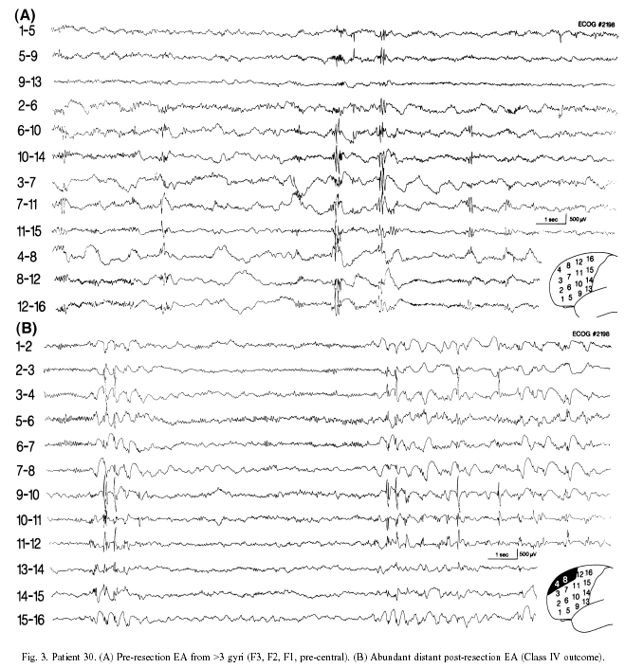

Slide 10
Can interictal activity be a sufficient marker of the epileptogenic zone?
By localization (brain region)
Temporolimbic | Never
Temporal neocortical | Maybe
Frontal | Often
Parieto-occipital | Rarely/Never
By etiology
Tumor, vascular lesion, cicatrix/encephalomalacia | Often
Cortical dysplasia | Maybe/Often
Unknown (MRI negative) | Maybe

Slide 11
From Intracerebral EEG… to Non-Invasive Methods

Slide 12
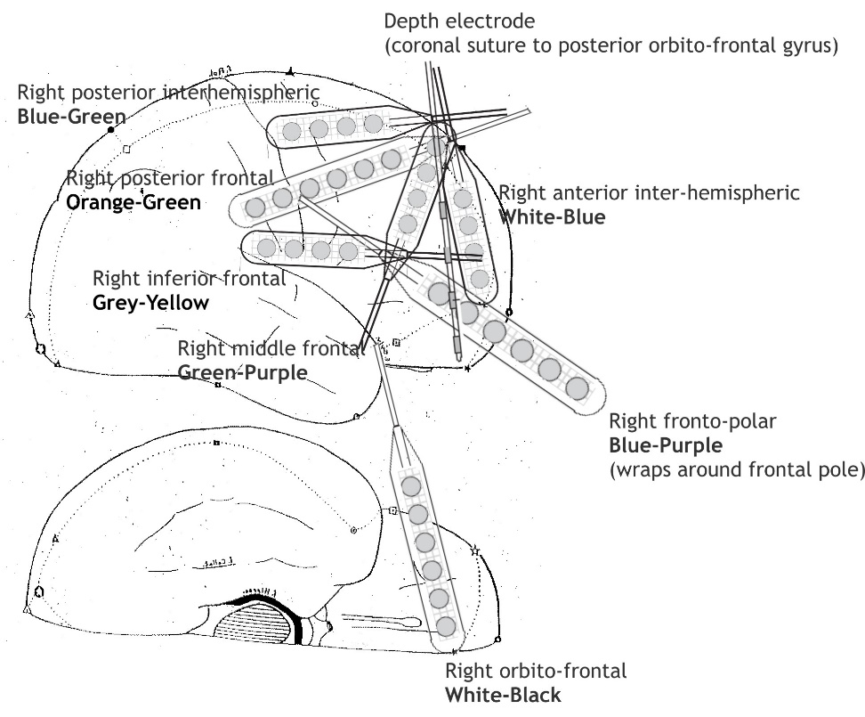
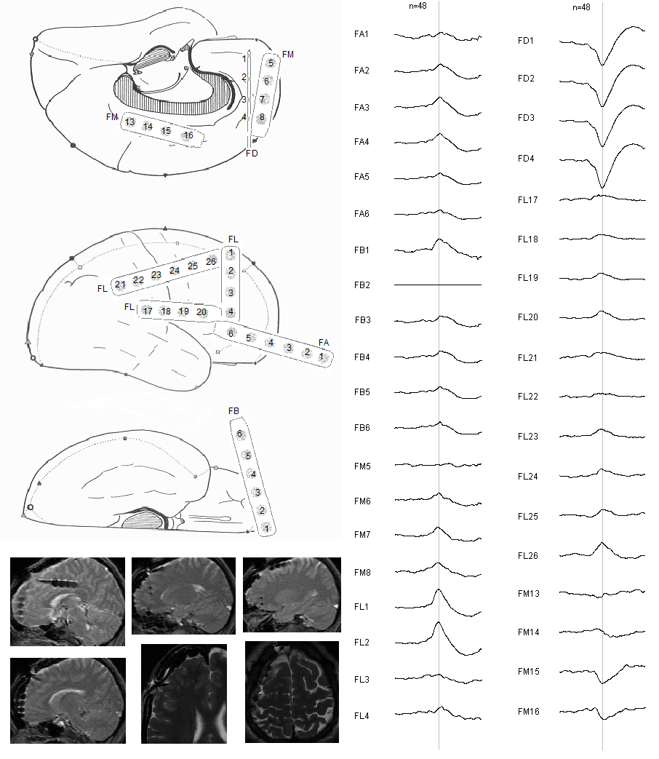
Right frontal lobe epilepsy, normal MRI

Slide 13
*
*

Slide 14
*
*

Slide 15
*
*

Slide 16
Subclinical frontal spike/wave seizure

Slide 17
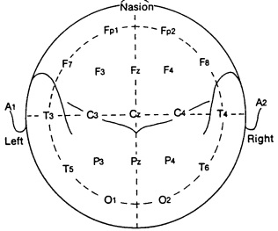
Subclinical frontal spike/wave seizure

Slide 18
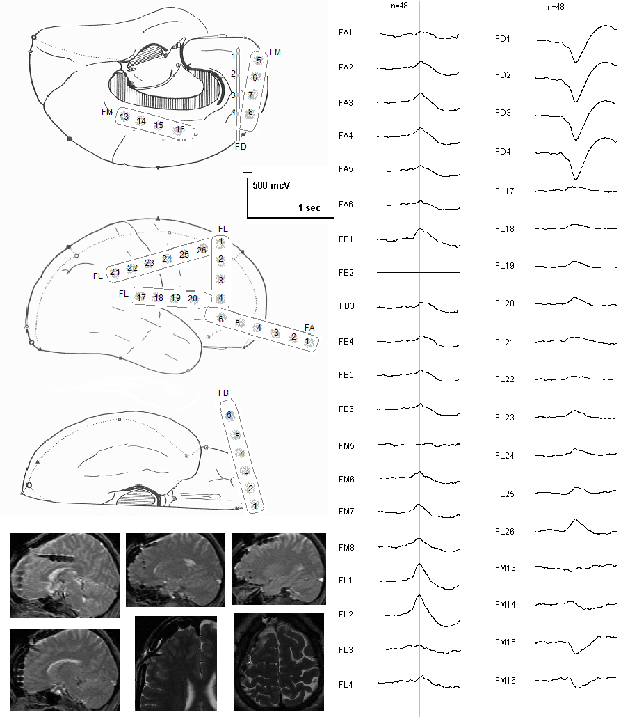
Generalized tonic-clonic seizure, right frontal lobe epilepsy

Slide 19
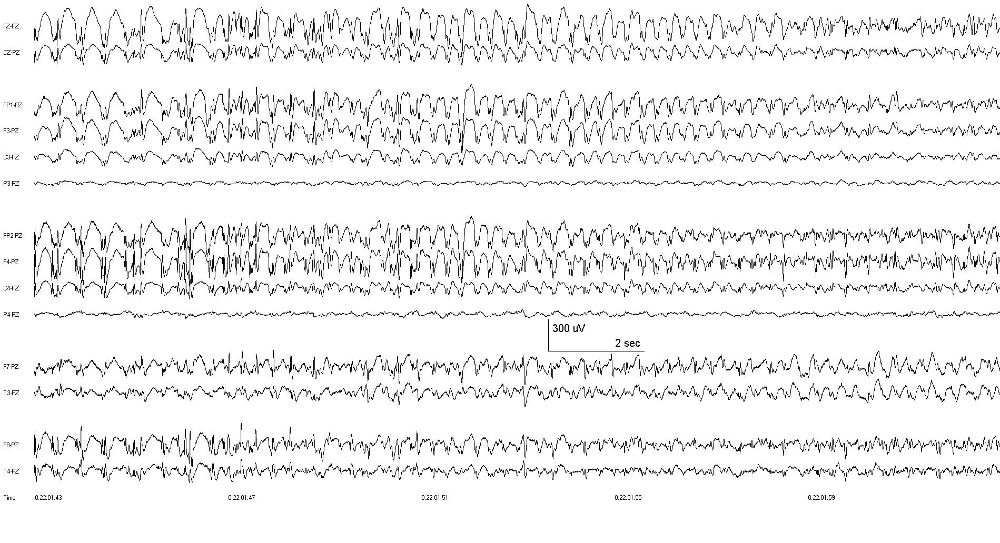

Slide 20
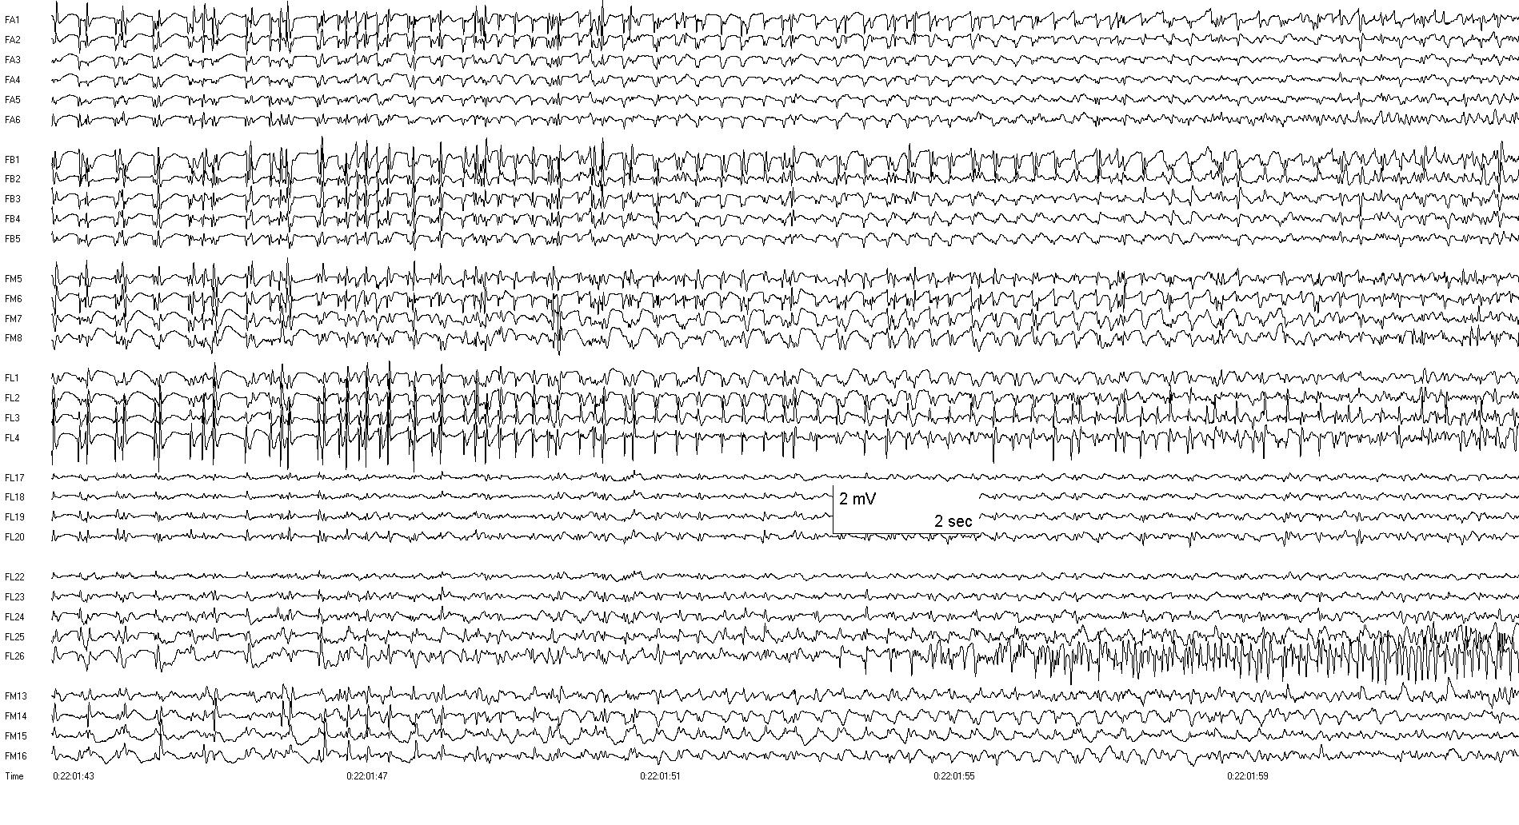

Slide 21
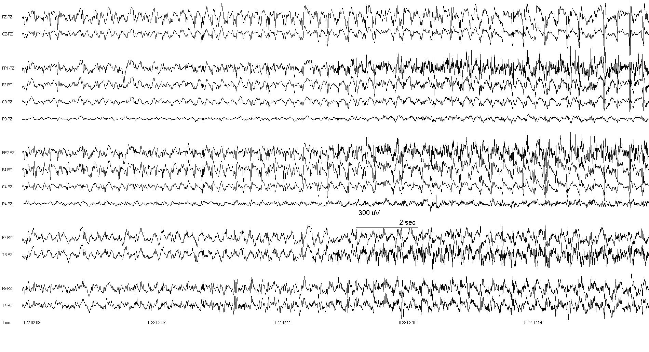

Slide 22
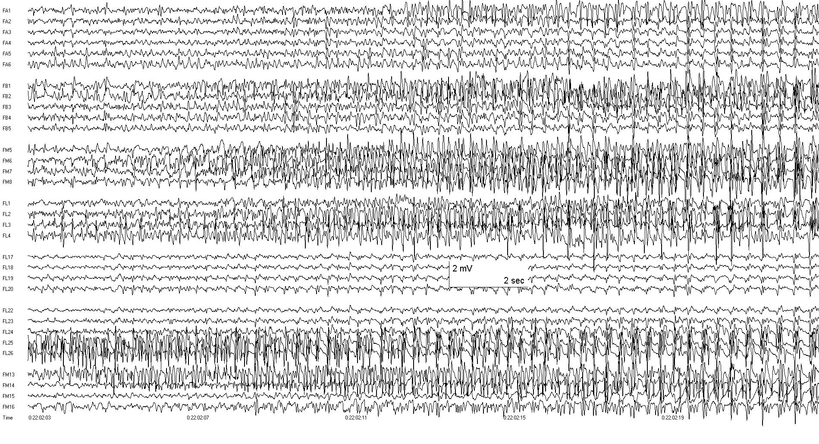

Slide 23
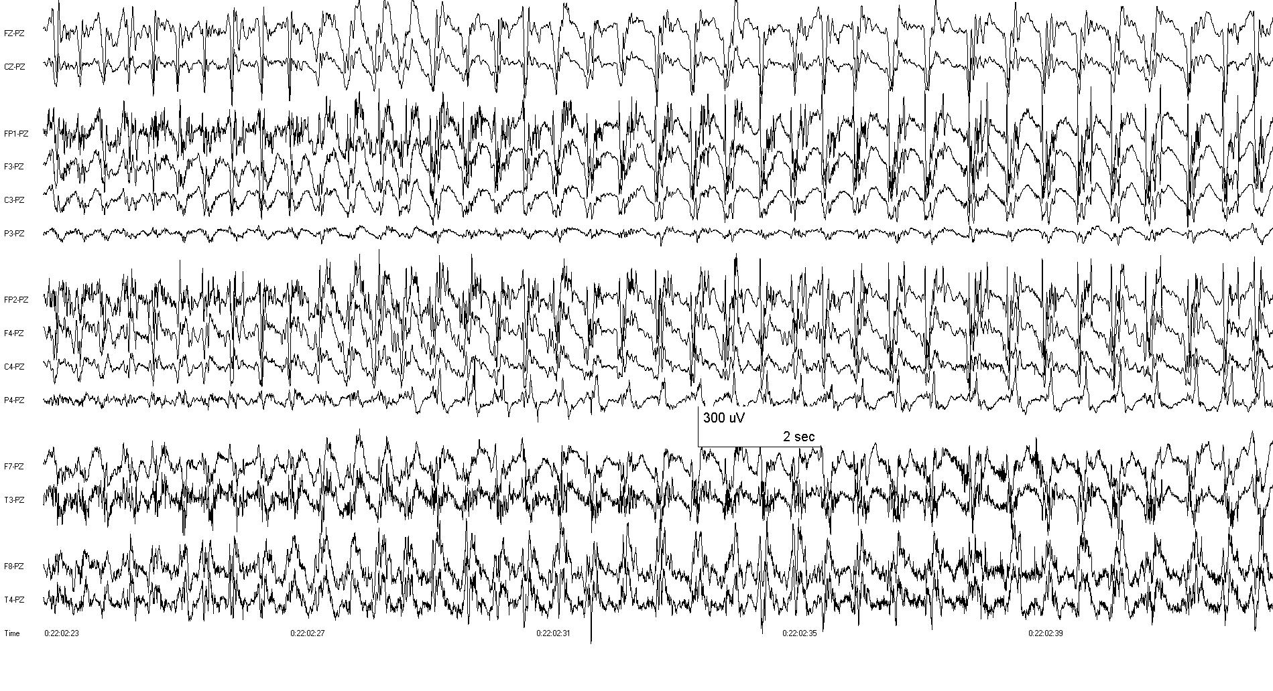

Slide 24
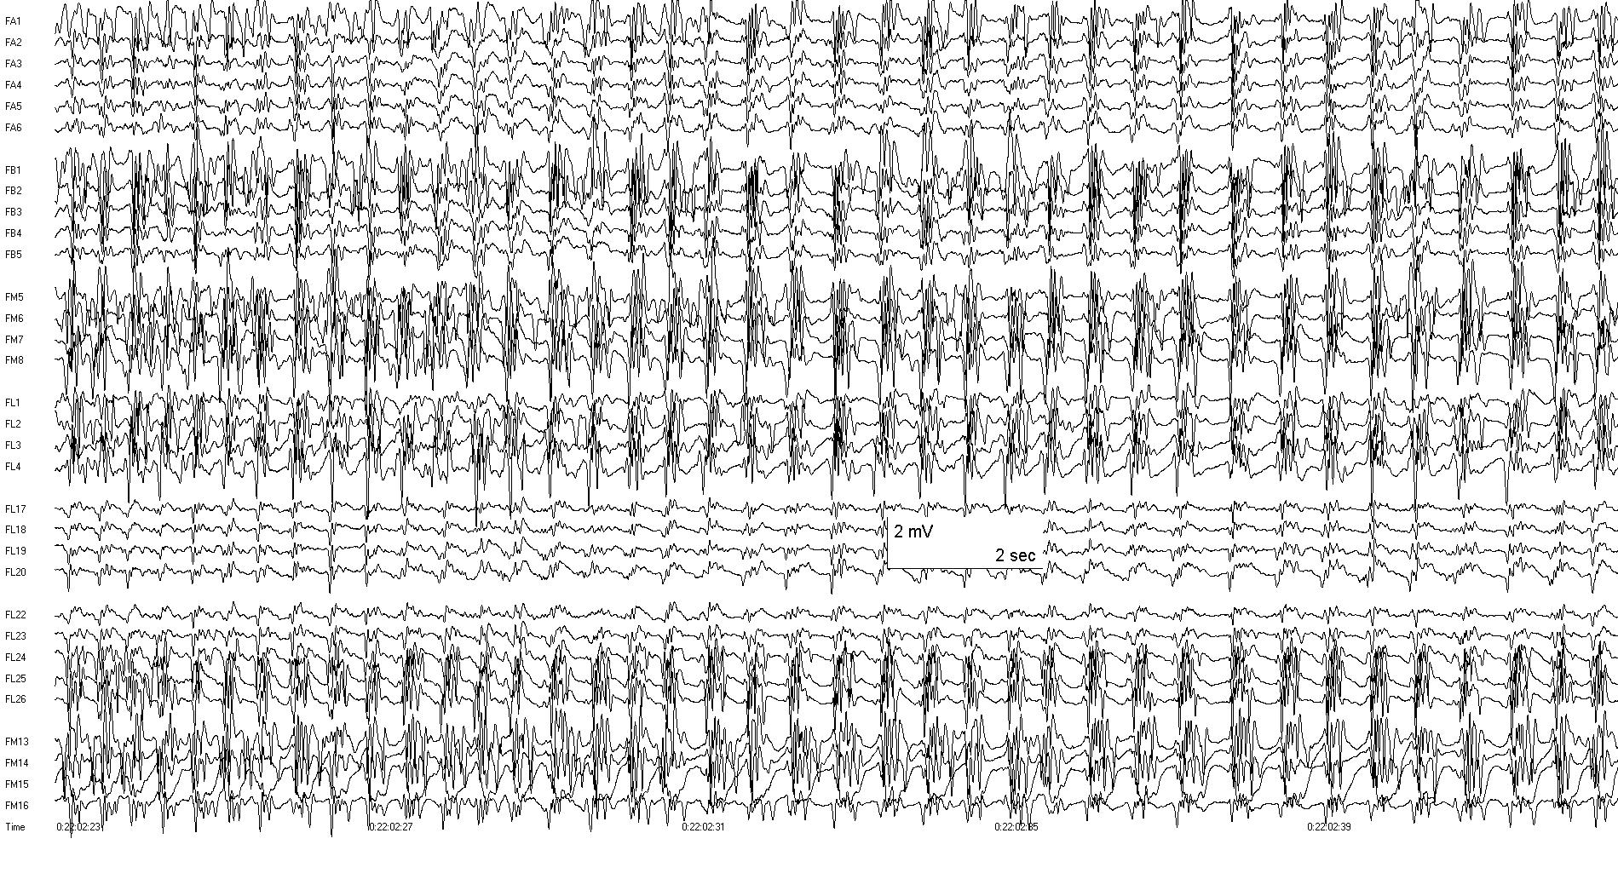

Slide 25
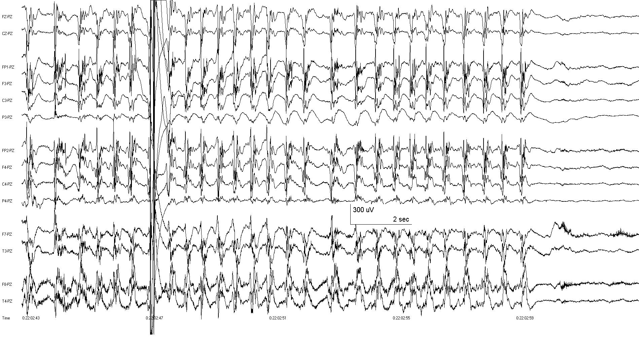

Slide 26
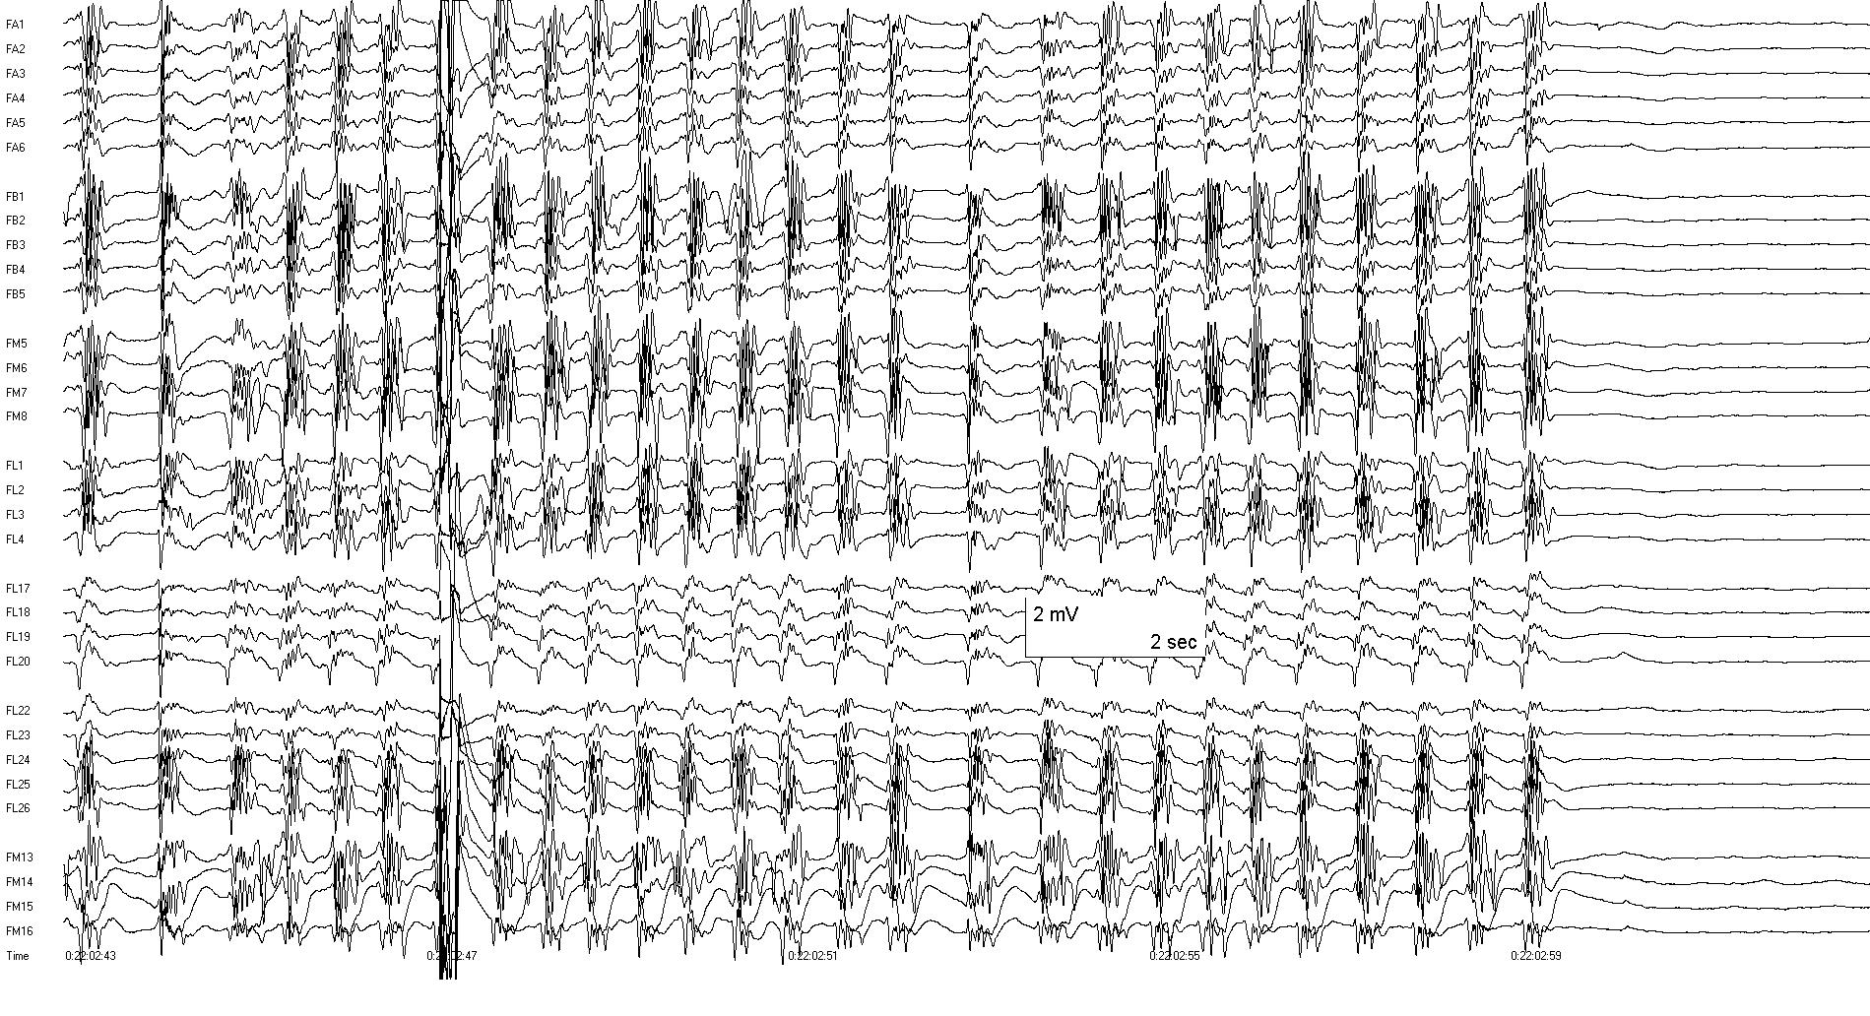

Slide 27
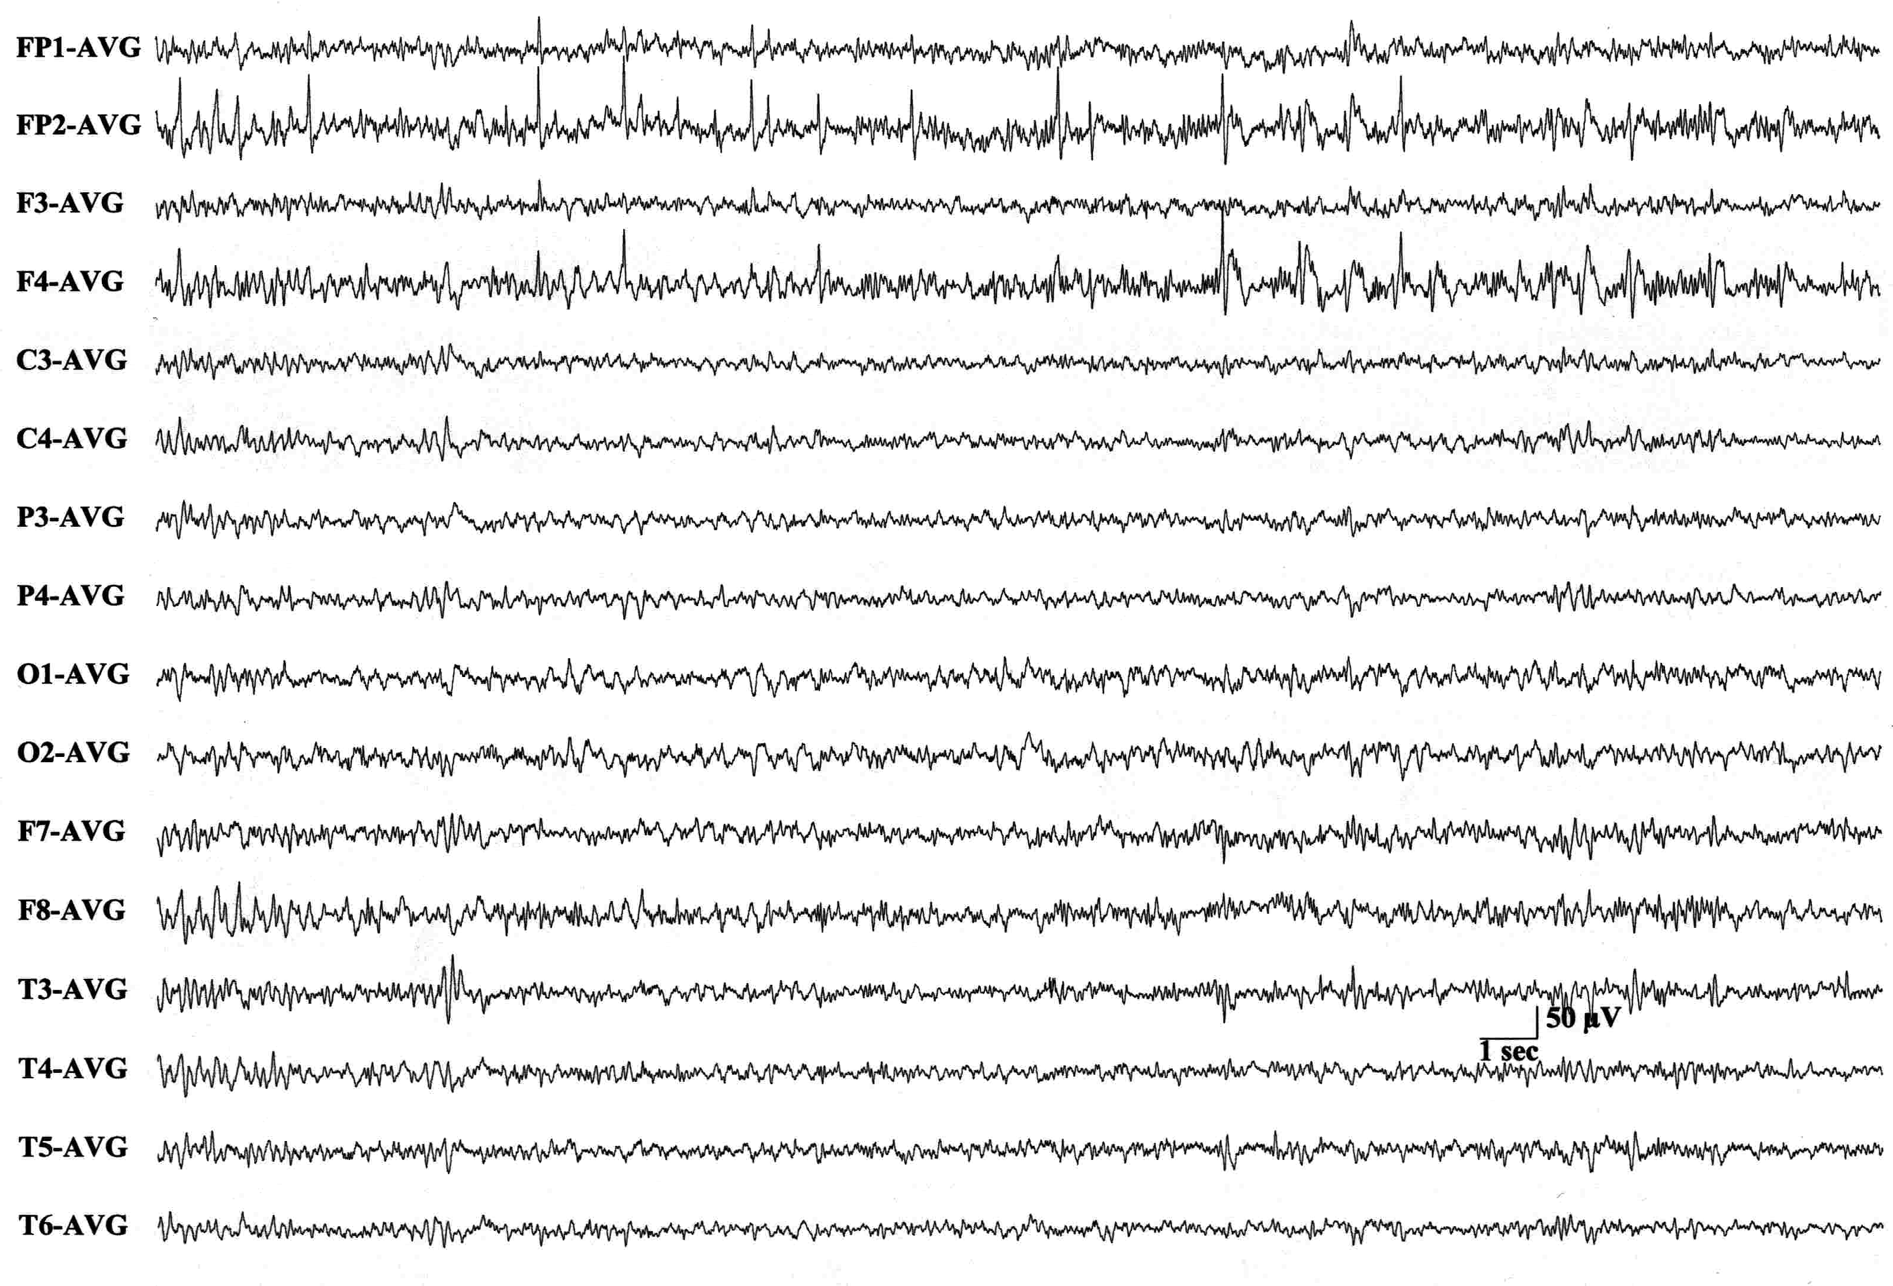
Different patient, right frontal lobe epilepsy
Interictal scalp EEG: Right frontopolar and midfrontal spikes

Slide 28
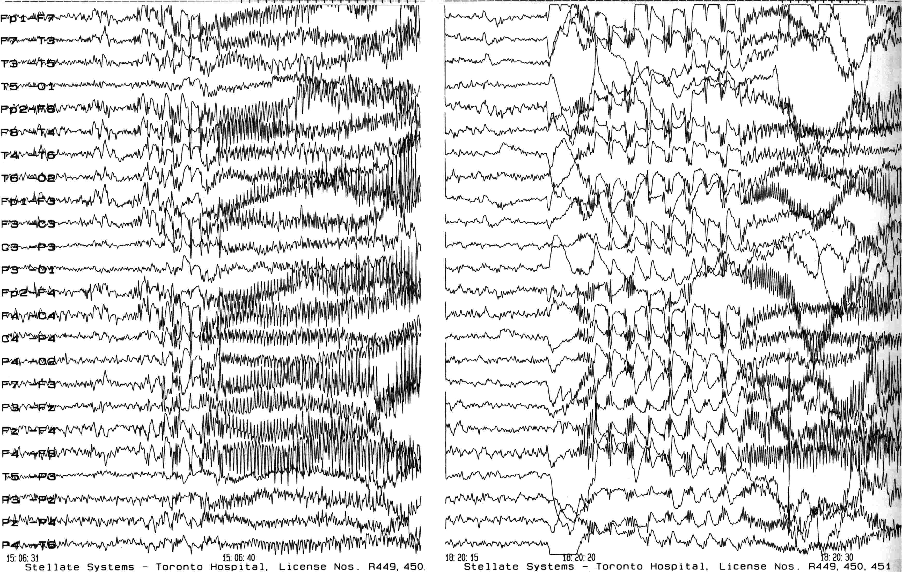
Ictal scalp EEG: Diffuse rhythmic seizure onsets, bilateral, anterior > posterior, right > left

Slide 29
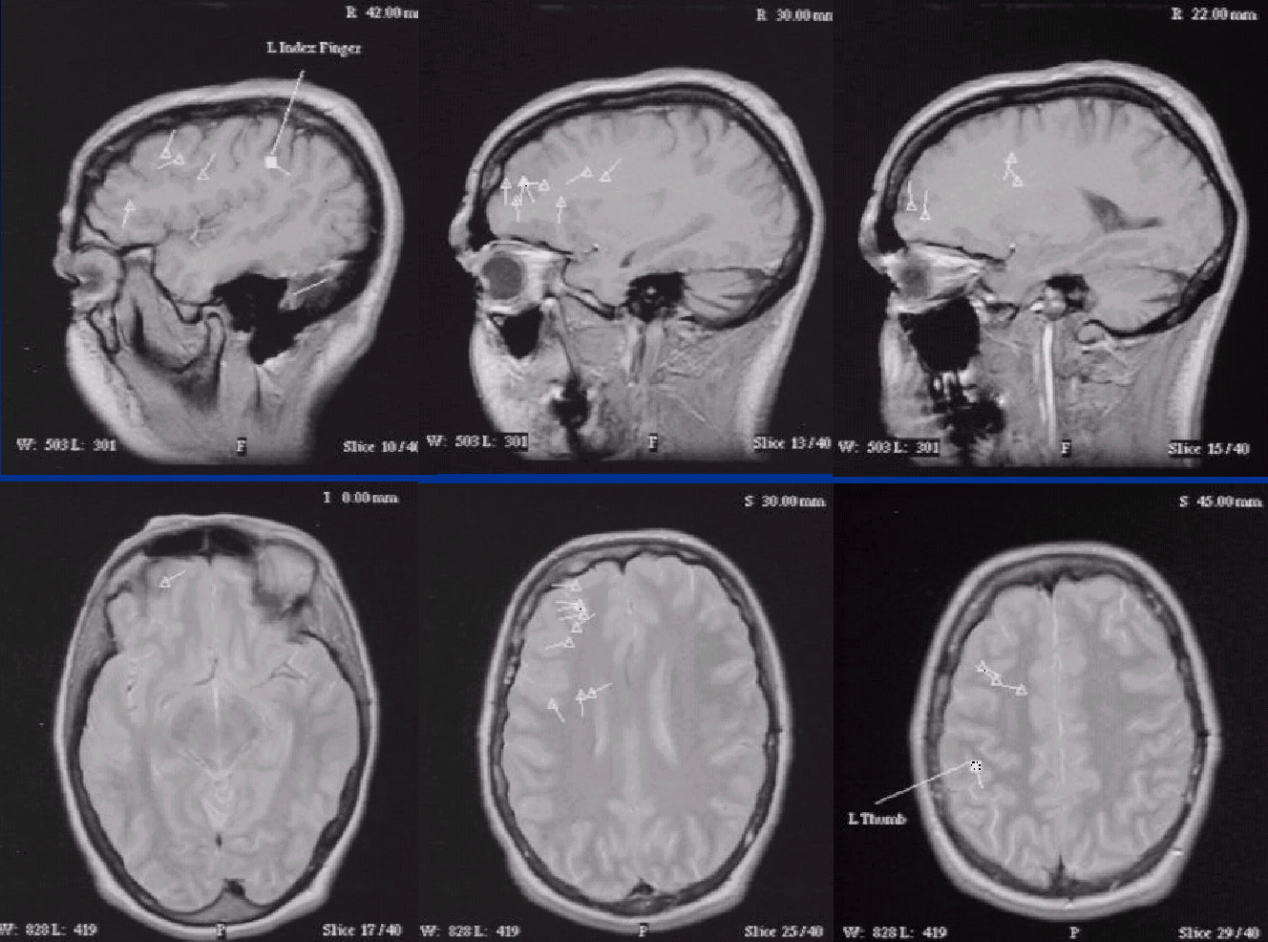
MEG/MSI: Right frontopolar and midfrontal spike dipole sources

Slide 30
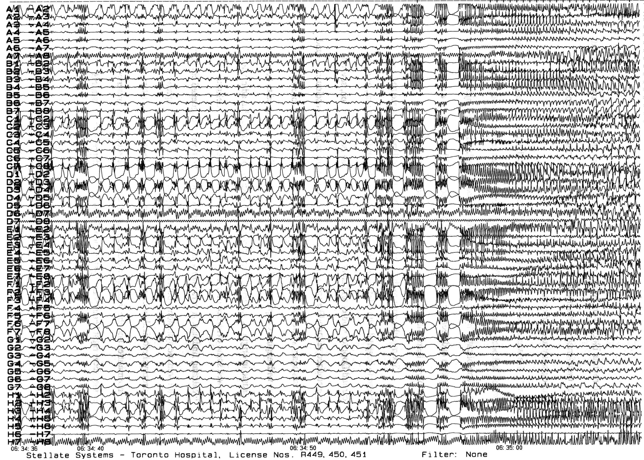
Ictal intracranial EEG (right frontal subdural grid and strips):
Clinical seizures all showed diffuse rhythmic seizure onsets involving all contacts with no localization

Slide 31
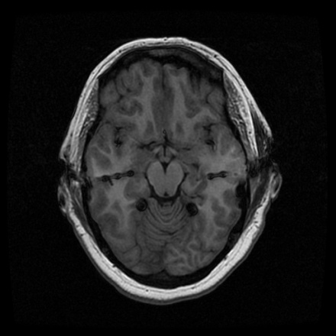
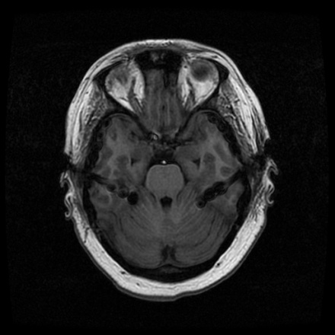
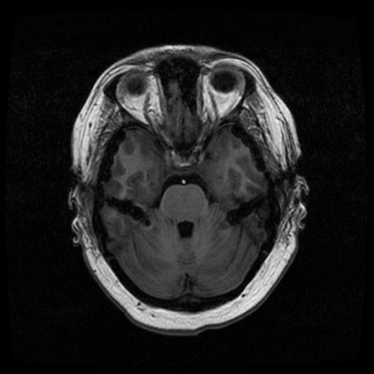
Temporolimbic seizures, temporal lobe epilepsy

Slide 32
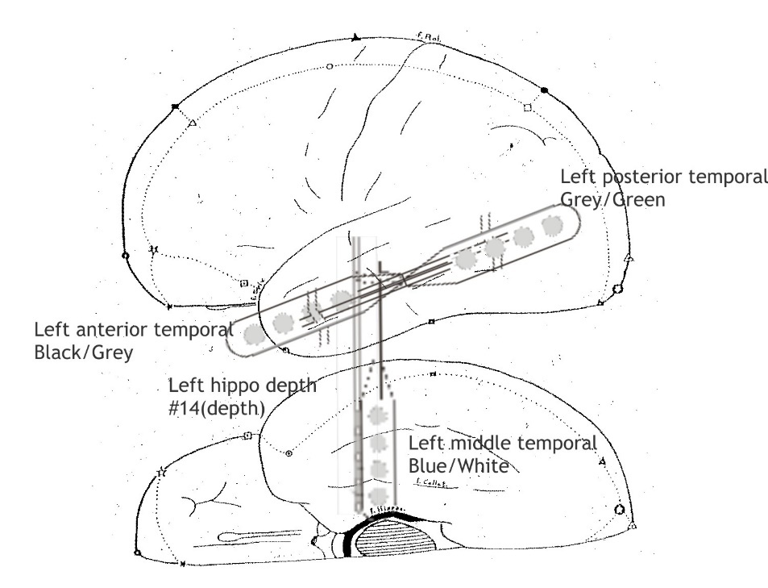
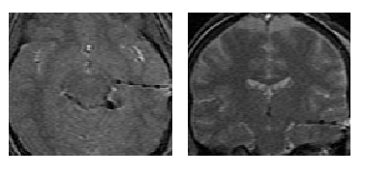
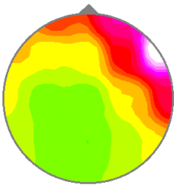
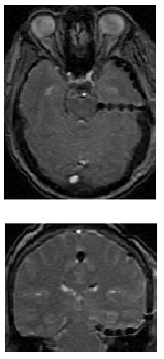
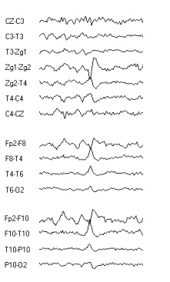

Slide 33
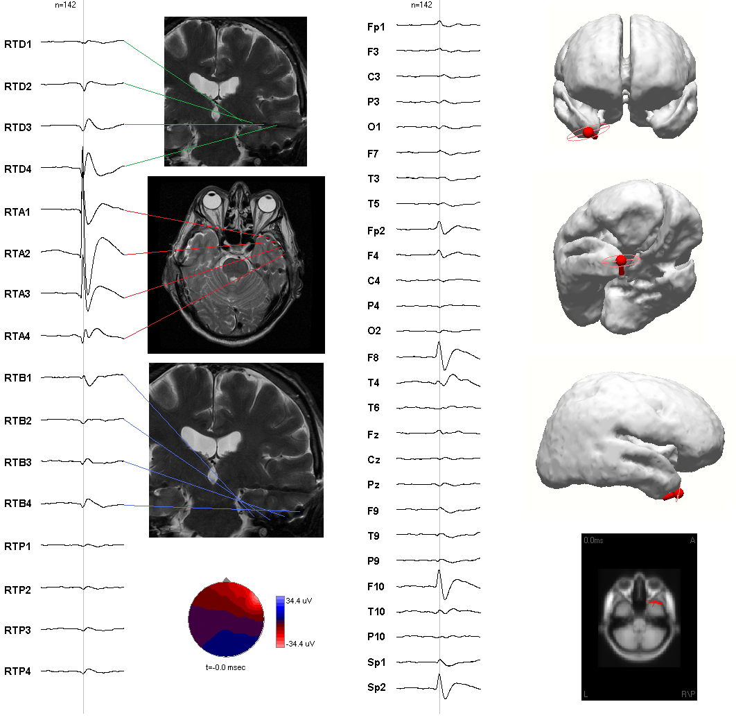
Wennberg et al.
2011;122:1295-1313
Right anterior temporal spikes

Slide 34
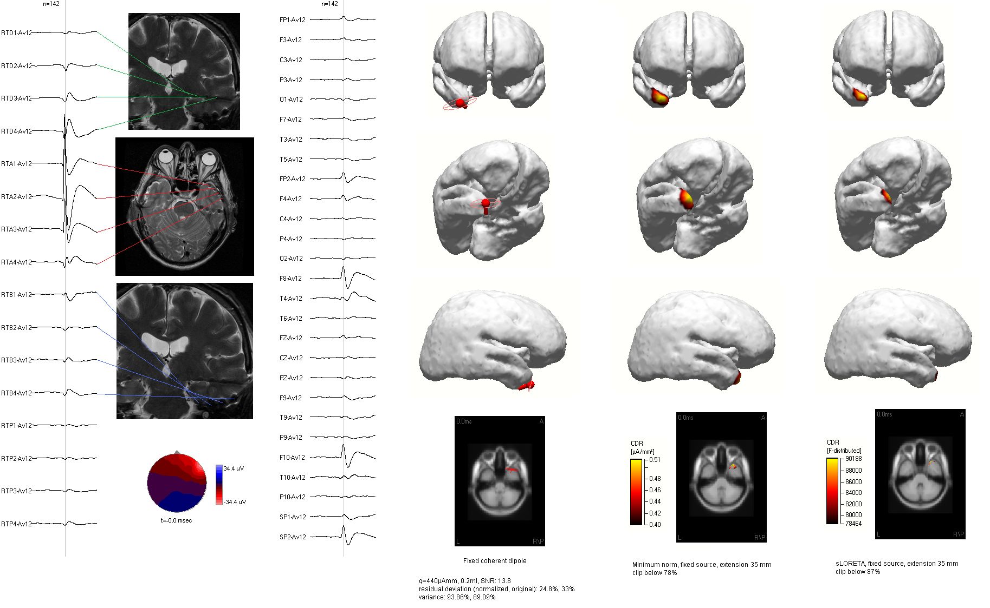

Slide 35
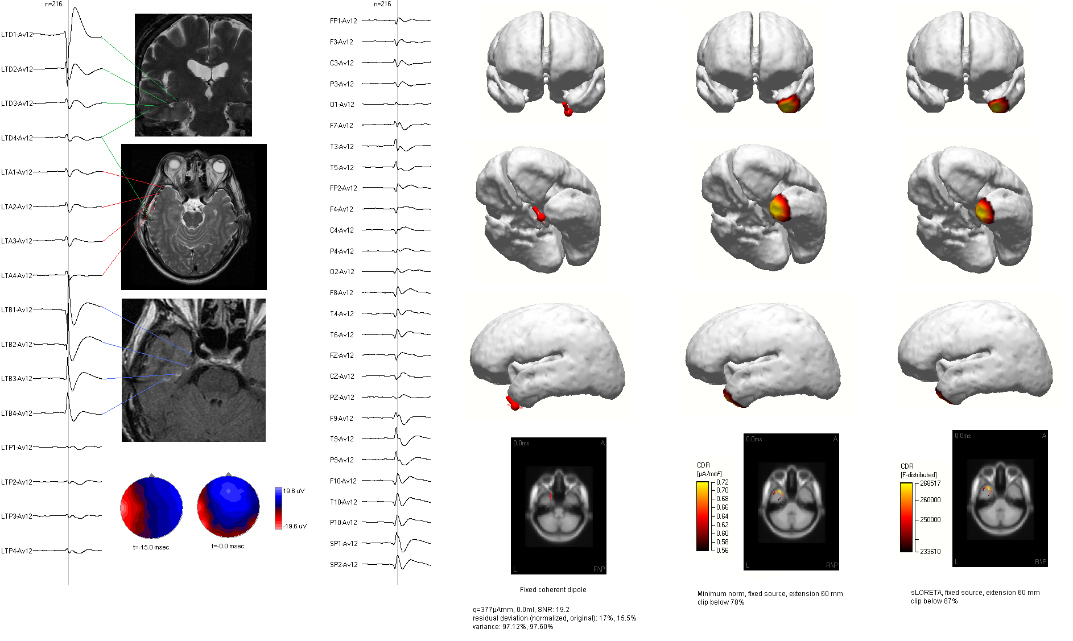

Slide 37
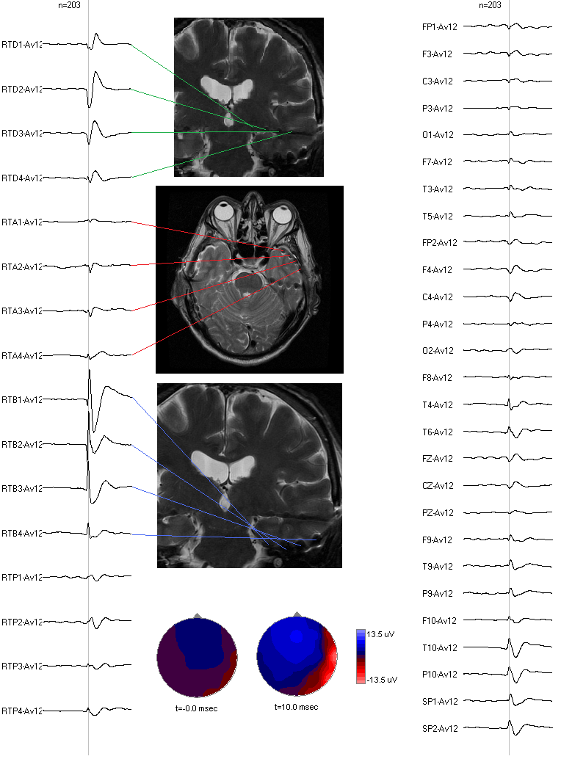
Right mediobasal temporal spikes
Left mediobasal temporal spikes

Slide 38
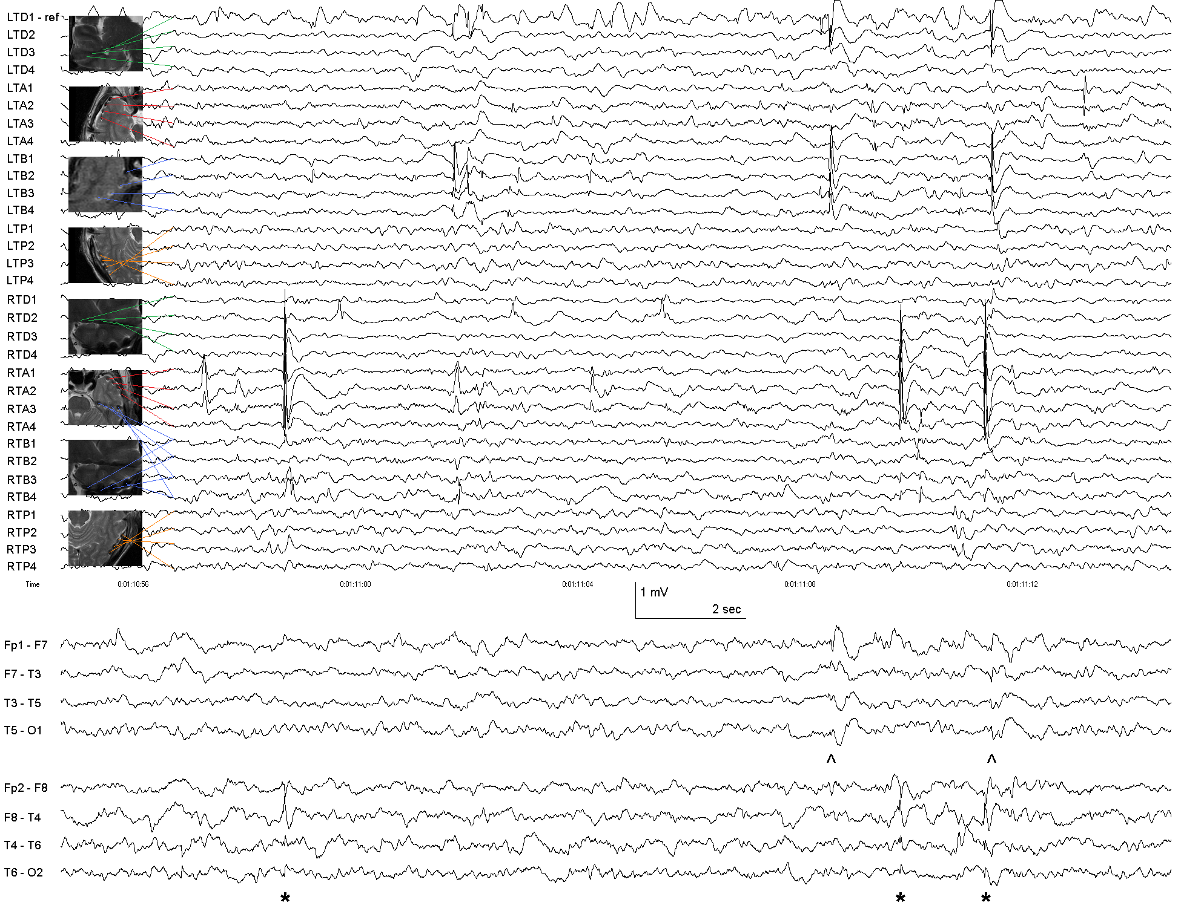
Wennberg and Cheyne. Clin Neurophysiol, 2015.

Slide 39



“Focal” onset
left hippocampus

Slide 40
Regional onset
right hippocampus and ?uncus/amygdala

Slide 41
Regional onset
right mesial temporal
“spread” to left

Slide 42
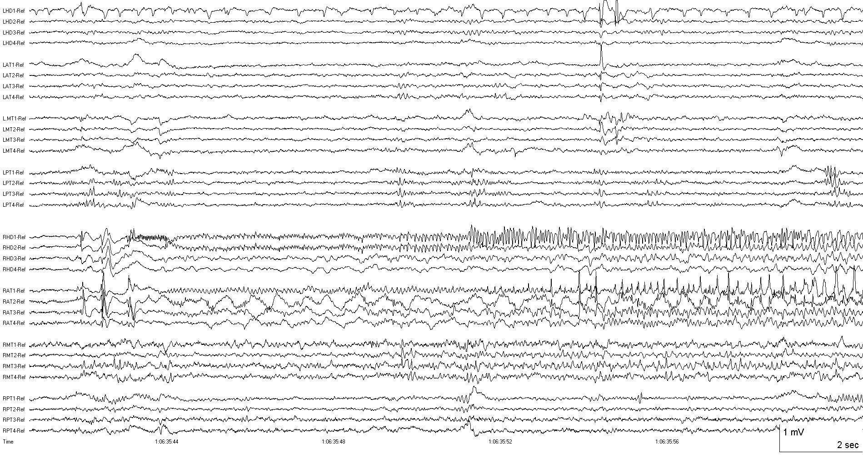
Right mesial temporal onset, different seizure, same patient

Slide 43
From Intracerebral EEG …to Non-Invasive Methods

Slide 44
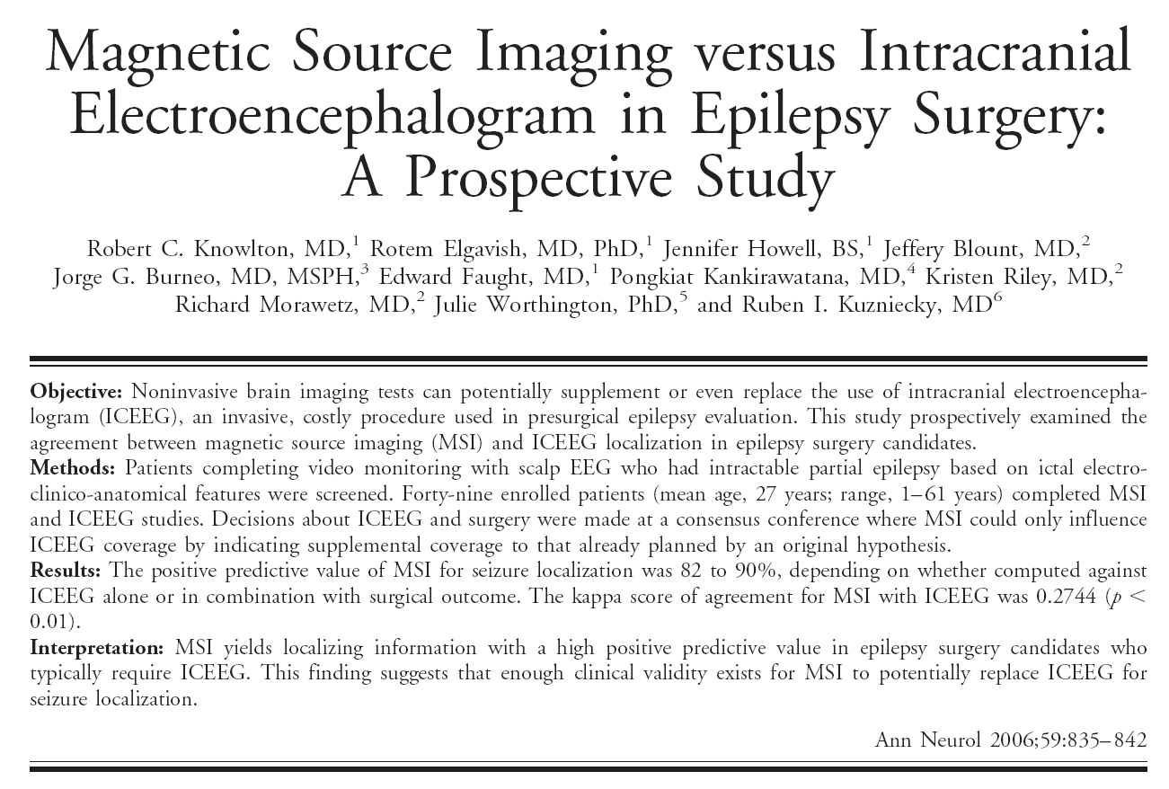
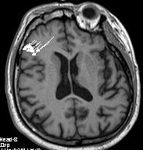
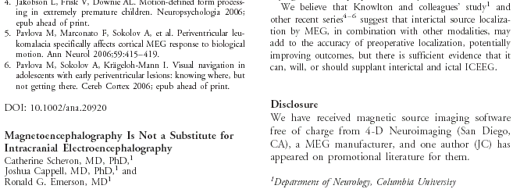
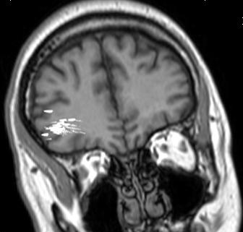

Slide 45
Effect of epilepsy magnetic source imaging on intracranial electrode placement
Robert C. Knowlton, MD, MSPH; Shantanu N. Razdan, MBBS, Nita Limdi, PhD, MSPH; Rotem A. Elgavish, MD, PhD; Jeff Killen, RT(MR); Jeffrey Blount, MD; Jorge G. Burneo, MD, MSPH; Lawrence Ver Hoef, MD; Lebron Paige, MD; Edward Faught, MD; Pongkiat Kankirawatana, MD; Al Bartolucci, PhD; Kristen Riley, MD; and Ruben Kuzniecky, MD
Annals of Neurology, 2009;65:716-723
Interpretation: MSI spike localization increases the chance that the seizure onset zone is sampled when patients undergo ICEEG for presurgical epilepsy evaluations. The clinical impact of this effect–improving diagnostic yield of ICEEG–should be considered in surgery candidates that do not have satisfactory indication of epilepsy localization from seizure semiology, EEG, and MRI.
…For patients with normal or non-localized anatomic imaging and limited or non-localized scalp EEG, potential for replacing ICEEG almost certainly exists in a subset of patients with very-well localized unifocal spike sources in a location that is strongly concordant with seizure history and semiology. Work is still needed to further define the diagnostic features that accurately identify these patients so that they may avoid the risks and expense of ICEEG…
…At the time of study design [2001-2006], knowledge of MSI interpretation–how to optimally weight different characteristics and patterns of dipole source estimates–was limited...
…Another issue is the problem of modeling extended sources with an equivalent current dipole model...

Slide 46
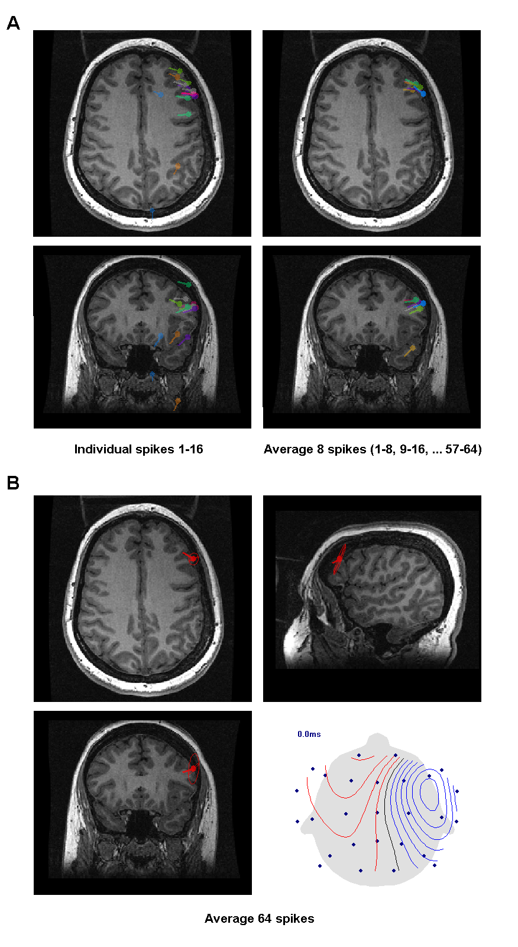
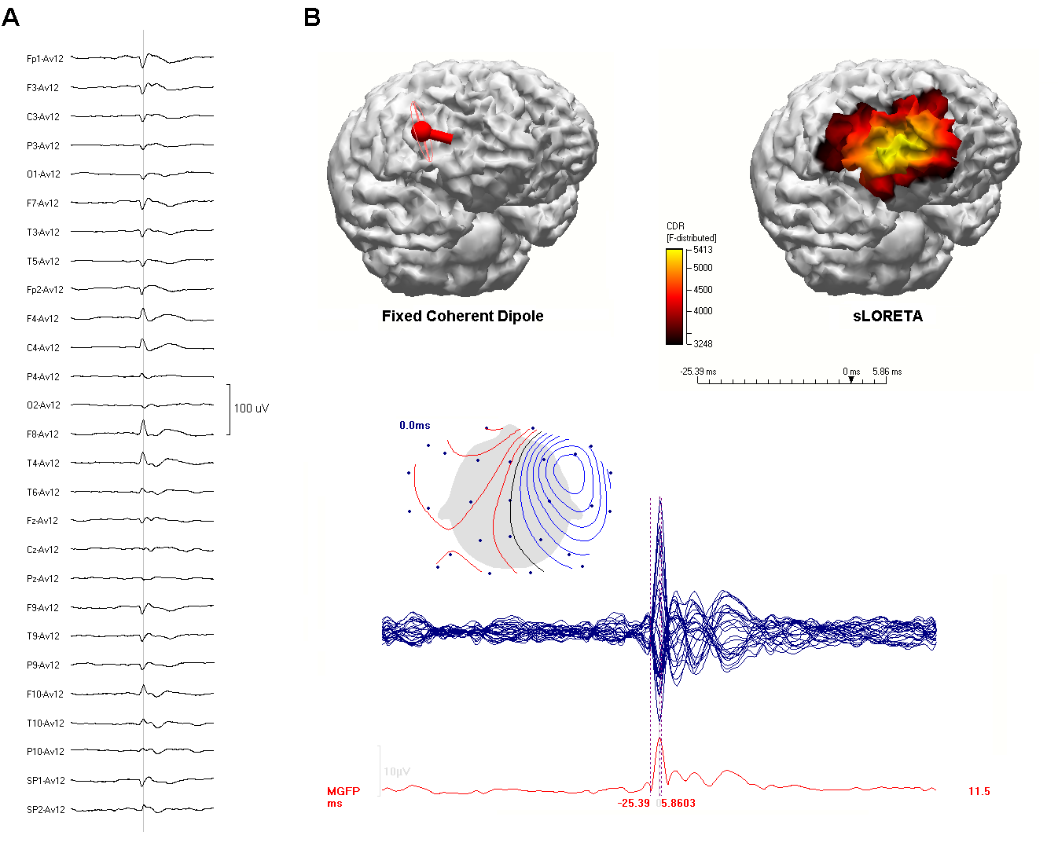
EEG/ESI of lateral frontal interictal spike focus (different patient, normal MRI)
Effects of spike averaging on dipole source reliability →

Slide 47
*
*
Back to first right frontal lobe patient
Would these spikes be identifiable using scalp EEG or MEG?

Slide 48
*
*

Slide 49
*
*

Slide 50
*
*

Slide 51
*
*

Slide 52
*
*

Slide 53
Video-EEG presentation – adult case
Partial seizure descriptions
  “increased left arm and face sensation”
  “hot flashes and burning pain”
  “left arm and eye burning pain”, few seconds to one minute, occasionally progressing to left arm contraction, LOC, rare falls
  “wave-like sensation left arm or forearm → pain in entire left arm”
  “spikes in the arm → all the way up the back and into left side of face”
  “arm feels as though it has been cut with a sword”

Slide 54


Slide 55


Slide 56


Slide 58





Slide 59







R L
R L
L R
R L
R L
L R

Slide 60


















R L
R L

Slide 61
R L
R L
L R
R L
R L
Straight to surgery with ECoG? Or intracranial EEG?
L R

Slide 62
From Intracerebral EEG … to Non-Invasive Methods

Slide 64


MEG for epilepsy surgery
Noninvasive localization of abnormal brain region responsible for seizures using magnetic source imaging (MSI)
Frontal Lobe Epilepsy
Temporal Lobe Epilepsy
MEG
EEG

Slide 65


Slide 66

L R
L R

Slide 67
*

Slide 68
*

