Slide 1
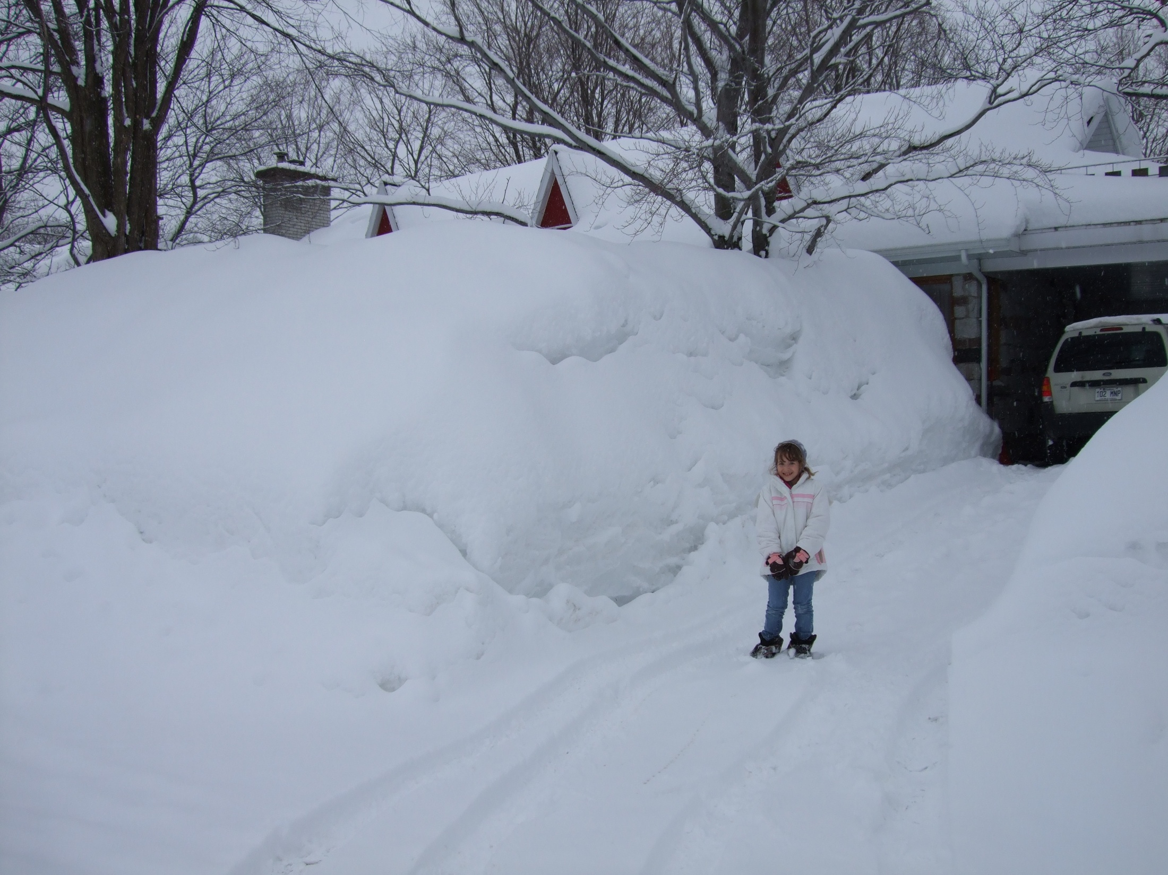
Neuronal and Ionic Dynamics in Relation to Seizure Onset and Termination
Timofeev Igor
Centre de recherche de l'Institut universitaire en santé mentale de Québec (CRIUSMQ)
Québec, Canada G1J 2G3
Canadian League Against Epilepsy
Scientific Meeting
October 14 – 16, 2016
Hotel PUR Quebec, Quebec City

Slide 2
Faculty/Presenter Disclosure
Relationships with commercial interests:
Grants/Research Support:
Speakers Bureau/Honoraria: Unfortunately none
Consulting Fees: Unfortunately none
Other: Salary paid by
Faculty: Igor Timofeev

Slide 3
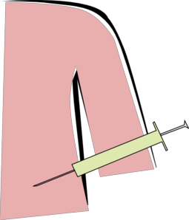
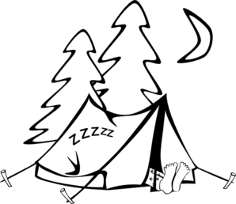
Transition from sleep oscillations to a seizure Most of neorcortical seizures are nocturnal
Natural States
Anesthesia
Slice
(Timofeev and Steriade, 2003)

Slide 4
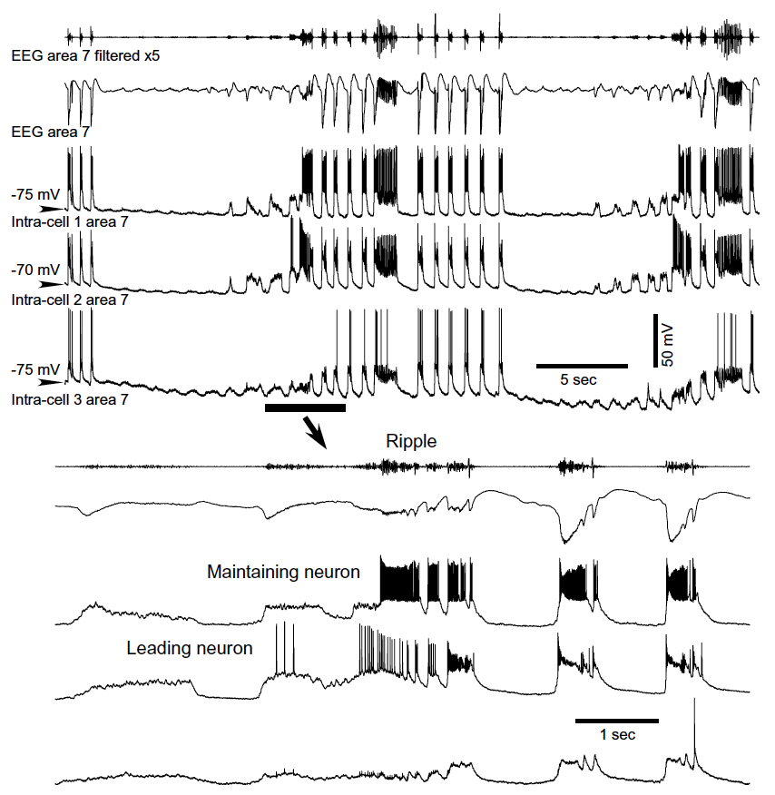
Progressive development of paroxysmal activity during spontaneously occurring electrical seizure.
Timofeev, Steriade, 2004

Slide 5
Progressively increased neuronal firing at the onset of seizures and decreased firing toward the end of seizures.
Some consequences of intense neuronal firing:
Increased K+, Decreased Ca2+, Synaptic depression
(Bazhenov et al., 2004)

Slide 6
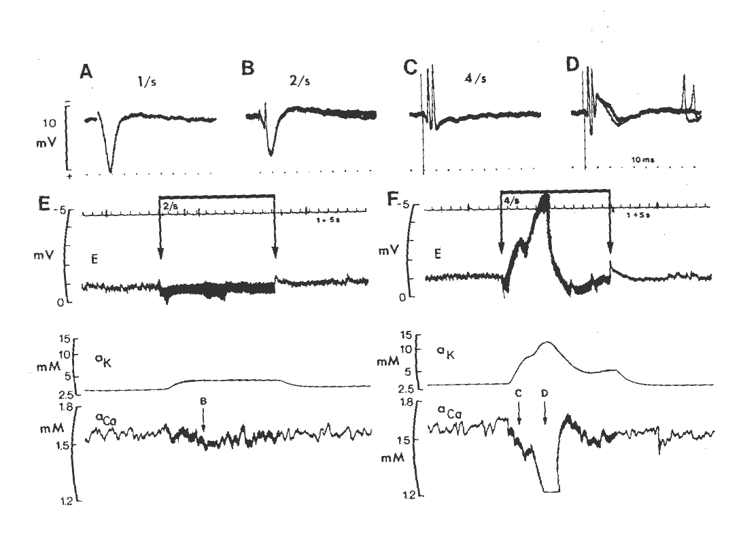
Frequency-dependent increase in [K]_{o} and drop in [Ca]_{o} in CA3, in hippocampus in situ (Krnjević & Morris, 1980)
Notes:
Fig 2 in K & M 1980 (CJPP): all data from same run – time of responses (evoked by fimbrial stim) is indicated in E and F: big drop in [Ca] corresponds to time when slow negative wave appears in D!

Slide 7
Synaptic responsiveness during seizure
Seigneur J, Timofeev I, 2011

Slide 8
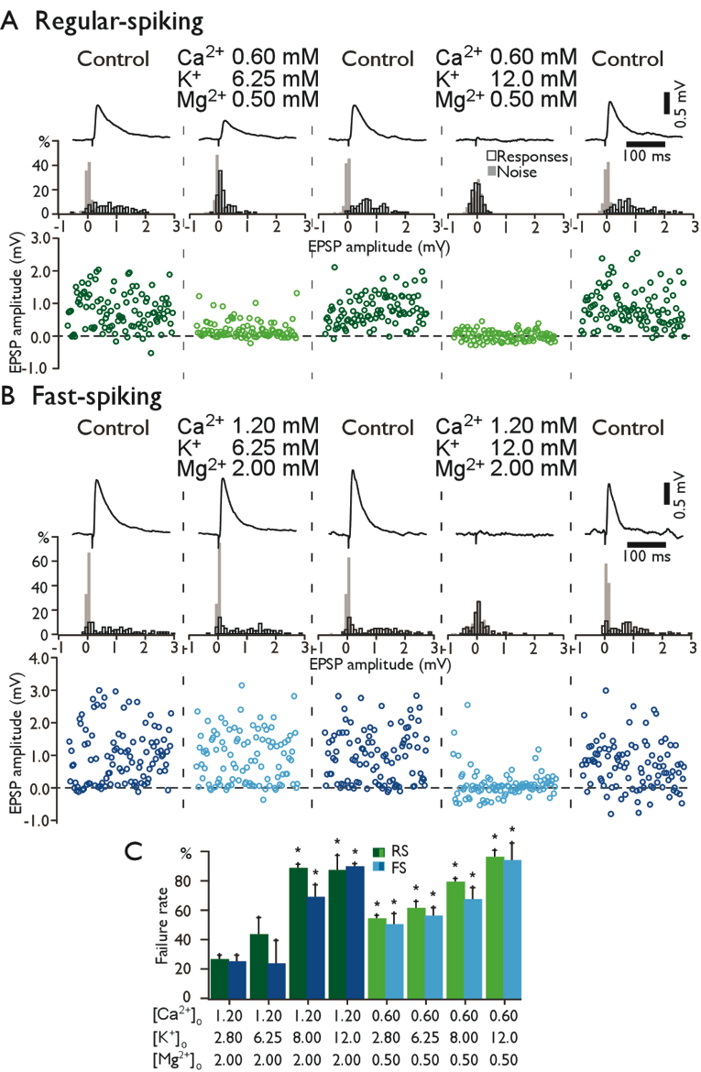
Different ionic conditions modulate efficiency of synaptic responses.
Seigneur J, Timofeev I, 2011

Slide 9
Action potential propagation into proximal axon in 12 mM K⁺ conditions
Seigneur J, Timofeev I, 2011

Slide 10
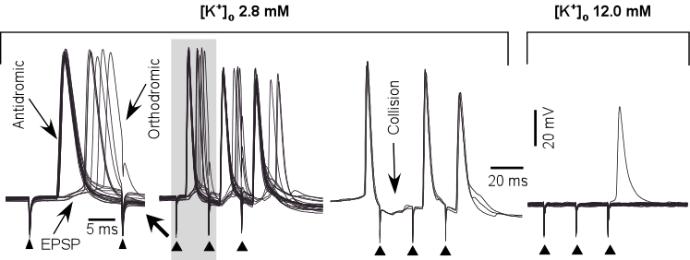
Seigneur J, Timofeev I, 2011

Slide 11
Depression of cortically evoked EPSPs after seizures
Nita D et el., 2007.

Slide 12
Selective enhancement of neocortical ripples during seizures.
(Grenier et al., 2003)

Slide 13
The ultrastructure and size distribution of connexon pores in buffers containing different divalent cations. Thimm, J. et al., J Biol Chem 280, 10646-10654 (2005).

Slide 14
Halothane diminishes ripples and stops seizures.
(Grenier et al., 2003)

Slide 15
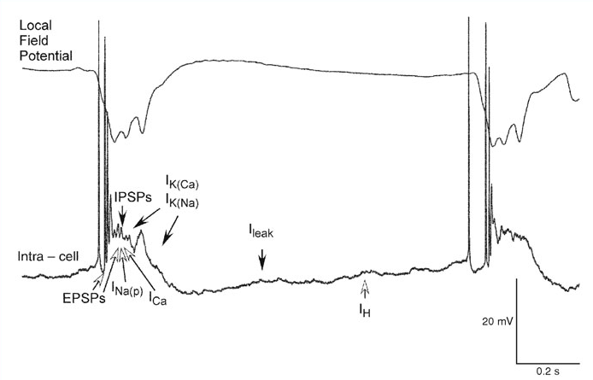
What stops seizures?
Timofeev, 2010

Slide 16
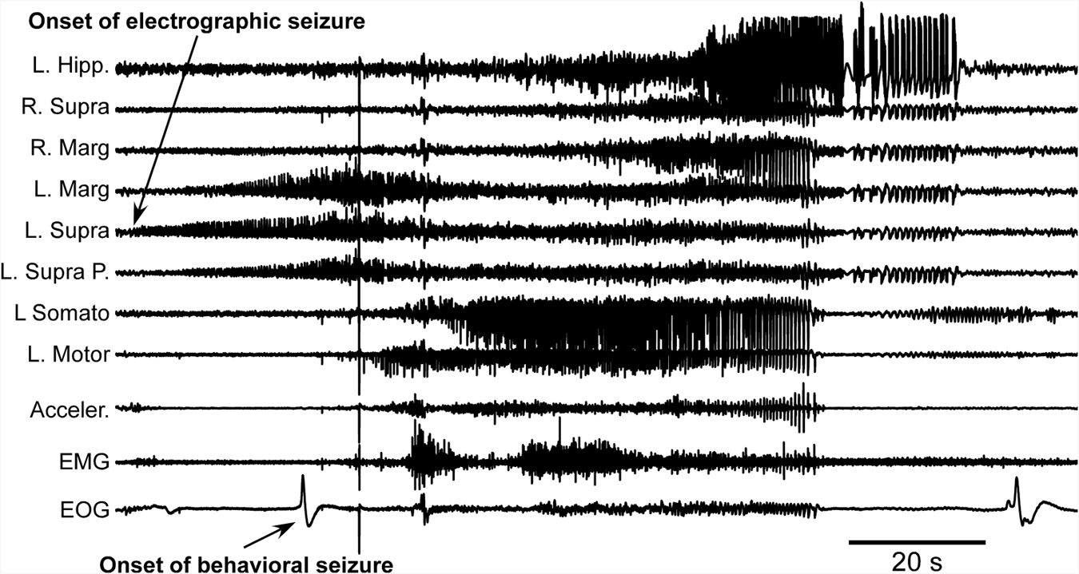
A seizure induced by partial deafferentation of left suprasylvian gyrus of cat
Timofeev et al., 2013

Slide 17
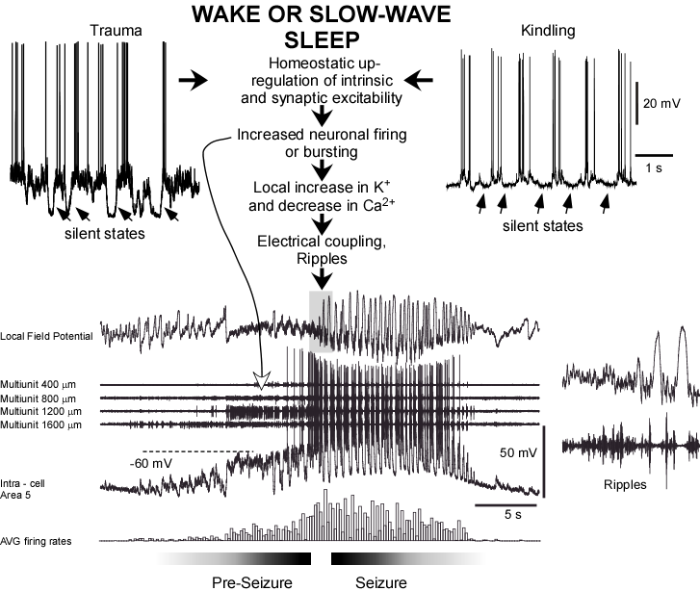
General conclusion
(Timofeev, 2010)

Slide 18
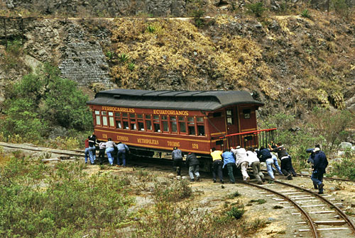
Acknowledgements
Bosses:
V. Taranenko
M.Steriade
Collaborators:
M. Bazhenov
T. Sejnowski
A. Destexhe
M. Volgushev
M. Beaulieu
Post-Docs:
Cissé Y.
Toplonik L.
Crochet S.
Akhmetova E.
Feresko A.
Kovacs K.
Pinard C. Grand L.
Sherozia M.
Kusmierczak M.
Bukhtiyarova O.
PhDs:
Grenier F.
Fuenteallba P.
Rosanova M.
Chauvette S.
Nita D.
Seigneur J.
Avramescu S.
Zomorrodi R.
Lemieux M.
Lobo de França B.
Soltani S.
Master’s:.
Boucetta S.
Pokidchenko T.
Boucher J.-F.
Lajeunesse F.
Ozur A.
Supported by:
Canadian Institutes of Health Research,
Canada Foundation for Innovation,
Natural sciences and engineering Research Council
National Institute of Health,
Fonds de la Recherche en Santé du Québec
My family.
Technicians:
P. Giguere
S. Ftomov
Multiple summer students and trainees of collaborators

